Slide 1


Slide 2

Introduction to
Acuity STAR
Author: Derrick Gould
Last Update: March 2025
Target Audience: Member Secretaries

Slide 3

Intro Training Goals
In today’s class, we will learn:
Know how to access STAR from anywhere
Gain knowledge of the features of the STAR Portal
How to determine where academic activities go in STAR
All of the features of the STAR Data Grid
Some helpful tips and tricks for using STAR
How to generate STAR Reports
How to get online help within STAR
A little about the other CV views
Know who to contact for help with STAR

Slide 4
About STAR
STAR is an acronym for ‘Staff Tracking & Activity Reporting’ and used to capture and report on Clinical Faculty academic career activities (Not Clinical)
STAR is a custom developed, secure web application
Main Idea: Record information once and report on it infinitely
The Schulich School of Medicine and Dentistry guideline is to update each member’s STAR database at least once per month

Slide 5
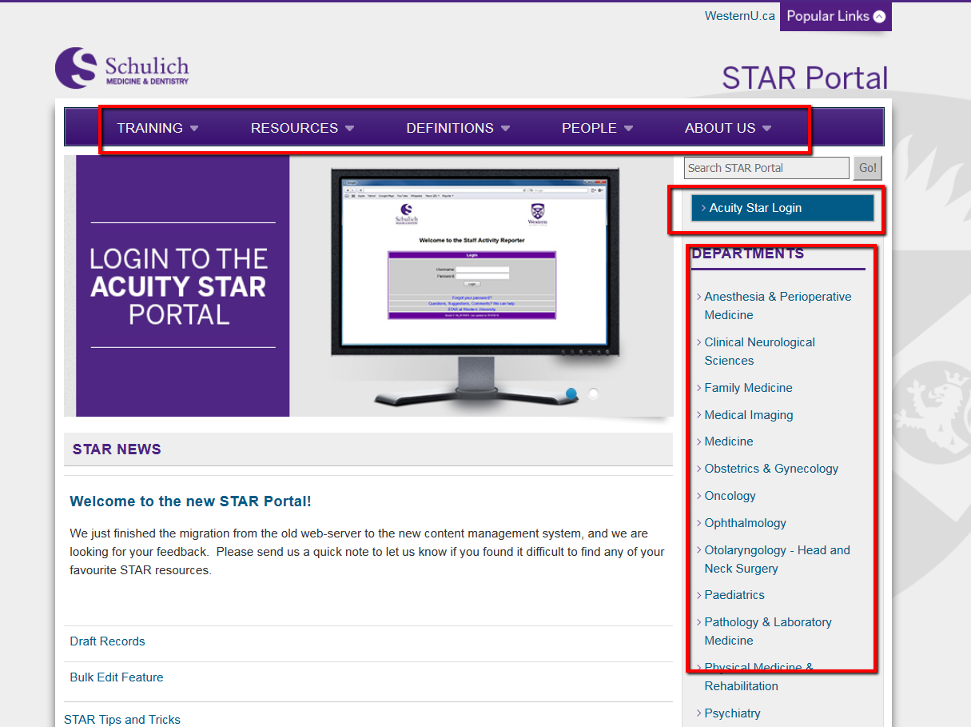
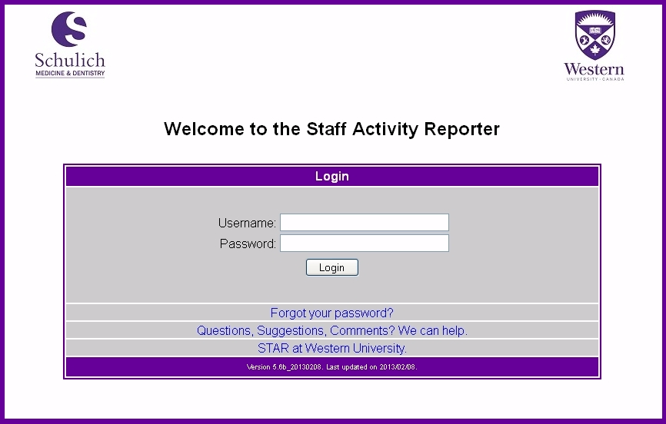
Logging Into STAR
Firefox, Chrome or Internet Explorer can be used.
Google UWO STAR
Add these two sites to your bookmark toolbar
Disable Pop-Up Blocker for the STAR application
Check with your STAR Coordinator if you need a password reset
  http://www.schulich.uwo.ca/star/
https://star.schulich.uwo.ca
Notes:
You can use other browsers like Internet Explorer, however there are known issues with certain versions.
Regardless of which browser you choose, it is critical to disable popup blockers for Acuity STAR. This needs to be done only once and the browser will remember your setting.

Slide 6
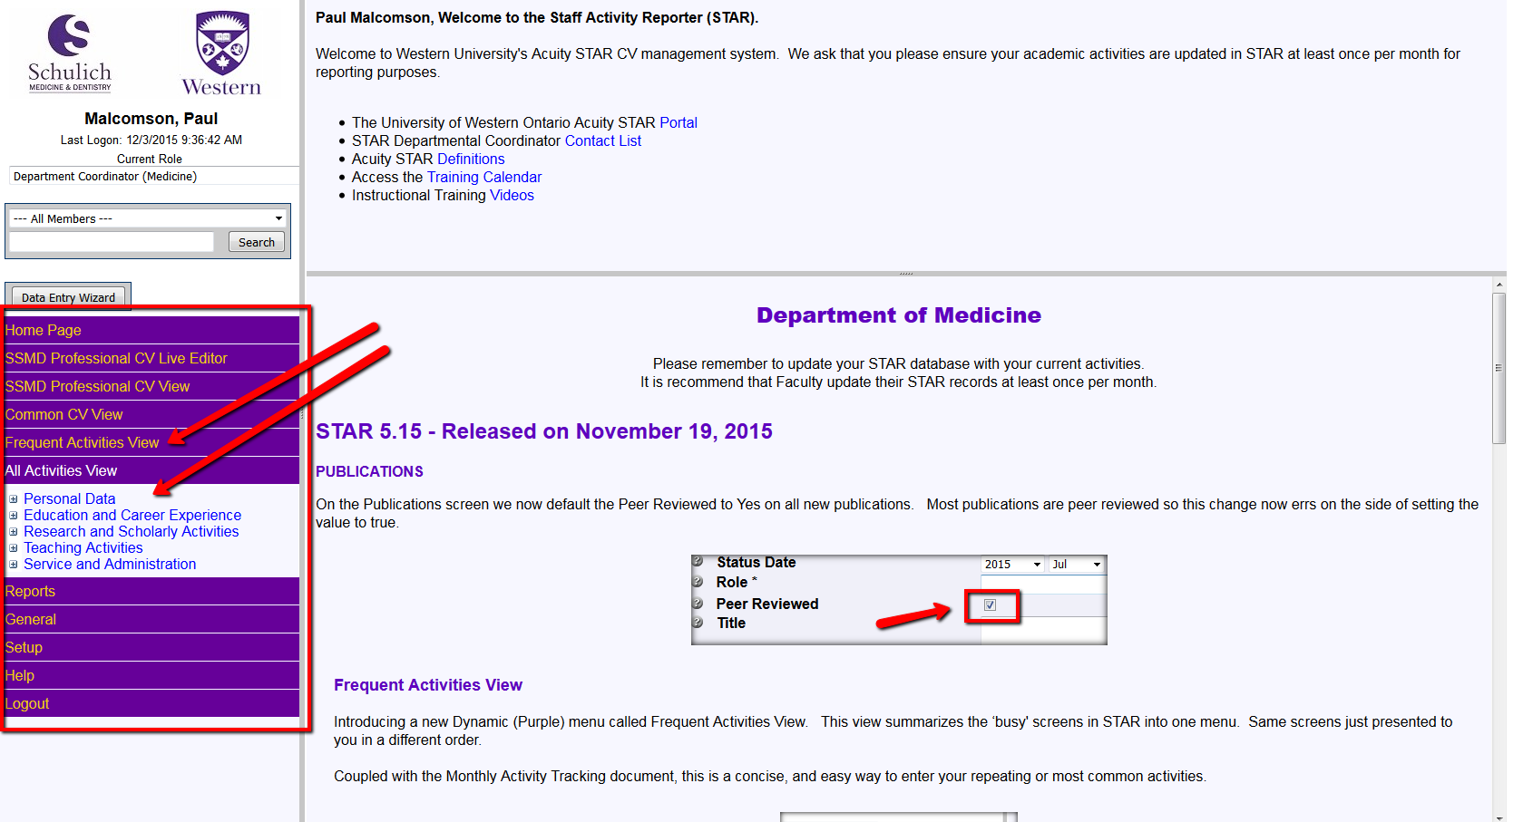
The STAR Landing Page
Notes:
Initially after logging on you should land on the Home Page. This has been set specifically for your department and contains important information from your STAR Coordinator.
Clicking on a purple menu choice will expand that menu item. The sub-menu items can be expanded or collapsed using the Plus or Minus (+/-) beside each menu item.

Slide 7

STAR Portal
Demo: STAR Portal

Slide 8
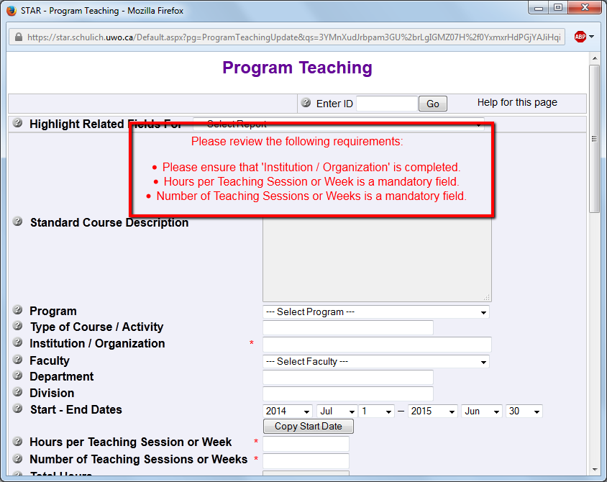
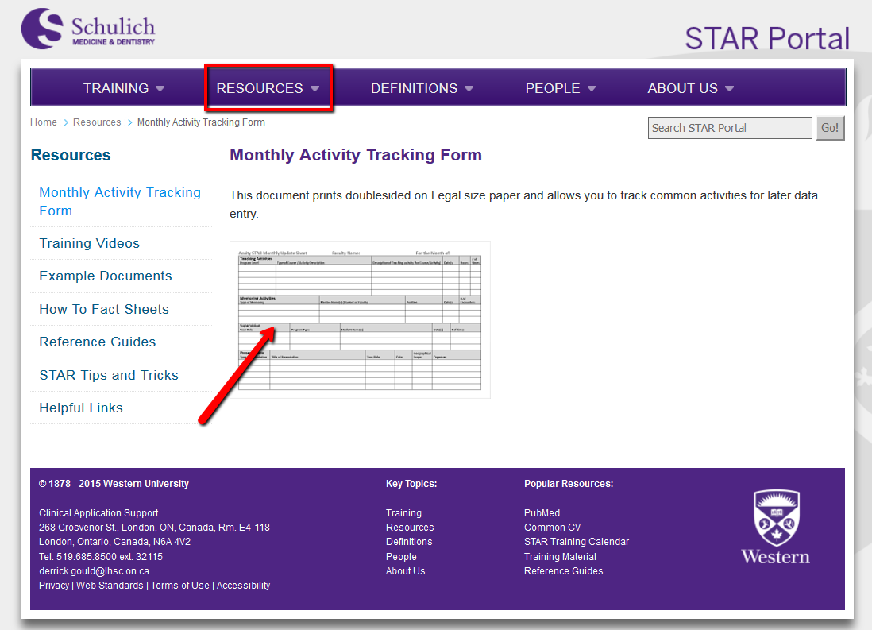
Mandatory Fields

Slide 9
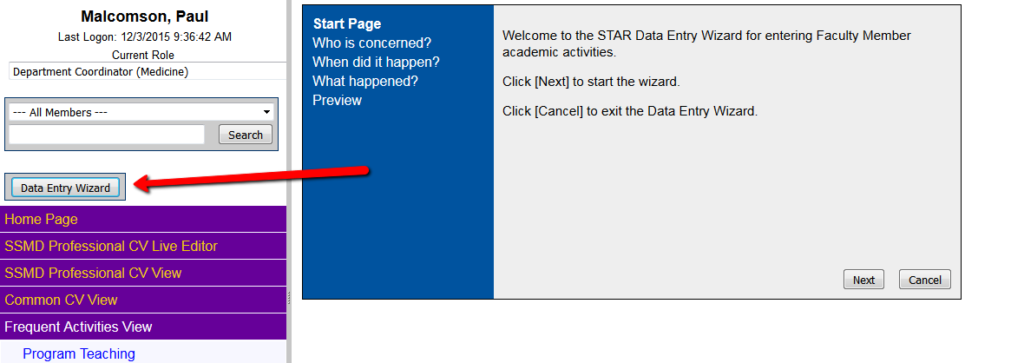
Data Entry Wizard
Notes:
Data Entry Wizard
Located just below the Search bar is a Wizard that should allow you to quickly answer several key questions and have you navigate directly to the Data Entry Page with those answers populated.
Questions have been organized in a way that you can choose the Faculty Member (if you manage more than one person’s data), choose the Activity date then answer some details about the activity.
The next page outlines the initial questions currently available

Slide 10
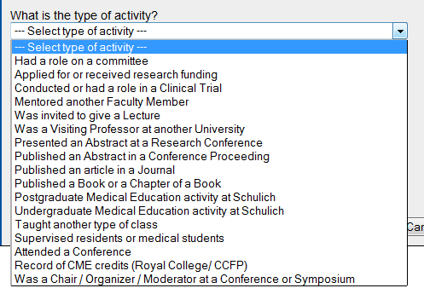
Data Entry Wizard
Notes:
Once you answer the initial question, any subsequent Wizard screens are designed to
Clicking Finish at the end of the Wizard will open the appropriate data entry screen with your question answers populated on the correct fields for that screen.

Slide 11
Tips & Tricks
If the buttons disappear in the data grid:
  Check to see if the double scrollbars are offset
  Check to see if the Buttons option is deselected in the Grid Columns Section
If you enter a record and do not see it in the data grid:
  Check to see if you have data filters set prohibiting you from seeing all data records.
  Check to ensure the last modified date field is sorted (descending)
Inputting Publication information
  Use PubMed ID and ‘GO’ button to input individual publications
  Use the Publications Import button to import multiple PubMed records at once

Slide 12
Tips & Tricks
What Dates to Enter:
  If the event happened on a single day - put the same date into both Start Date and End Date fields.
  If the event happened several times during the year – put academic year start and end dates in STAR (July 1 – June 30).
  Use ‘Copy Start Date’ button to simplify dates

Slide 13
Tips & Tricks
Three example documents available
  SSMD Professional CV, Promotion CV, and Teaching Dossier
  Shows exactly where in STAR the data comes from
Reference guide, How To Fact Sheets, Videos
Monthly update form
  Helps log and capture required entries or changes
  Allows you to accumulate changes
  Available from your Coordinator or from https://www.schulich.uwo.ca/star/resources

Slide 14
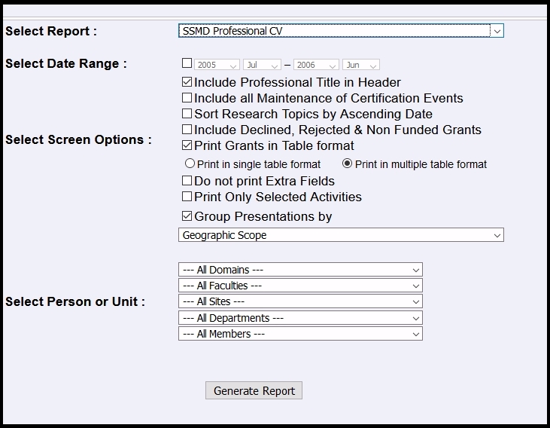
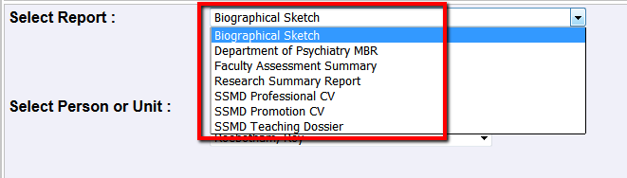
STAR Reports
Bio Sketch
Department of Psychiatry MBR
SSMD Professional CV
SSMD Promotion CV
SSMD Teaching Dossier
Abbreviated CV
Notes:
Primary Appointees Only checkbox:
Standard drop down menus to filter specific data

Slide 15

STAR Support
Help buttons for specific data questions
Online reference material is on the portal
STAR Coordinators across all departments
https://www.schulich.uwo.ca/star/contacts

Slide 16

Class Review
Have the goals for today been met?
Do you know how to access STAR from anywhere?
Were you provided with a walkthrough of the All Activities View menu?
Have you been shown helpful tips and tricks for using STAR?
Do you now have a good understanding of where basic activities go?
Do you have a working knowledge of the STAR Data Grid?
Do you know how to generate the STAR Reports?
Can you find 2 levels of online help within STAR?
Were you shown where to find additional resources on the Portal?
Do you know who to contact for help with STAR?
Other Questions?

Slide 17


