Slide 1


Slide 2

Welcome to the
Acuity STAR workshop for
Faculty Development
Author: Derrick Gould
Last Update: January 2025
Course Duration: 1 Hour
Target Audience: Clinical Faculty Members
Notes:
This course is designed for Faculty Members, who will receive CME credit for attendance of the full course. Other roles are able to attend where space permits, but no formal credit is issued in these cases.

Slide 3

Agenda
Welcome, Introductions & Housekeeping
Disclosures
Learning Objectives
Interfaces with STAR
STAR Reports
Logging into STAR
Navigation Demo
Common Activities
Tips & Tricks
STAR Portal
STAR Resources
Monthly Tracking Sheet
Course Review
* This course is 100% interactive.

Slide 4
Presenter Disclosure
Presenter: Derrick Gould
I disclose that I have no commercial interests whatsoever with this course including:
  Grants/Research Support: none
  Speaker Bureau/Honoraria: none
  Consulting Fees: none
  Other: none

Slide 5
Disclosure of Commercial Support
This program has not received any commercial support of any sort from any organization
This program has not received any in-kind support of any sort from any organization
There is no perceived or potential conflict of interest for Derrick Gould or any member of the course planning committee for delivery of this program material
There is no need to mitigate any potential bias for this course.

Slide 6
Learning Objectives
By the end of today’s session participants will know:
The overall goal of using STAR
How STAR connects and supports Schulich
How to access STAR from anywhere
How to navigate through the STAR menus
How to generate STAR Reports
How to enter some common activities
Some tips and tricks for ensuring data completeness
Notes:
Specific Goals are:
To instruct faculty how to find the STAR portal and STAR application on the internet using Google and by navigating the SSMD home page.
To demonstrate the interactive nature of the accordion menus, and show how clicking on content pages differs from clicking on menu pages.
To show faculty members how to navigate to the report menu, and generate and print an .rtf report such as the SSMD Professional CV.
To demonstrate to faculty members how to navigate to and access some of the most common data pages, then show how to make changes and save them.
To give some specific helpful hints on how to ensure that the data entered into STAR is as complete and accurate as possible.
To explain the online help, the documentation, training material and secondary contacts available to help a faculty member when they have questions.

Slide 7

Acuity STAR Interfaces
Other
SAS
CFPC
Acuity STAR
CCV
RCPSC
PubMed
Grants
Database
One45

Slide 8

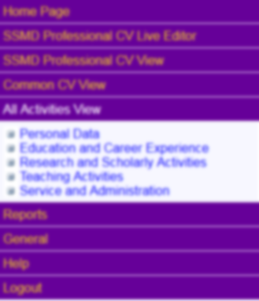
Acuity STAR Reports
Acuity STAR
CDP Support
ARC Performance
Department MBP/PBR
Departmental Funding
Research Report
Promotion Documents
Professional CV

Slide 9
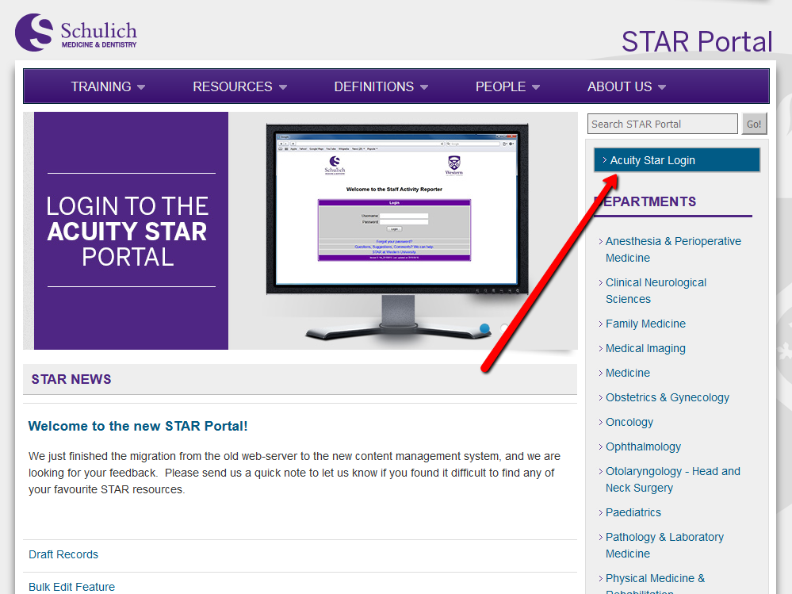
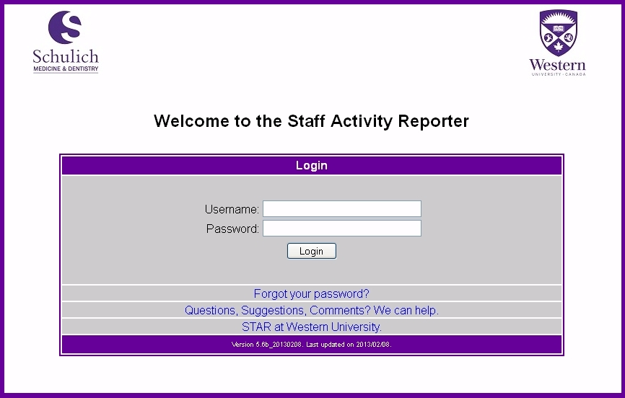
Logging Into STAR
Google: UWO STAR
Add these two sites to your bookmarks
Disable Pop-Up Blocker for the STAR application
Check with your STAR Coordinator if you need a password
  https://www.schulich.uwo.ca/star/
https://star.schulich.uwo.ca
Notes:
You can use other browsers like Safari, Chrome, Internet Explorer or others, however there are known issues with some versions of these tools. The current version of Firefox works with all platforms (PC / Mac / Etc) and is the browser required for use with STAR if you need help troubleshooting a problem.
Regardless of which browser you choose, it is critical to disable popup blockers for Acuity STAR. This needs to be done only once and the browser will remember your setting.

Slide 10

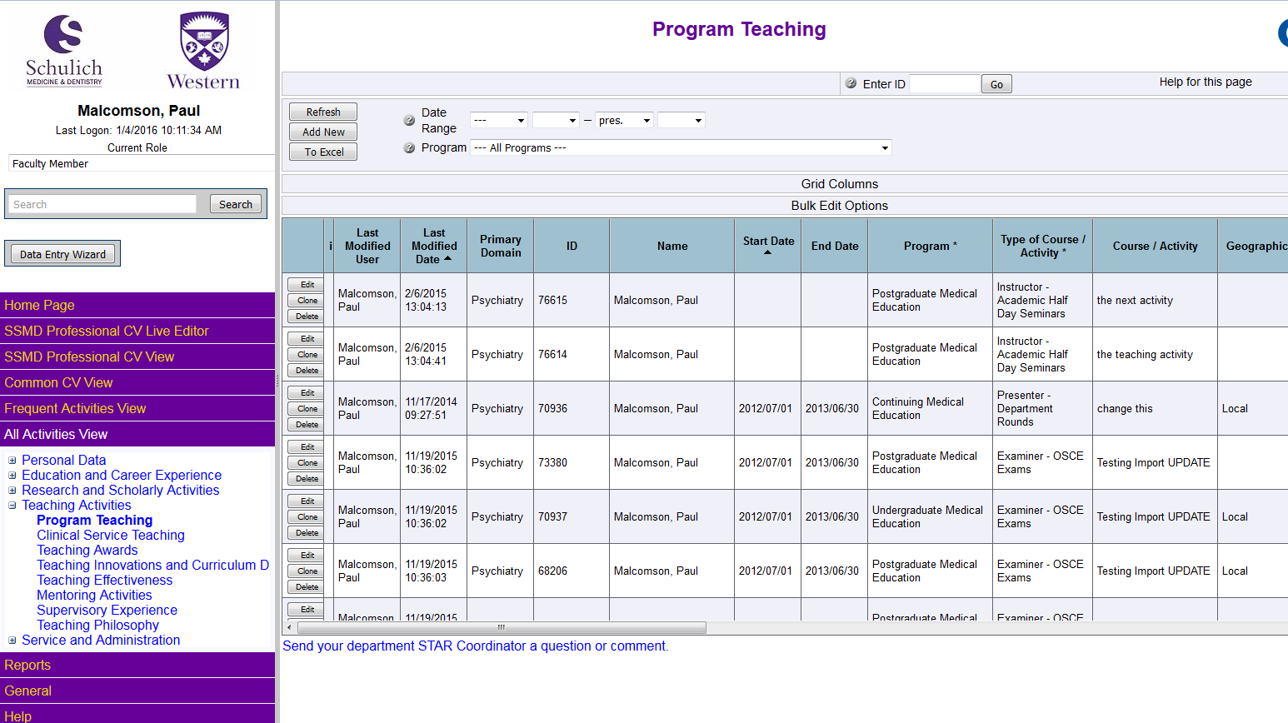
Acuity STAR Faculty Members
Navigation Demo
Notes:
Switch the instructor’s computer to a Firefox window and proceed to demonstrate how to use the accordion menus to navigate through STAR.
Important Points:
When clicking on menu items, the content area is not intended to be refreshed.
When clicking on the page links, the menu does not change but the content window is refreshed with a data grid from that page.
All Activities menu and the SSMD Professional CV view are the two most used menus. The both display the same data, just organized differently.
If you have been given a ‘special role’ such as Department Auditor, then you must use the Current Role drop down (top left of the screen) to change roles.
The data grid columns can be sorted (clicking on them once for descending and again for ascending) and you have the ability to hide or display columns using the Grid Columns button.
The top of the data screen has controls to filter data, by date for example.
Sorting, hiding columns and data filters are all retained by STAR across sessions. Remember this if you filter by a date one time, it will retain this filter until you reset and click REFRESH.
Scroll bars on the right hand side of the screen can cause some confusion or give the appearance of hiding information.
Changes to Hospital and Western appointments and your rank history are controlled by your STAR coordinator.
If you have a member secretary working on your STAR data they will see the same screens and data that you do.

Slide 11
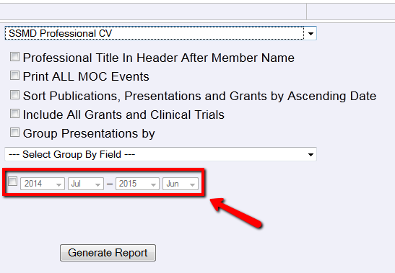
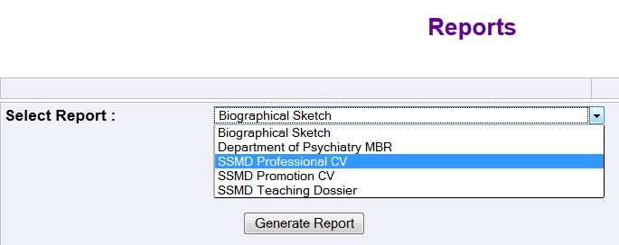
STAR Reports
Abbreviated CV
Biographical Sketch
Department of Psychiatry MBR (Psychiatry only)
SSMD Professional CV
SSMD Promotion CV
SSMD Teaching Dossier
Notes:
New report options – several checkboxes have been introduced to group data on the SSMD Professional CV
Grouping presentations by Geographic Scope (unchecked will not group)
Grouping presentations by Activity Type (unchecked will not group)
Checkbox for printing All MoC Events. Checking this will include all of your Maintenance of Certification Events
Checkbox for including “, Professional Title” in CV header after Member Name (across all pages)
Options to sort Publications, Presentations and Grants sections ASCENDING by date. The default is DESCENDING.
All reports are generated in .rtf format and can be opened in a word processing application like MS Word.

Slide 12
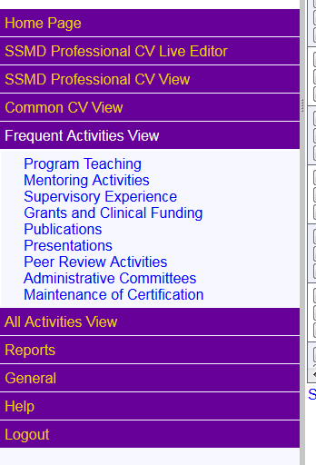
Acuity STAR Faculty Members
Common Activities

Slide 13
Common Activities
Program Teaching – UME, PME, CME
Supervision and Mentoring – include names
Publications – use PubMed
Presentations – includes teaching outside of Schulich
Grants and Clinical Funding
Peer Review Activities
Administrative Committees - task force, working group etc
Maintenance of Certification - CPD Events

Slide 14
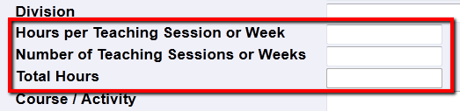
Common Activities
Program Teaching
Continuing, Undergraduate, and Postgraduate
Course activities are defined by Department
Total hours are calculated
Use Academic Year for repeated activities
‘/ Admin’ means course administration
Notes:
Program Teaching
You should use the ‘Admin’ program name if you are involved with curriculum development or similar
Continuing Medical Education and CME Admin
Undergraduate Medical Education and UME Admin
Postgraduate Medical Education and PME Admin
Hours per Teaching Session or Week * Number of Teaching Sessions or Weeks = Total Hours (you cannot enter this value).
Using Academic Year allows for accurate grouping by dates on reports.
Can be linked to Teaching Effectiveness evaluations depending on your Department.
Clinical Teaching
Considered to be Clinical Teaching within the context of patient care.
Only included in the Teaching Dossier only

Slide 15
Common Activities
Supervision Vs. Mentoring
Student / Faculty Name is mandatory
Supervision can be when you have an active role in reviewing performance
  Formal; Medical Based Leadership
  Resident Research Projects
Mentoring can be either a faculty to faculty process OR mentoring a student or group of students
  Career Based Leadership
  All Mentoring Content is Strictly Confidential
Notes:
Supervision
Mentoring at Schulich is not a supervisory process where performance is evaluated by someone you report to rather, it is a process where subject matter experts offer feedback, advice and counsel with the goal of development, assistance and support.
Supervision is when you will evaluate the performance of a student and have a defined role in that supervision. Roles in STAR for Supervision currently are:
Co-Supervisor
Primary Supervisor
Secondary Supervisor
Thesis Committee Member
Thesis Examiner

Slide 16
Common Activities
Publications
Use PubMed ID for accurate citation information
Role – principal author, senior responsible author, co-author…
Peer Reviewed publications are key
Presentations
Presentation Type, Activity Type and Role
Visiting Professor and Invited Lecturer both appear on the Teaching Dossier
Notes:
You can record presentations with a role of Co-Author, even if you did not present. This allows for all activities to be recognized.
Presentation Types include:
Visiting Professorship = Invited to another Institution for multiple teaching sessions, typically over several weeks or more.
Invited Lecturer = Invited to give a teaching based lecture, typically occurring once.
Plenary Presentation = Keynote or podium presentation,
Abstract Presented = Abstract was presented at the meeting or conference
Poster Presentation = Poster was presented at the meeting or conference
Conference Presentation = Any other presentations made
Student Presentation = Presentation occurred as a student
Media Presentation = when you are interviewed by CBC or radio etc
Presentation Roles:
Visiting Professor = Will be included on the APTD
Invited Lecturer = Will be included on APTD
Keynote Speaker = You are the plenary or podium or distinguished speaker for this event; this activity will print on the APCV
Presenter = Use this role when you are the presenter at this event; this activity will print on the APCV
Co-Author = Use this role when you co-wrote the topic but are not presenting; this activity will print on the APCV
Supervisor = Use this role when you are involved in the topic as a supervisor; this activity will print on the APCV
Expert = When you are considered the expert for an interview or session; this activity will print on the APCV

Slide 17
Common Activities
Abstracts
Both published and presented will print in a separate Abstracts section on CV
Presentations
  Abstract Presented
  Poster Presented
Publication
  Published Abstract (conference proceedings)
Notes:
You can record presentations with a role of Co-Author, even if you did not present. This allows for all activities to be recognized.
Presentation Types include:
Visiting Professorship = Invited to another Institution for multiple teaching sessions, typically over several weeks or more.
Invited Lecturer = Invited to give a teaching based lecture, typically occurring once.
Plenary Presentation = Keynote or podium presentation,
Abstract Presented = Abstract was presented at the meeting or conference
Poster Presentation = Poster was presented at the meeting or conference
Conference Presentation = Any other presentations made
Student Presentation = Presentation occurred as a student
Media Presentation = when you are interviewed by CBC or radio etc
Presentation Roles:
Visiting Professor = Will be included on the APTD
Invited Lecturer = Will be included on APTD
Keynote Speaker = You are the plenary or podium or distinguished speaker for this event; this activity will print on the APCV
Presenter = Use this role when you are the presenter at this event; this activity will print on the APCV
Co-Author = Use this role when you co-wrote the topic but are not presenting; this activity will print on the APCV
Supervisor = Use this role when you are involved in the topic as a supervisor; this activity will print on the APCV
Expert = When you are considered the expert for an interview or session; this activity will print on the APCV

Slide 18
Common Activities
Grants and Clinical Funding
Date, Status, PI, Co-PI, Short Title, Amount and Application Summary are all required
You can prorate $ across multiple years
Complete as much information as possible
Schulich would like to see all Grant Status’:
  Applied (The grant application has been submitted for review)
  Declined (This grant was approved / awarded but it was declined by the applicant)
  Funded (This grant was approved / awarded)
  Not-Funded (The grant was approved but funding was not available)
  Rejected (The grant application was rejected)
Notes:
Grant applications typically require a significant amount of effort to complete, therefore Schulich would like to see all Grants applied for regardless of their disposition.
Some useful websites for funding information include the following:
Physicians’ Services Foundation: http://www.psifoundation.org/
View Decisions – CIHR: http://www.cihr-irsc.gc.ca/e/38021.html
Award & Competition Results - Research Western- Western University: http://www.uwo.ca/research/excellence/results.html
Home - ClinicalTrials.gov: http://www.clinicaltrials.gov/
CFI - Funded Projects: https://www2.innovation.ca/pls/fci/fcienrep.base
NSERC - Funding Decisions: http://www.nserc-crsng.gc.ca/nserc-crsng/fundingdecisions-decisionsfinancement/index_eng.asp

Slide 19
Common Activities
Administrative Committees
Tracks the working groups or committees you are part of
Working Group, Task Force, Committee etc.
Main Activities and Contribution show your impact to the committee
Allocate hours per year

Slide 20
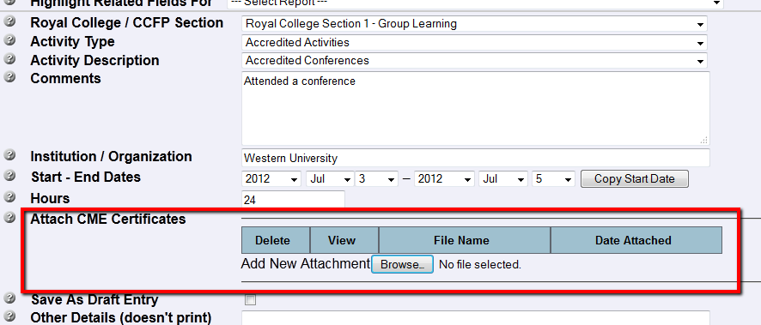
Common Activities
Maintenance of Certification
Captures activities that can be claimed by either the Royal College or CFPC
Scan and upload PDF copies of your credits
Notes:
Maintenance of Certification allows you to record both accredited and non-accredited activities that you would claim through your licensing college. Several of these activities appear on the
It is important to note that when it comes to Rounds or Grand Rounds, if you attend then it is an accredited learning activity and belongs in Maintenance of Certification.
If you present or speak at Rounds or Grand Rounds, it is considered a presentation and should go in Presentations with the Type = Invited Lecture and the Activity Role = Invited Lecturer.
When you are attending Rounds:
Menu: Personal Data
Page: Maintenance of Certification
Royal College / CCFP Section: Section 1 - Group Learning
Activity Type: Accredited Activities
When you are presenting or speaking at Rounds:
Menu: Research and Scholarly Activities
Page: Presentations
Type: Invited Lecture
Activity Role: Invited Lecturer

Slide 21
Acuity STAR Faculty Members
STAR Tips & Tricks

Slide 22
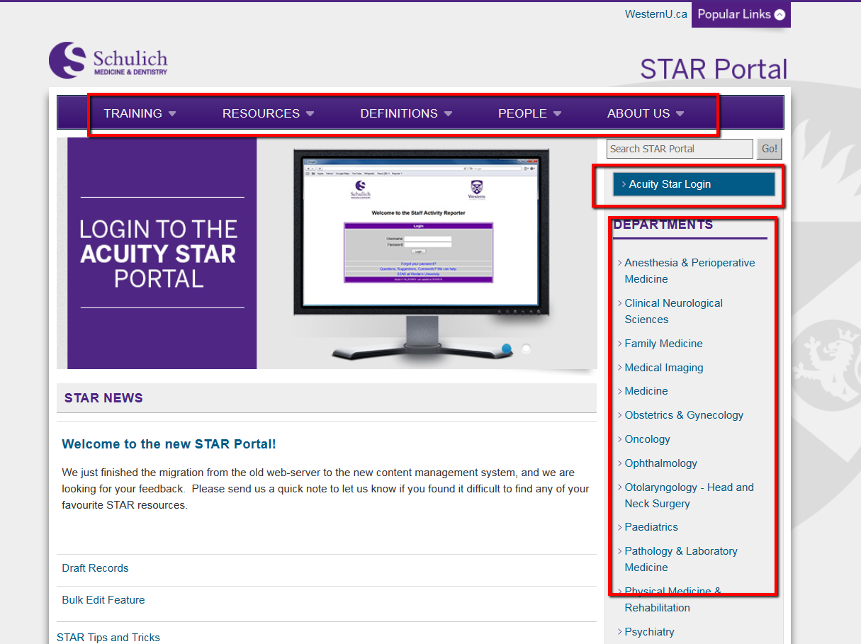
Acuity STAR Portal
https://www.schulich.uwo.ca/star/
Notes:
Data Entry Wizard
Located just below the Search bar is a Wizard that should allow you to quickly answer several key questions and have you navigate directly to the Data Entry Page with those answers populated.
Questions have been organized in a way that you can choose the Faculty Member (if you manage more than one person’s data), choose the Activity date then answer some details about the activity.
The next page outlines the initial questions currently available

Slide 23
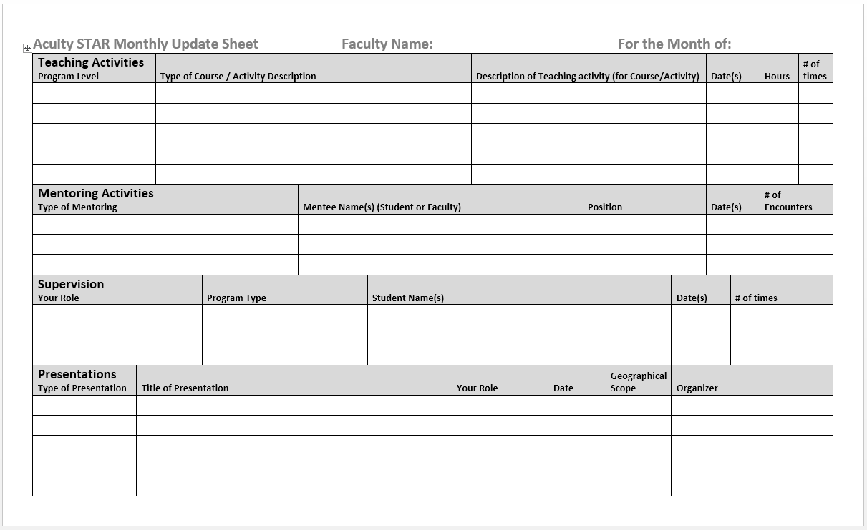
Monthly Update Sheet
2 Pages - Print double sided Legal paper
Intended as a template
Frequent activities
All required fields

Slide 24
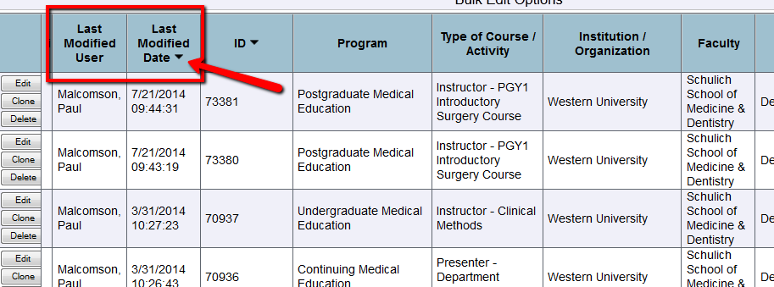
Last Modified
Each data grid has two fields, Last Modified User and Last Modified Date
Quickly locate who made changes and when
Useful to sort (down arrow) on Modified Date

Slide 25
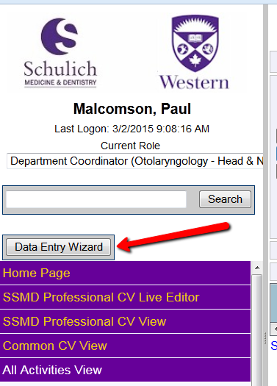
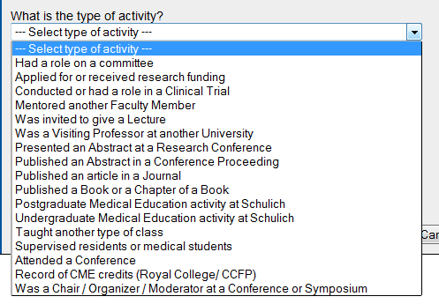
Data Entry Wizard
This feature will allow novice users to enter information into STAR without a base
understanding of the activities themselves. The wizard will walk the user through a
series of questions and then determine which page in STAR is most appropriate.
Notes:
Data Entry Wizard
Located just below the Search bar is a Wizard that should allow you to quickly answer several key questions and have you navigate directly to the Data Entry Page with those answers populated.
Questions have been organized in a way that you can choose the Faculty Member (if you manage more than one person’s data), choose the Activity date then answer some details about the activity.
The next page outlines the initial questions currently available

Slide 26
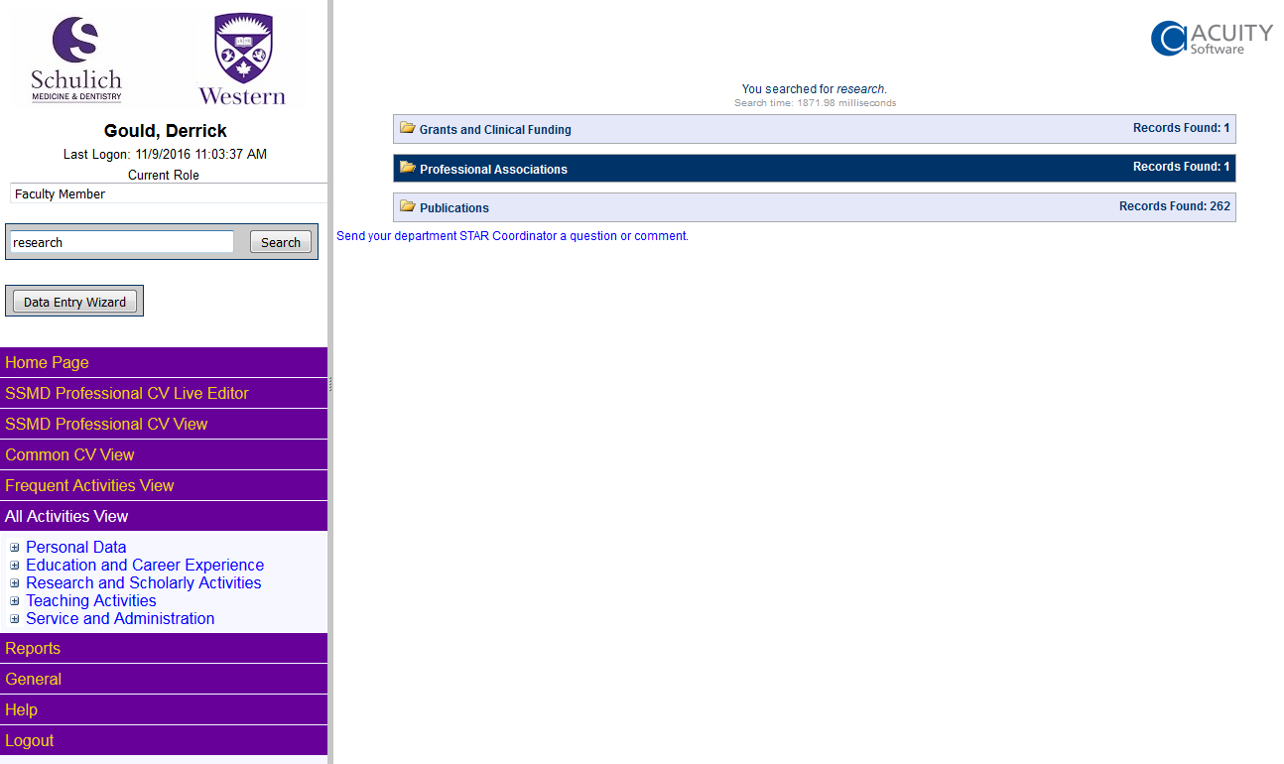
Searching STAR
This feature will search through a members data to find the instance or instances of
specified key words, and present that information grouped by which pages the keywords
were found in.
Notes:
Data Entry Wizard
Located just below the Search bar is a Wizard that should allow you to quickly answer several key questions and have you navigate directly to the Data Entry Page with those answers populated.
Questions have been organized in a way that you can choose the Faculty Member (if you manage more than one person’s data), choose the Activity date then answer some details about the activity.
The next page outlines the initial questions currently available

Slide 27
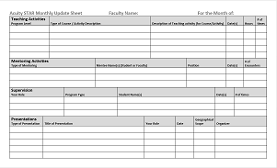
Tips for Complete Data
Things to do
Clone records from data grid OR Save/Clone
Geographic Scope
  Sponsoring organization, not the physical location
Span dates across Academic Year
Use STAR monthly update form
Contact STAR coordinator
Things to avoid
Use the ‘Other – specify’ values (Wherever Possible)
Use acronyms (ATLC, UWO, etc.)

Slide 28
Course Review
Have we covered these knowledge areas?:
Know the overall goal of STAR
How STAR connects and supports Schulich
How to access STAR from anywhere
How to navigate through the STAR menus
How to generate STAR Reports
How to enter some common activities
Some tips and tricks for ensuring data completeness

Slide 29


