Slide 1
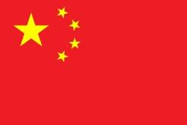
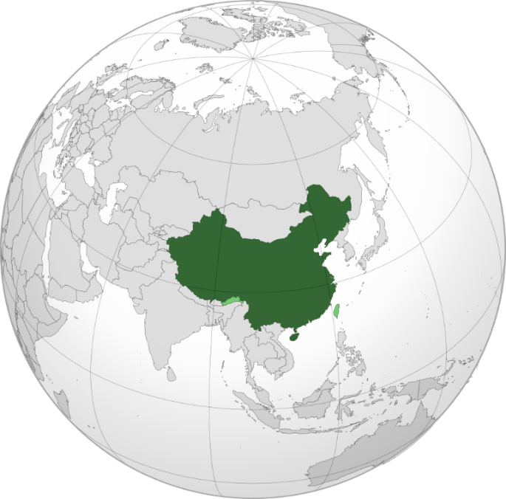

CHINA
Facts & Figures
History of China
Capital | Beijing
Largest City | Chongqing
Official Languages | Standard Chinese
Official Script | Simplified characters
Currency | Renminbi (CNY)
Geography (estimates)
Population | 1408.28 million
Pop. Density | 147/km²
Area | 9.6 million km²
Time Zone | CST
Government
President | Xi Jinping
Legislature | National People’s Congress
*Independence or Founding Date*
One of the world’s oldest civilizations, with over 3,000 years of recorded history.
Major contributions to early science, medicine (e.g. acupuncture, herbal remedies), and philosophy.
Ruled by dynasties until 1912, including the Han, Tang, Song, and Qing—periods marked by growth in traditional Chinese medicine (TCM).
1912: Republic of China founded after fall of Qing Dynasty; followed by political instability and war.
1949: People’s Republic of China established under Communist Party leadership.
Mao-era reforms (e.g. Cultural Revolution) disrupted education and healthcare.
Since 1978: Major economic and healthcare reforms; modernization of hospitals and public health systems.
Now a leader in global health research and disease prevention (e.g. COVID-19 response).

Slide 2
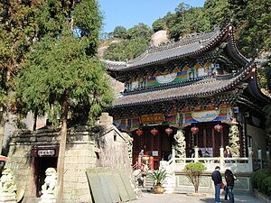
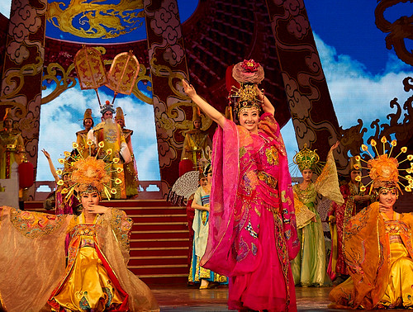

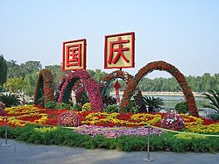
Highly diverse cuisine known for a breadth of cooking techniques and ingredients.
The most influential cuisines are the “Eight Major Cuisines” – Sichuan, Cantonese, Jiangsu, Shandong, Fujian, Hunan, Anhui, and Zhejiang.
Traditional Chinese dishes include: Chǎofàn (fried rice), Hundun Tang (Wonton soup), Mápó Dòufu (Mapo tofu), Cōng Yóu Bǐng (scallion pancakes), and Gong Bao Ji Ding (Kung Pao Chicken).
Mainland China – Official Public Holidays
New Year’s Day (1 day)
Spring Festival (Chinese New Year, 4 days)
Tomb-Sweeping Day (1 day)
Labour Day (2 days)
Dragon Boat Festival (1 day)
Mid-Autumn Festival (1 day)
National Day (3 days)
Language & Religion
Cuisine
Music & Art
Important Dates & Holidays
China has as many as 292 living languages.
The national language of China is Standard Chinese – a variety of Mandarin based on the Beijing dialect.
Chinese culture has historically been shaped by Confucianism, Taoism, and Buddhism – the “three doctrines”.
The most common practice is Chinese folk religion which is framed by the “three doctrines”.
From modern to traditional there is a highly diverse range of Chinese music.
Traditional Chinese opera originated thousands of years ago and has multiple forms including Beijing and Cantonese opera.
China also has Chinese pop or C-Pop which includes mandopop and Cantopop.

