Slide 1


Department of Family Medicine
Enhanced Skills
Orientation Session
July 11th, 2025
Department of Family Medicine
Dr. Tatiana Jevremovic
Associate Professor & Enhanced Skills Program Director

Slide 2

Program Vision
The current vision of the Enhanced Skills Program is to provide residents with additional training in specialized fields of family medicine for a duration of 6 to 12 months in length.
The aim is to attract exceptional residents who want to be leaders in these sub-specialized fields of family medicine while still adhering to the guiding principles of family medicine.
It is our hope that these residents will then attempt to encompass these new skills within the practice of family medicine

Slide 3
Program Contacts
ES Program Director: Dr. Tatiana Jevremovic (tjevremo@uwo.ca)
DFM Program Director: Dr. Dan Grushka (dgrushk@uwo.ca)
DFM Associate Program Director: Dr. Christina Cookson (ccookso@uwo.ca)
Program Administrator: Ms. Laura Sparrow (laura.sparrow@schulich.uwo.ca)
Postgraduate Education Manager: Ms. Liz McInnis (liz.mcinnis@schulich.uwo.ca)
Postgraduate Academic Program Coordinator: Ms. Claudia Baker (claudia.jarosz@schulich.uwo.ca)
Office of Distributed Education: (Distributed.Education@schulich.uwo.ca)
Family Medicine Post Graduate Office: (fmpgc@schulich.uwo.ca)

Slide 4

Programs Offered
Academic Family Medicine
Care of the Elderly*
Sport & Exercise Medicine
Palliative Care
Emergency Medicine
Chronic Disease Management
Hospitalist
Child Health*
Obstetrics & Women’s Health
Primary Care Rheumatology
Family Medicine-Oncology
Individualized Program
* Not being offered this year

Slide 5

Types of Programs
Category 1 Programs:
Programs that adhere to an agreed upon set of national guidelines, objectives and evaluations
ER, COE, Palliative Care, SEM
Cannot deviate from the program objectives
Category 2 Programs:
Programs that have been designed at the university level that adhere to the guiding principles of Enhanced Skills training in the CFPC red book, but do not have a nationally agreed upon set of guidelines, objectives and evaluations
More internal flexibility with regards to training

Slide 6

Meeting your Program Director!
Objectives
Responsibilities
Journal club
Call
Grand Rounds
Evaluations
Rotation schedule
Scholarly project

Slide 7

Academic Family Medicine
Program Director:
Dr. Christina Cookson
Residents:
Dr. Joseph Herbert Dr. Wesam Alerian

Slide 8

Sports & Exercise Medicine
Program Director:
Dr. Graham Briscoe
Residents:
Dr. Austin Kemp Dr. Gerald Power Dr. Jasmine Aggarwal Dr. Matthew Ryckman Dr. Jessica Sadri-Gerrior

Slide 9

Palliative Care
Program Directors:
Dr. Trish Valcke Dr. Kathleen Milne
Residents:
Dr. Megan Chevalier (on mat leave) Dr. Aivy Cheng
Dr. Margaret MacDonald

Slide 10

Obstetrics & Women’s Health
Program Directors:
Dr. Nisha Arora
Residents:
Dr. Caroline McKenna
Dr. Olaitan Awopetu Dr. Khadija Bibi
Dr. Hannah He

Slide 11

Primary Care Chronic Disease Management
Program Director
Dr. Sonja Reichert
Resident:
Dr. Madiha Akbar

Slide 12


Windsor Hospitalist Program
Program Director
Dr. Danielle Soulliere
Residents
Dr. Menas Awad
Dr. Abida Sayed

Slide 13
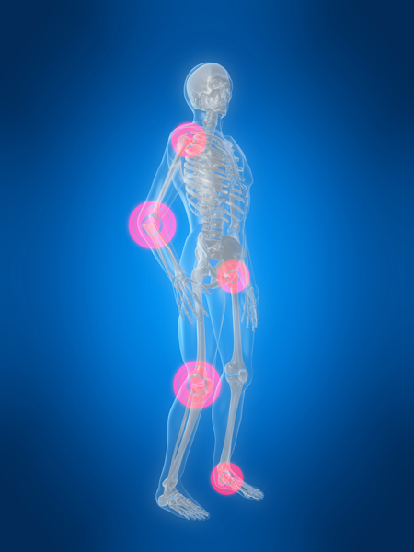
Primary Care Rheumatology
Program Director
Dr. Gina Rohekar
Residents
No resident

Slide 14

Family Med-Oncology
Program Director
Dr. John Lenehan
Residents
Dr. Joanna Walters

Slide 15
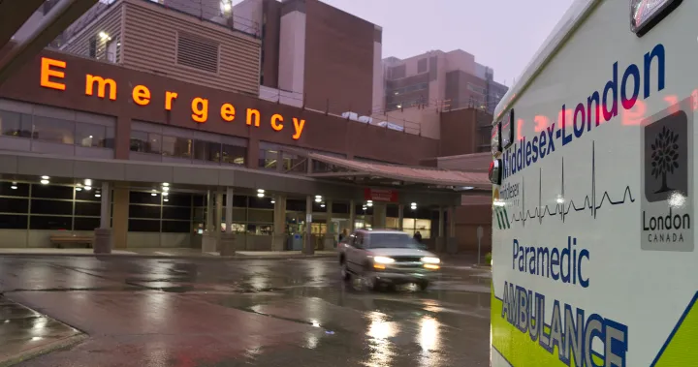
Emergency Medicine
Program Director:
Dr. Kevinjeet Mahngar
Residents:
Dr. Boyan Woychyshyn Dr. Fatimah Kharal Dr. Simon Bahru Dr. Daniel Capdeville Tanure Dr. Ashley Wang Dr. Sadek Mowakket Dr. Peter Denezis Dr. Katelyn Gray Dr. Justin Roy Dr. Ryan Sanford

Slide 16

Accreditation
External Review was in November 2019
Next accreditation – November 2027
Program is FULLY ACCREDITED

Slide 17
Connectivity to the Department of Family Medicine
Direct connectivity to the department will be achieved with:
Orientation session
Meeting with ES Program Director - To discuss progression in program - To discuss resident concerns
Invitation to Family Medicine teaching / events
Participation in Resident Research Day
Family Medicine mentoring system - Confidential Mentorship Program

Slide 18
Enhanced Skills Chief Resident
TBD

Slide 19
Social Connectivity
Chief Resident
Roles:
attending the subcommittee meetings, liaising with the other residents, helping to organize a journal club/seminars series, planning social events, acting as a resident mentor for concerns
Invited to attend all PGY-1 & PGY-2 social events
Invited to Family Medicine Annual Retreat

Slide 20
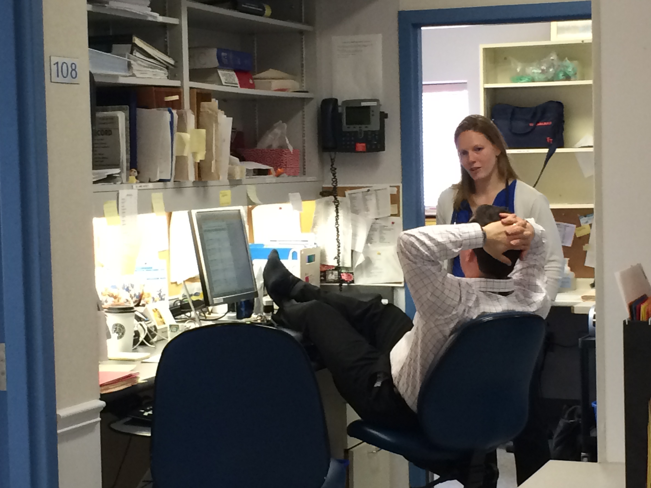
Evaluations
All evaluations are done using the one45 system
ITERs (CBME format)
Field Notes
Use the MyFM family medicine field notes
CBME Faculty advisor forms
Exit review
Notes:
In-Training Evaluation Report (ITER) is a summative assessment form, completed at the end of an educational experience, that details a resident’s performance in each of the CanMEDS/CanMEDS-FM roles, linked to the objectives for that educational experience.
Competency Based Medical Education Residency Program (CBME Residency Program) is a Residency Program that is planned and organized around competencies required for practice.

Slide 21

Evaluations
You are responsible for directing rotation evaluations to the appropriate preceptor unless done so automatically by the one45 system
Please do not forget to do your quarterly meetings (faculty advisor form) with your PD
Field notes are to be completed on myFM. We expect a minimum of 50 field notes
You can direct any questions to FMPG office

Slide 22
MyFM – Field Notes
Field notes are to be completed on myFM. We expect a minimum of 50 field notes
All residents should identify 2 patients they see early in the year and ask permission to follow up with them later in the year (excluding EM)
Demonstrate continuity of care and comprehensive care within the enhanced skills program
Discuss these cases with the preceptor supervising you when you first encounter these patients.

Slide 23
Academic Connectivity
All residents are invited to:
Attend Family Medicine and PGME grand rounds
Teach at PGY-1 & PGY-2 half days
PGY-3 Seminar Series:
Topics to be determined by the group in conjunction with the chief resident
Topics can include: critical appraisal, practice management, how to set up an office, how to incorporate, CMPA talk, etc.

Slide 24

Scholarly Activity
The project is not meant to be an onerous activity
All resident are eligible for funding and assistance from the Centre for Studies in Family Medicine
Acceptable modes of research include: case reports, quality improvement (QI) analysis, clinical/scientific research, self-reflection projects, etc.
All topics should be discussed with your program director

Slide 25
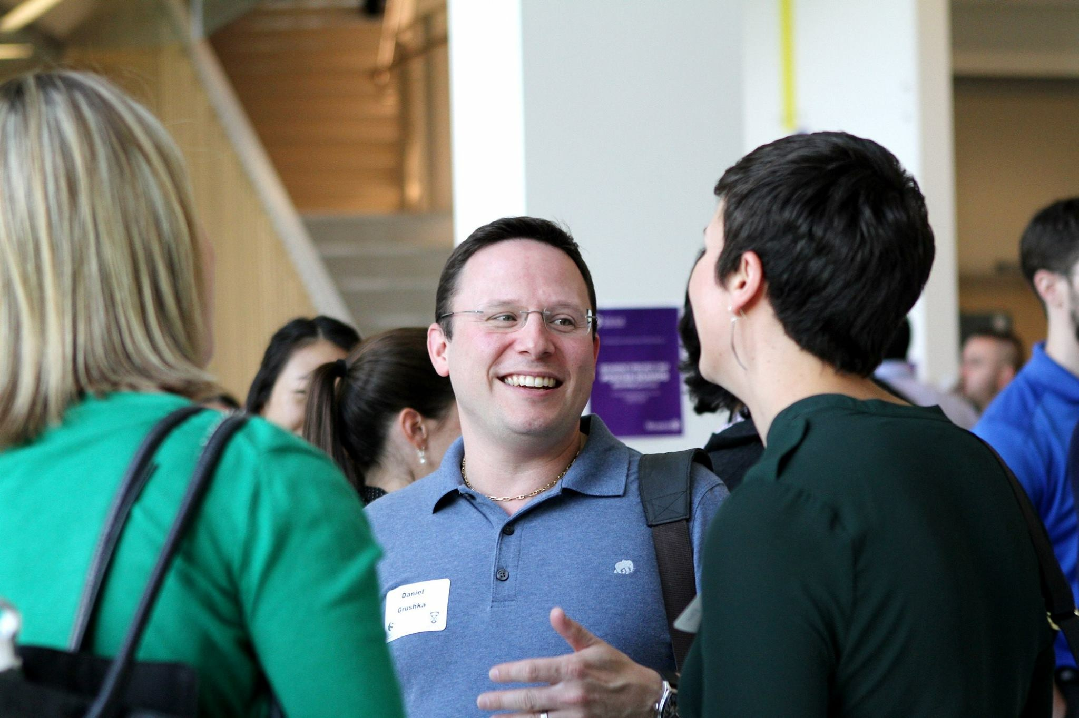
Resident Research Day
All ES skills residents are required to present at Resident Research Day 2026
Presentation format is that of a short oral presentation at Family Medicine Research Day in June 2026
Abstracts will be due in April 2026
Postgraduate Academic Program Coordinator: Ms. Claudia Baker (claudia.jarosz@schulich.uwo.ca)

Slide 26
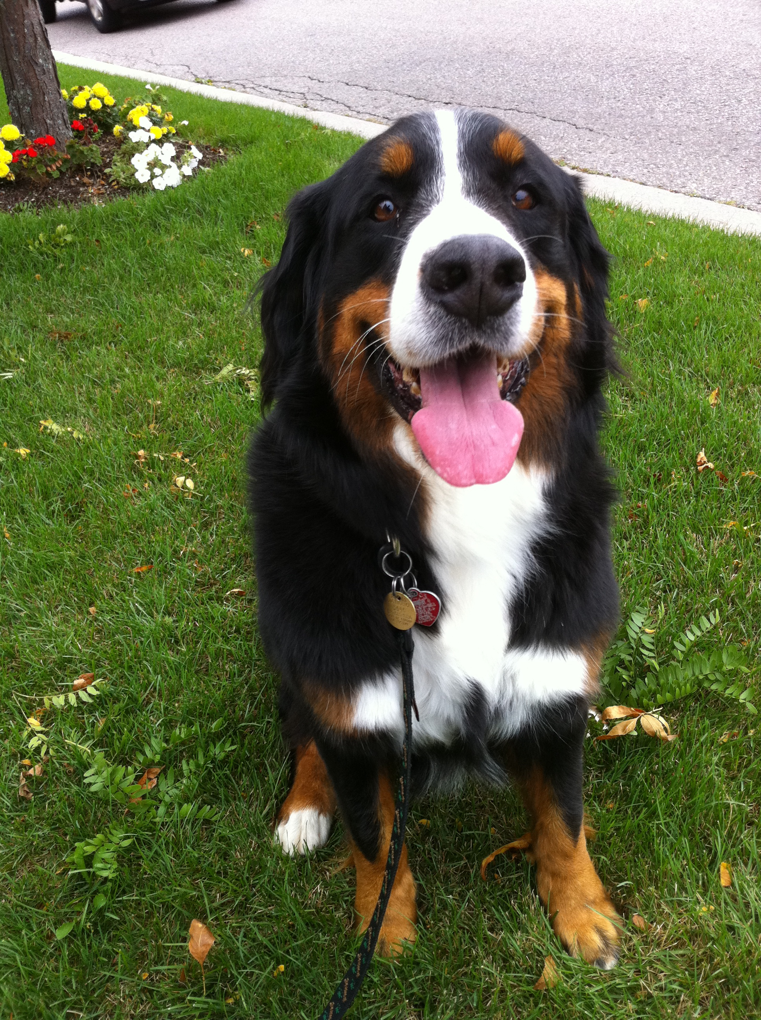
Vacation and Conference**
Program Length | Vacation | Professional Leave
12 month program | 4 weeks | 1 week
9 month program | 3 weeks | 5 days
6 month program | 2 weeks | 3.5 days
3 month program* | 1 week | 2 days
*3 month programs are not currently offered at Western unless under special circumstances.
**As per PARO contract.
Copy FMPGC on all vacation requests
fmpgc@schulich.uwo.ca

Slide 27
Academic Funds
The department of FM will provide funds to attend courses, conferences and workshops.
Requests must be pre-approved before asking for reimbursement.
Additional funds are available on a competitive basis through the PGME office.
If you are a previous Western FM resident, you can carry over any additional funding you have remaining.
Program Length | Funds
12 month program | $400
9 month program | $300
6 month program | $200
3 month program* | $100
*3 month programs are not currently offered at Western unless under special circumstances.
*ACLS is a Medical Affairs Requirement and the cost is covered by LHSC

Slide 28

Vacation and Conference
Process:
Vacation form needs to be approved by the current rotation supervisor and program coordinator.
Form found online: https://www.schulich.uwo.ca/familymedicine/postgraduate/current_residents/policies/professional_leaves_vacation_religious_holiday.html
Confirmation must be sent to fmpgc@schulich.uwo.ca

Slide 29

Moonlighting
Refer to complete policy in the ES Resident Manual
Complete 50% of program and be in good standing
Cannot occur in Western affiliated institutes
Cannot interfere with ES commitments

Slide 30

Certification
All residents who successfully complete the program will receive:
UWO certificate
Category programs are eligible for CAC from CFPC
Exams for certification:
Sports Medicine (conducted through CASEM)
Palliative Care (conducted through UWO)
Emergency Medicine (conducted through CFPC)
Thesis required:
Academic Family Medicine

Slide 31
CACs
All residents in Category 1 programs who successfully complete the program will be granted a CAC from the CFPC
http://www.cfpc.ca/cac/

Slide 32

Graduation
There is a graduation ceremony and reception in June that you are invited to attend
At that time you will receive your certificate
If you chose not to attend, you are responsible for picking up your certificate, as they are not mailed
June 2026

Slide 33
Resources
Family Medicine website: http://www.schulich.uwo.ca/familymedicine/
Please refer to website regarding updates from the department and the new Enhanced Skills Program website
Please refer to the orientation manual for all policies
All policies that govern PGY-1 & PGY-2 apply to PGY-3 residents

Slide 34

Office of Distributed Education (DE) Rotations
Residents completing rotations outside LHSC/SJHC/UWO, within the Distributed Education region, may be eligible to receive travel and accommodation funding.
For further details, go to: www.schulich.uwo.ca/distributededucation
Or contact us at: distributed.education@schulich.uwo.ca

Slide 35



Questions??

