Slide 1
Department of Family Medicine
Enhanced Skills Program
Application Information Session for Family Medicine Residents
Dr. Kyle Carter, MD, CCFP(EM)
Enhanced Skills Program Director & Assistant Professor
August 23rd , 2023

Slide 2
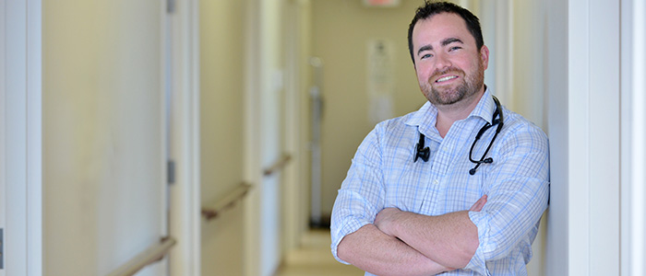
Who am I?
Schulich School of Medicine (class of 2011)
Western Family Medicine – Regional Program (Mount Brydges)
Western PGY-3 Emergency Medicine
Emergency Medicine (St Thomas, Sarnia, Woodstock, Strathroy, HFO, Walkerton)
Hospitalist Medicine (Sarnia, Strathroy, St Thomas)
Family Medicine (WIC urban, locums, SWMHC)
Allergy Practice SWMHC – (focus practice)

Slide 3
Program Contacts
ES Program Director: Dr. Kyle Carter kcarte@uwo.ca
DFM Program Director: Dr. Julie Copeland jcopeland3@uwo.ca
DFM Associate Program Director: Dr. Daniel Grushka (dgrushk@uwo.ca)
Program Administrator: Ms. Laura Sparrow laura.sparrow@schulich.uwo.ca
Office of Distributed Education: Mrs. Brenda Hennessey distributed.education@schulich.uwo.ca

Slide 4
Enhanced Skills Programs

Slide 5
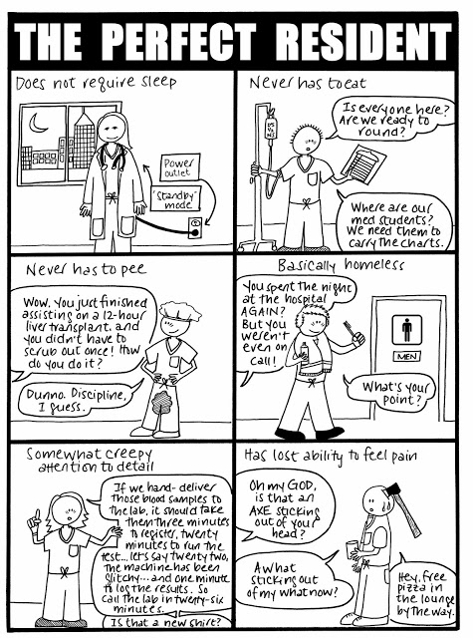

Slide 6
Program Vision
Provide family medicine residents with additional training in specialized fields of family medicine for a duration of 6 to 12 months in length.
Attract exceptional residents who want to be leaders in these sub-specialized fields of family medicine while still adhering to the guiding principles of family medicine.
Graduate family physicians that then encompass these focused skills within the practice of family medicine

Slide 7
Why Enhanced Skills?
Opportunity to become and expert and resource to your community
Increased job opportunities in varied centres: urban, rural, academic.
Ability to develop a focused practice.
Excellent remuneration and flexible lifestyle options.
Limited reentry opportunities after graduating

Slide 8
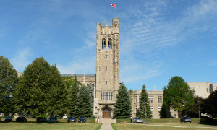
Why Western?
Fully accredited program (2020)
Long track record of excellence
Graduates have found employment in all areas: urban, rural, academic
Third largest program in Canada

Slide 9
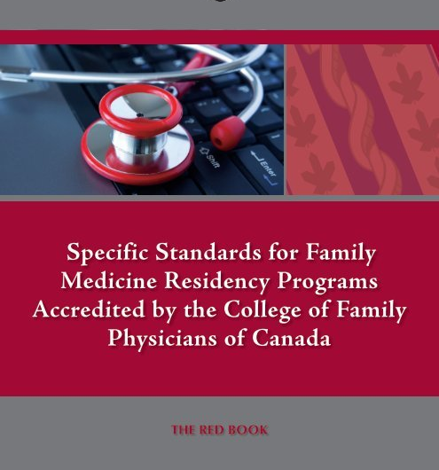
Types of Programs
Category 1 programs
Programs that adhere to an agreed upon set of national guidelines, objectives and evaluations
ER, COE, Palliative Care, SEM
Cannot deviate from the program objectives
Category 2 programs
Programs that have been designed at the university level that adhere to the guiding principles of Enhanced Skills training in the CFPC red book, but do not have a nationally agreed upon set of guidelines, objectives and evaluations
More internal flexibility with regards to training

Slide 10
CATEGORY 1 Programs
Emergency Medicine (1 year)
Sport & Exercise Medicine (1 year)
Palliative Care (1 year)

Slide 11
CATEGORY 2 Programs
Academic Family Medicine (1 year)
Child Health (6 blocks)
Chronic Diseases Management ( 1 year)
Enhanced Skills - Individualized Program (varies)
Hospitalist (6 blocks)
Obstetrics & Women's Health (6 blocks)
Family Medicine Oncology (1 year)
Primary Care Rheumatology (1 year)

Slide 12
Emergency Medicine
Program Director:
Dr. Munsif Bhimani munsif.bhimani@lhsc.on.ca
Number of residents
9 Resident Positions
1 RoS Resident Position (Windsor)

Slide 13
Positions Nationally
University | Positions
Memorial | 4
Dalhousie | 4
Laval | 11
Sherbrooke | 6
Montreal | 10
McGill | 12
Ottawa | 5
NOSM | 7
Queen’s | 8
University | Positions
Toronto | 7
McMaster | 4
Western | 10
Manitoba | 6
Saskatchewan | 8
Alberta | 7
Calgary | 8
UBC | 9
Western has the largest Ontario based CFPC-EM program

Slide 14
Emergency Medicine
Academic ER – LHSC – 2 blocks
Community ER – 1 block (Goderich, Chatam, Strathroy, Leamington, Owen Sound, Sarnia, St. Thomas, Stratford, Windsor)
Community ER/Anesthesia – 1 block
Ortho-Hybrid – 1 block
Peds-ER – 2 blocks (can be split between Childrens or PCCU)
CCTC – 2 blocks
CCU – 1 block
POCUS – 1 block
Elective – 1 block
Simulation Training
POCUS
Research

Slide 15
Sport & Exercise Medicine
Program Director:
Dr. Graham Briscoe – graham.a.briscoe@gmail.com
Number of residents
2-4 residents/year

Slide 16
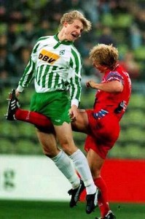
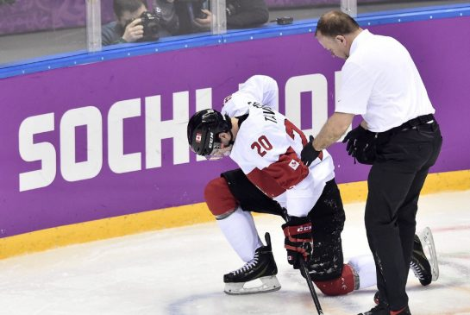
Sport & Exercise Medicine
The Resident will spend time at:
FKSMC in direct patient care
Fanshawe Clinic providing general medical care in a student health setting.
With Orthopaedic Surgeons and other designated Specialists as well as allied Health Professionals including physiotherapists, pedorthists, and bracing specialists at FKSMC.
Other activities include:
Varsity athletics and participate in community event coverage.
Teaching of family medicine residents and Kinesiology MSc. Students
Research opportunities in the form of projects or pursuing a Master’s degree

Slide 17
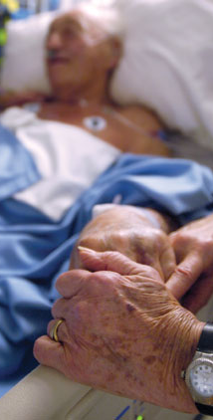
Palliative Care
Program Director:
Dr. Trish Valcke – pvalcke@thehospice.ca
Number of residents
2 residents/year

Slide 18
Palliative Care
London Stream:
4 blocks LHSC (Victoria campus),
1 block LHSC (University campus),
2 blocks Windsor hospice,
1 block Windsor oncology,
2 blocks Sarnia,
3 blocks elective
Windsor Stream:
2 blocks LHSC (Victoria campus),
1 block LHSC (University campus),
2 blocks WRH consult service (Metropolitan campus, and HDGH PCU),
2 blocks Windsor hospice,
1 block Windsor oncology,
2 blocks Sarnia,
3 blocks elective

Slide 19
Western Highlights
Rotations
3 electives blocks
Horizontal experience during the year
Psychosocial oncology at LRCP when in London
Pain clinic at LRCP when in London
Foundations of palliative care online course

Slide 20
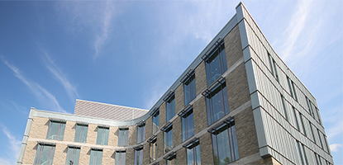
CATEGORY 2 Programs
Primary Care Chronic Disease Program
Primary Care Rheumatology
FM-Oncology
Individualized Program
Academic FM Program
Windsor Hospitalist
OB and Women’s Health
Child Health

Slide 21
Academic Family Medicine
Program Director:
Dr. Christina Cookson
ccookson2012@gmail.com
Number of residents
1-2 residents/year

Slide 22
Academic Family Medicine
Joint program between the departments of Family Medicine and Graduate Studies
Goal of the program is to train academic clinicians with an interest in teaching and research
Two tracts
Thesis & course work
Non thesis/major essay & course work

Slide 23
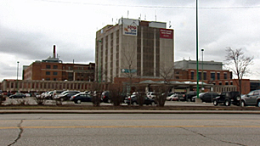
Windsor Hospitalist Program
Program Director
Dr. Danielle Soulliere – Danielle.Soulliere@wrh.on.ca
Number of residents
1-2 resident/year

Slide 24
Windsor Hospitalist Program
The training would take place at the Hotel Dieu Grace Hospital and Windsor Regional Hospital
2 blocks CTU at Hotel Dieu Hospital
1 block hospitalist Windsor Regional Hospital
1 block ICU with rapid response team at Hotel Dieu
1 block RCU/ICU at Windsor Regional Hospital
2 week elective infectious disease
2 weeks to be divided up as electives chosen from the following areas of specialty: cardiology, nephrology, neurology, endocrinology, GI, Oncology, palliative-inpatient care, radiology, neonatal ICU, chronic care

Slide 25
Obstetrics & Women’s Health
Program Directors:
Dr. Andrea Alarie (Kitchener) –andrea.alarie@icloud.com
Dr. Paige Hacking (London) – paige.hacking@gmail.com
Number of residents
1-4 residents/year

Slide 26
Obstetrics & Women’s Health
Goal is to offer residents a chance to increase their knowledge, experience and procedural base in Women’s Health
6 block program where the resident will be assigned to 1 of 2 home sites
Kitchener – high volume OB + clinics (many learners)
London – high volume FM/OB + clinics

Slide 27
Horizontal Women’s Health Electives
Primary Care Women’s Health
Women’s Health Clinic at Victoria Hospital
Family Practice with strong OB and Women’s Health
Diabetes Family Planning Clinic at MLHU
Psychiatry
Eating Disorders clinic
PTSD Clinic
First Episode Mood Disorder
Post Partum Mood Disorder Clinic
Community Based Women’s Health
Violence and Sexual Assault Team
Medicine Based Women’s Health
Sexually Transmitted Infection Clinic
Genetics Clinic
Endocrinology Clinic
Surgical Based Women’s Health
Breast Clinic
Gynecology
Urogynecology Clinic
Fertility Clinic
Gynecology Clinic

Slide 28
Child Health
Program Director
Dr. Loretta Seevaratnam
lseevartnam@rogers.com
Number of Residents
1 resident/year

Slide 29
Child Health
Rotations
Rural general paediatrics (Sarnia and other sites) - 2 blocks
Tertiary inpatient paediatrics (London) - 1 block
Emergency & Airway (London) - 2 blocks
Electives (Varied Sites) - 2 blocks

Slide 30
Primary Care Chronic Disease Management Program
Program Director
Dr. Sonja Reichert
sreiche2@uwo.ca
Number of residents
1-2 residents/year

Slide 31
Primary Care Chronic Disease Management Program
12 month program that focuses on the management of patients with chronic diseases
Longitudinal rotations allow for flexibility regarding developing interests in specific fields
Rotations include outpatient clinics in:
Diabetes
Cardiovascular health
Nephrology
Neurology
COPD
Wound care
Rheumatologic diseases
Electives based on resident’s educational objectives

Slide 32
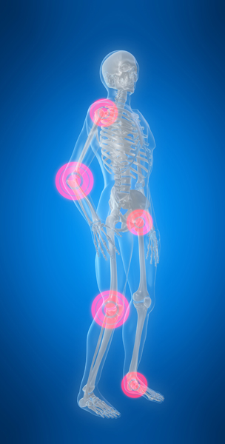
Primary Care Rheumatology
Program Director
Dr. Gina Rohekar
gina.rohekar@sjhc.london.on.ca
Number of residents
1 resident/year

Slide 33
Primary Care Rheumatology
1 year program based out of the St. Joe’s rheumatology clinic focusing on primary care based rheumatological conditions
Areas of focus:
OA
Inflammatory arthritis
Fibromyalgia
Tendonitis
Mechanical Back Pain
Connective Tissue Diseases
PMR

Slide 34
Family Med-Oncology
Program Director
Dr. John Lenehan
John.Lenehan@lhsc.on.ca
Number of residents
1 resident/year

Slide 35
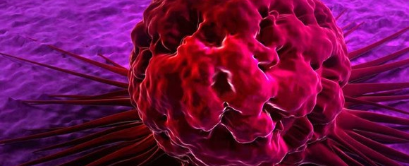
Family Med-Oncology
London: Inpatient medical oncology (1 block)
London: Rotations in lung, breast, GI, melanoma, head/neck, GU (5 blocks)
London: Hematology/Oncology (1 block)
London: Gyn/Onc (1 block)
London: Palliative Care/Pain Clinic (1 block)
Windsor: Inpatient Hospitalist-Oncology (1 block)
London or Windsor: Radiation-Oncology (1 block)
Windsor: General medical oncology clinic (1 block)
London/Windsor/Community: Elective – choice of community ICU, palliative care/hospice, research/admin, family medicine (1 block)

Slide 36
Individualized Program
Program Director
Dr. Kyle Carter kcarte@uwo.ca
Number of residents
1-2 residents/year
6-12 months programs available
Preference given to established programs over individualized program, with the exception of a well thought out program with objectives and a clinical supervisor.

Slide 37
Individualized Program
Must fulfill a community need
Within the extended scope of Family Medicine
Develop a curriculum design and find a supervisor from that field
Not an extension of core Family Medicine Training

Slide 38
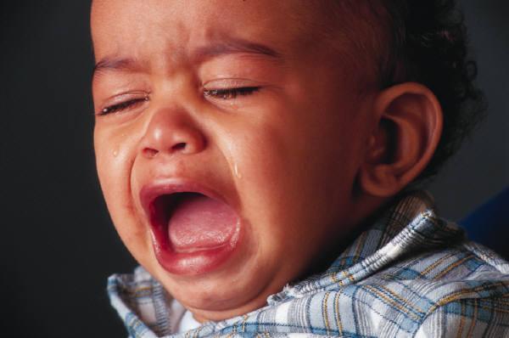
Enhanced Skills Requirements
Scholarly Activity
Resident Research Day
Longitudinal Clinical Experience
Connectivity to Family Medicine
Moonlighting

Slide 39
Scholarly Activity
The PGY3 project is not meant to be an onerous activity
All resident are eligible for funding and assistance from the Centre for Studies in Family Medicine
Acceptable modes of research include: case reports, quality improvement (QI) analysis, clinical/scientific research, self-reflection projects, etc.
All topics should be discussed with your program director

Slide 40
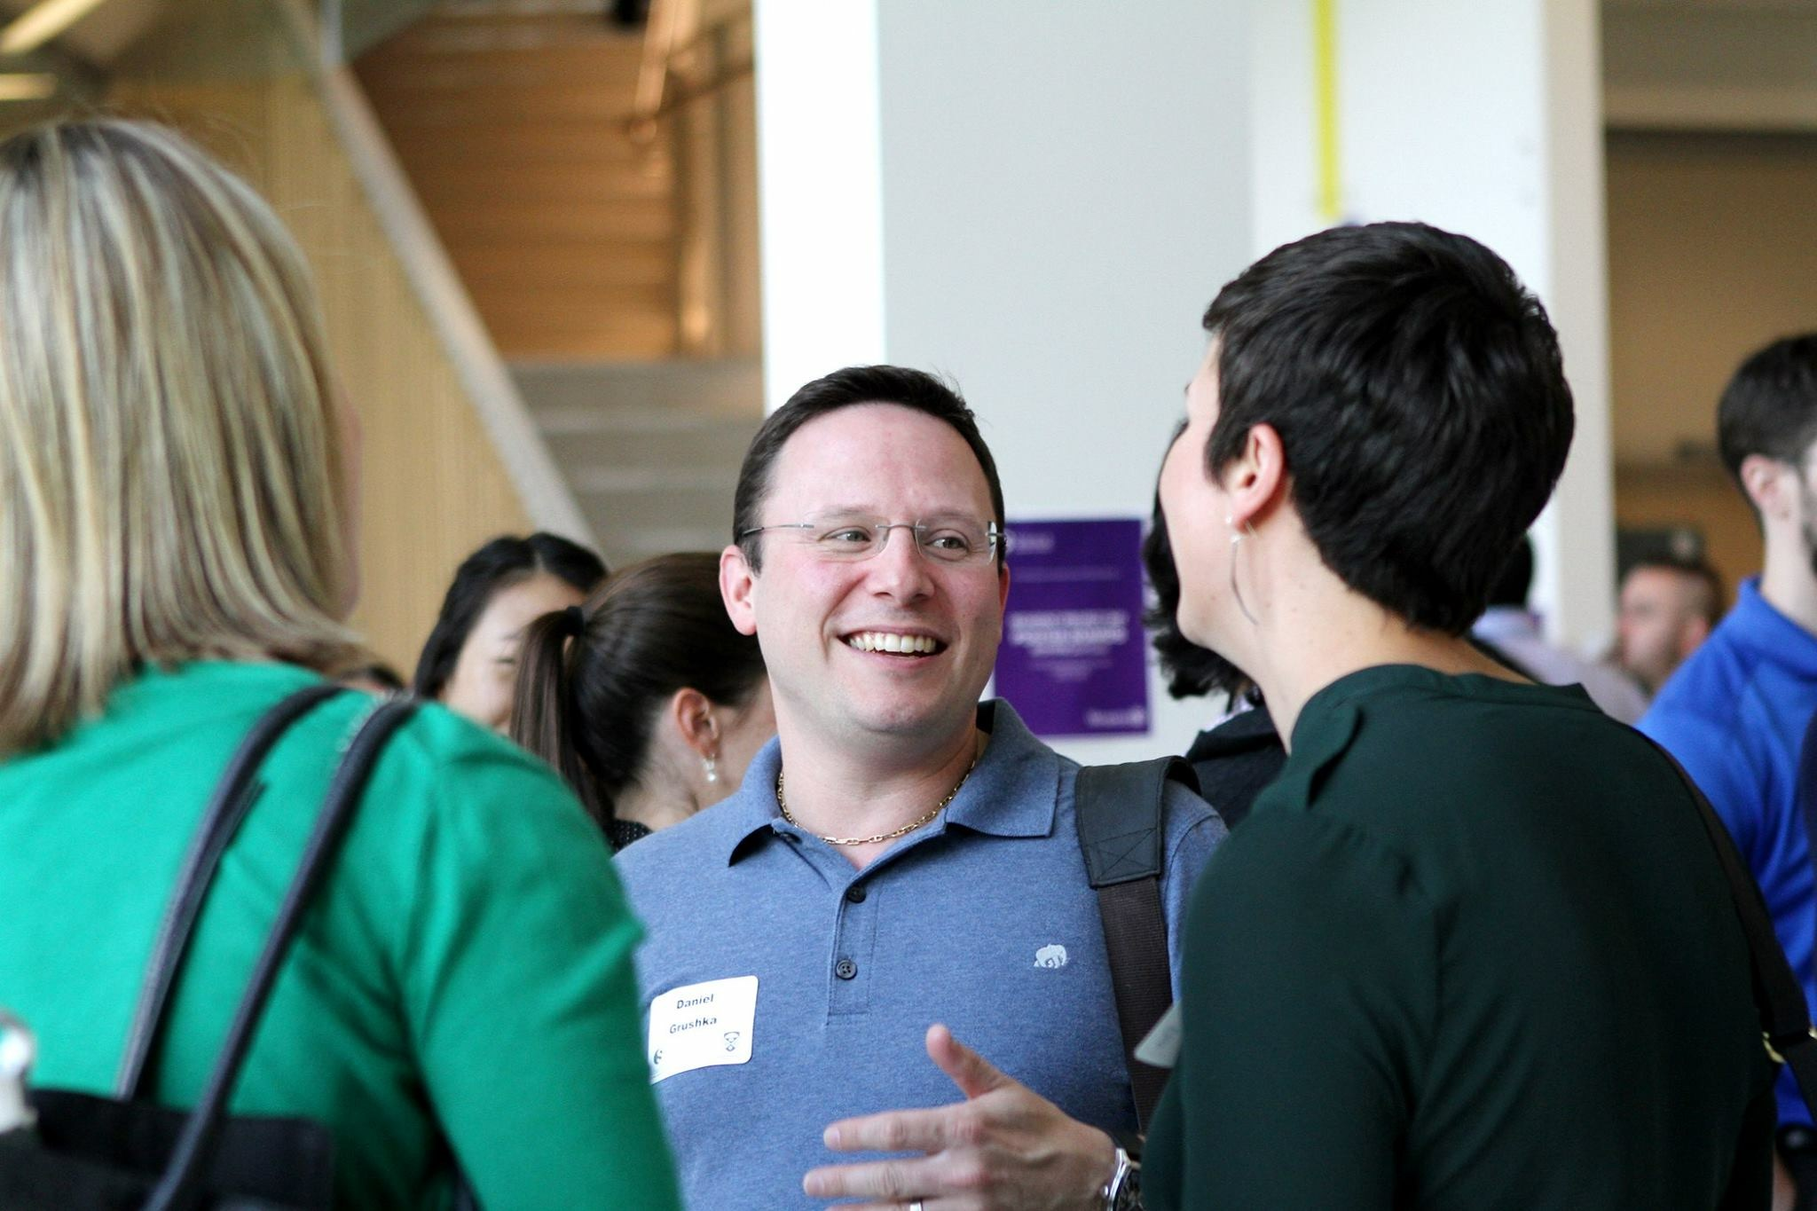
Resident Research Day
All ES skills residents are required to present at Resident Research Day 2024
Presentation format is that of a short oral presentation at Family Medicine Research Day in June
Abstracts will be due in April 2024

Slide 41
Field Notes – Longitudinal
All residents should identify 2 patients they see early in the year and ask permission to follow up with them later in the year (excluding EM)
Demonstrate continuity of care and comprehensive care within the enhanced skills program
Discuss these cases with the preceptor supervising you when you first encounter these patients.

Slide 42
Academic Connectivity
All residents are invited to:
Attend Family Medicine and PGME grand rounds
Teach at PGY-1 & PGY-2 half days
PGY-3 Seminar Series
Topics to be determined by the group in conjunction with the chief resident
Topics can include: critical appraisal, practice management, how to set up an office, how to incorporate, CMPA talk, etc.

Slide 43
Moonlighting
Refer to complete policy in the ES Resident Manual
Complete 50% of program and be in good standing
Cannot occur in Western affiliated institutes
Cannot interfere with ES commitments

Slide 44
Certification
All residents who successfully complete the program will receive:
UWO certificate
Category 1 programs are eligible for CAC from CFPC
Exams for certification:
Sports Medicine (conducted through CASM)
Palliative Care (conducted through UWO)
Emergency Medicine (conducted through CFPC)
Thesis required:
Academic Family Medicine

Slide 45
CACs
All residents in Category 1 programs who successfully complete the program will be granted a CAC from the CFPC
http://www.cfpc.ca/cac/

Slide 46
Application Process
Required documentation:
Application form on myFM / CaRMS application
4 reference letters
1 letter from PD
1 letter from primary FM supervisor
2 letters from ES related physicians
Letter of intent
CV

Slide 47
Eligibility
Current PGY2 resident in Family Medicine Training Program
Successful completion of a Family Medicine Resident Training Program in Canada prior to starting the ES program
As per the Postgraduate Education Office, IMG's who entered the postgraduate system through CaRMS in Ontario are eligible to be considered for Family Medicine PGY3 MOHLTC funded positions. IMG's from other provinces are eligible but would have to complete a ROS in Ontario prior to ROS in their original province of study.
Must hold CPSO, CMPA
Must pass prior to entering program:
LMCC I

Slide 48
Category 2 Enhanced Skills Programs
https://fm.schulich.uwo.ca/MyFM/es_application/

Slide 49
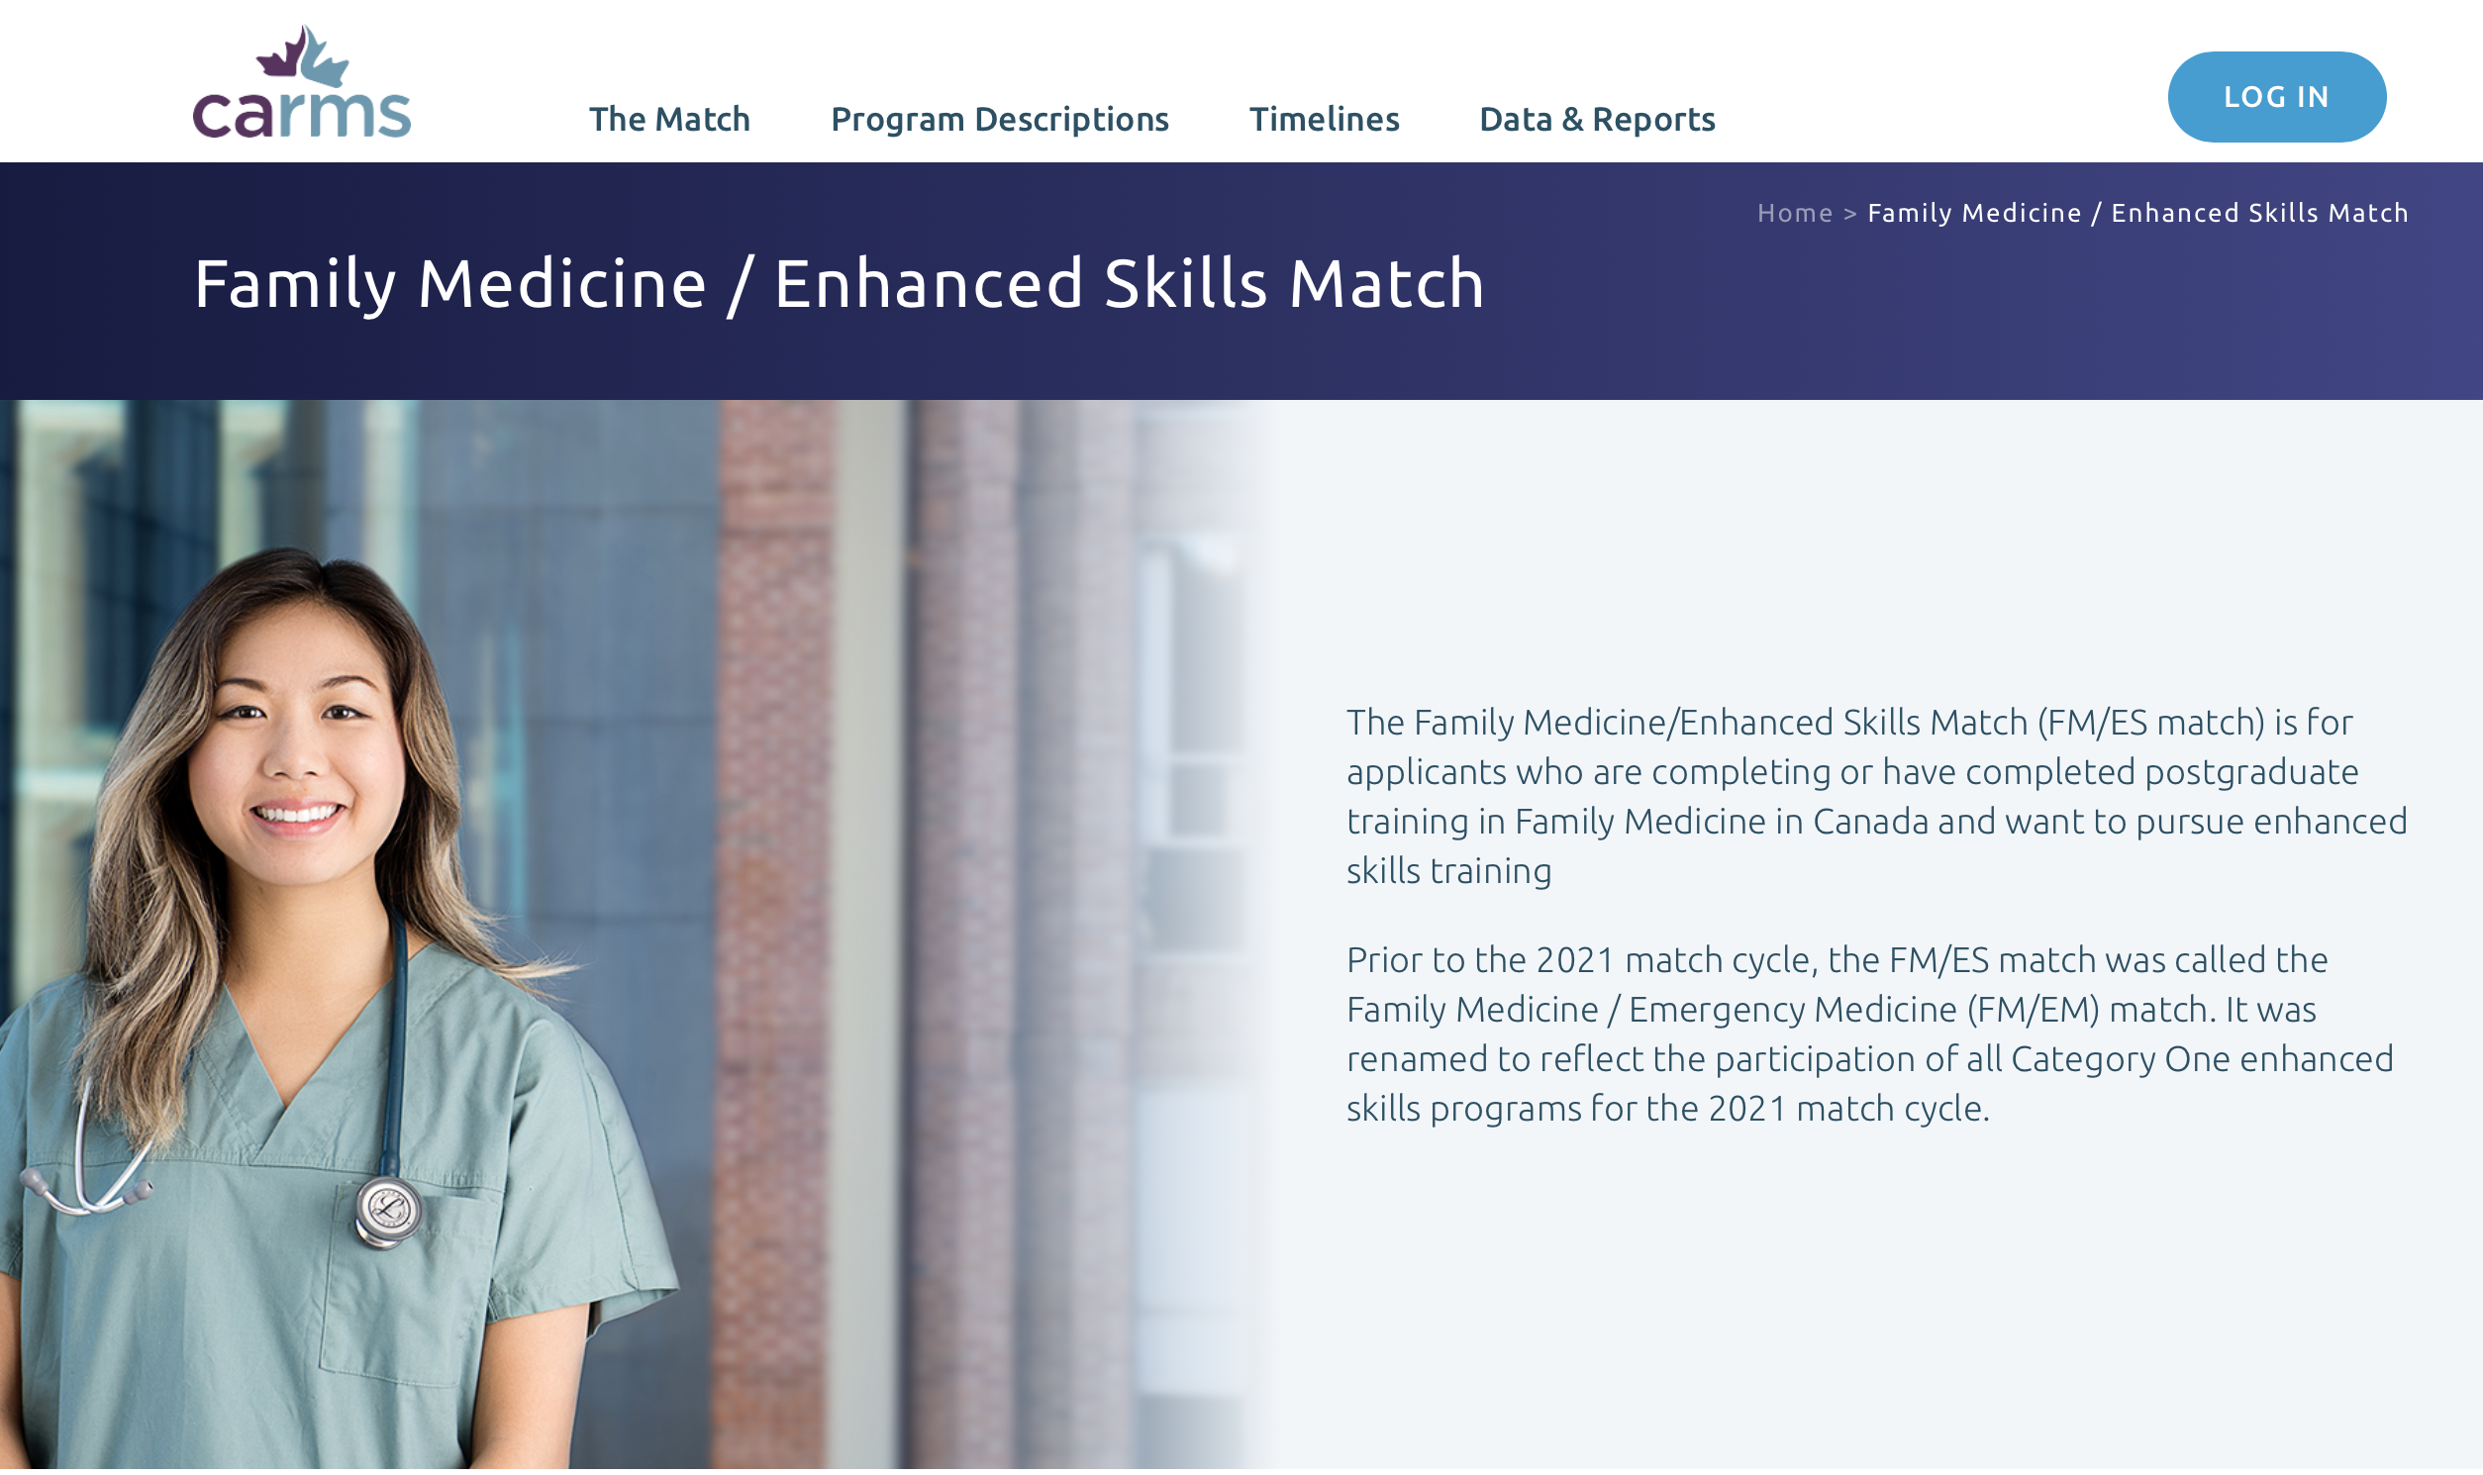
Category 1 Enhanced Skills Programs
https://www.carms.ca/match/family-medicine-enhanced-skills-match/

Slide 50
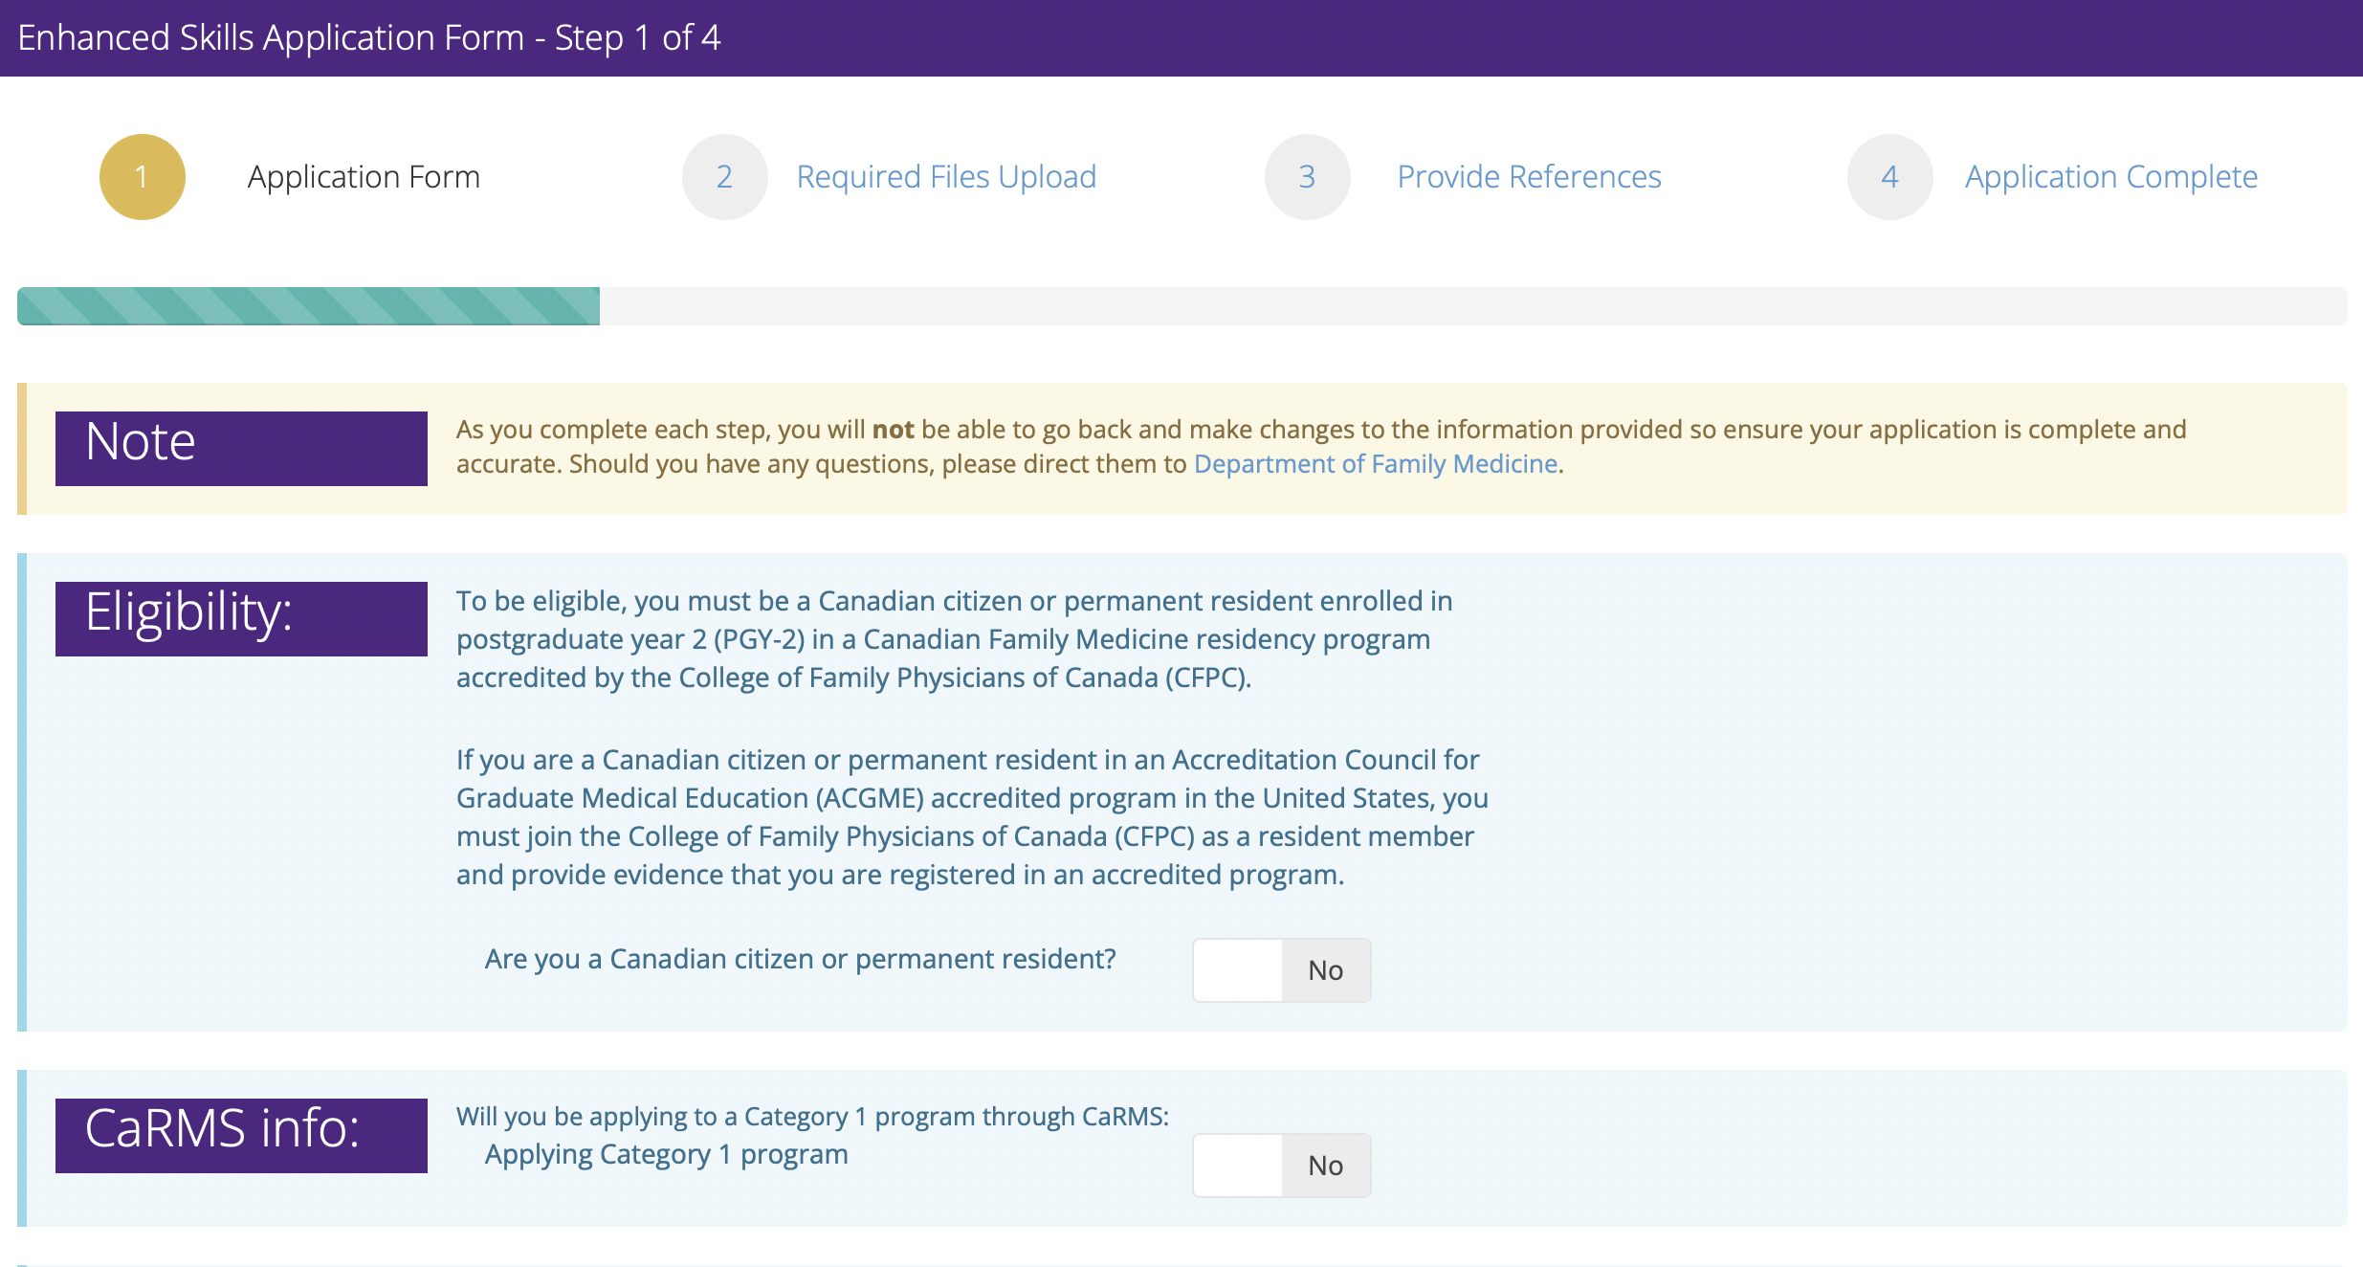
Category 2 Application

Slide 51
CaRMS Timeline
1 Aug. 2023
13 Sep. 2023
Application closes
13/14 Nov 2023
13 Dec. 2023
Category 1 CaRMS Match Date
1 July 2024
Start Date
30 June 2025
End Date
Applications open
30 Aug2023
Program Descriptions
6 Oct. 2023
Interview Offers
Western Interview Dates
Category 2 Timeline
1 Aug. 2023
Oct 15 - Dec 1 2023
1 July 2024
Start Date
30 June 2025
End Date
Application Opens
Rolling interviews and offers
Oct 6 2023
Interview Offers

Slide 52
Application FAQ
Category 2 offers completed prior to CaRMS match and is a binding contract with the University
Successful applicants are asked to withdrawal from CaRMS upon acceptance of position
Can apply to both or multiple programs
Off-cycle residents must be current PGY2 resident during application period (Aug 2-December 13th 2023) to apply
Interviews via ZOOM

Slide 53
Ministry of Health Re-entry
Practicing Family Physicians (minimum 1 year clinical practice)
Apply to the MOH directly
Deadline January 13th 2024
Approved applications presented to programs Februrary 2024
Programs offer interviews or decline based on capacity March 2024

Slide 54
How to prepare
Gain experience in your area of interest
Electives, horizontal electives, research, academic pursuits
Go beyond your training
Courses, conferences, certifications, etc
Demonstrate roundedness to your area
Understand the breadth of required training
Get facetime with those that may train you

Slide 55
What Were Looking For
What you plan to do with the training
A longitudinal preparedness for the year
Strong letters of reference from those within the field
Clear goals to achieve with the additional training
Demonstration of qualities that are important for your field

Slide 56
Things to Consider
What do you see your practice looking like?
How will that model serve your community?
Will the model remunerate you?
How will you career and practice change with time?

Slide 57
Resources
Family Medicine website: http://www.schulich.uwo.ca/familymedicine/
Please refer to website regarding updates from the department and the new Enhanced Skills Program website
Please refer to the orientation manual for all policies
All policies that govern PGY-1 & PGY-2 apply to PGY-3 residents

Slide 58
Questions??

