Slide 1
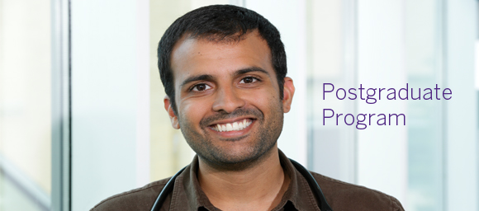
Resident Orientation
Jamie Wickett, Postgraduate Co-Director
Eric Wong, Postgraduate Co-Director

Slide 2
Announcements
Postgraduate Co-Directors
Accreditation Oct 2012
Chief Resident, Windsor Program – Dr. Vince Ruisi
Chief Resident, London Urban Program – Dr. Sarah Kawaguchi
Chief Resident, London Regional/Rural Program – Dr. Justin Mall
Package

Slide 3
Webcast Participants
Questions during the presentation email Kelsey.klages@schulich.uwo.ca to be answered

Slide 4
Greetings
Undergraduate Program
SWOMEN

Slide 5
Greetings from Undergrad!!
All residents play a vital role in teaching clinical clerks who rotate through the Academic Family Medical Centres.
Thank you for doing your part.
Here are a few things to keep in mind, as you have students with you.

Slide 6
Your Role…
If you are uncomfortable supervising clinical clerks, please let your supervisor know.
All clinical clerks have a set of objectives that inform their learning experience.
You may review the objectives which are available online

Slide 7
Your Role…
Students progress through family medicine is also “tracked” with their own tracking form, which you may be asked to sign – which you are allowed to do
These tracking forms are not meant to declare that a student is “competent” in a skill, but rather, that they have been exposed to the skill

Slide 8
Questions?
If you have any questions about the teaching experience or about a student, please do not hesitate in contacting me.
Thanks again!
George Kim, Undergraduate Academic Director
George.kim@schulich.uwo.ca

Slide 9
SWOMEN
SWOMEN = Southwestern Ontario Medical Education Network
Provides training experiences in the rural/regional settings to Western learners

Slide 10
SWOMEN
SWOMEN & FM:
Funds mileage/accommodations/preceptor for any rotation in Windsor
Funds PGY1 & 2 specialist elective rotations outside of London
Funds PGY3 rotations for specialist rotations outside London

Slide 11
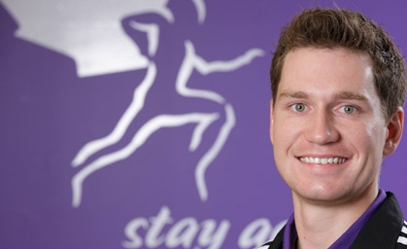
Objectives
Familiarize you with major aspects of the 2 years ahead

Slide 12
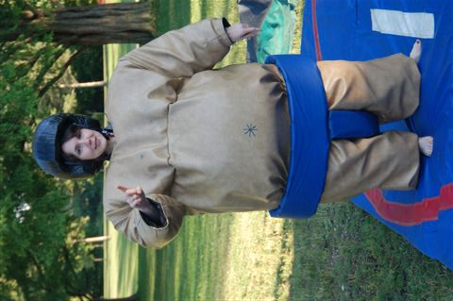
Important Contacts
Dr. Stephen Wetmore Chair
Dr. Jamie Wickett Postgraduate Co-Director
Dr. Eric Wong Postgraduate Co-Director – Accreditation, Academic Program ,Evaluation
Dr. Nelson Chan London Urban Program Director
Dr. Julie Copeland Rural/Regional Program Director
Dr. Dale Ziter Windsor Program Director
Dr. Lawrence Aoun Windsor Assistant Program Director
Dr. Daniel Grushka Enhanced Skills Program Director
Dr. Tania Rubaiyyat IMG Coordinator

Slide 13
How to contact?
Non-Windsor Residents
fmpgc@schulich.uwo.ca, 519-661-2037
If personal, can ask for direct contact with specific faculty
Windsor Residents
Ms. Tiffany Walsh, Family Medicine Education Assistant - Post Graduate Education
Ms. Debbie Curran, Family Medicine Secretary -Post Graduate Education

Slide 14
Important Contacts
Fred Ross Postgraduate Education Coordinator & Academic Program Coordinator fred.ross@schulich.uwo.ca
Sharon Story Scheduling & Student Relations Coordinator sharon.story@schulich.uwo.ca
Lin Hill Recruitment & Event Planning Coordinator
lin.hill@schulich.uwo.ca
Liz McInnis Pre-residency Program Coordinator
liz.mcinnis@schulich.uwo.ca
Dianne Brooks Program Assistant
dianne.brooks@schulich.uwo.ca
Kelsey Klages Resident Project Coordinator
kelsey.klages@schulich.uwo.ca
Pat Yong Finance Coordinator
pat.yong@schulich.uwo.ca

Slide 15
Resources
Email
UWO.ca
*.londonhospitals.ca

Slide 16
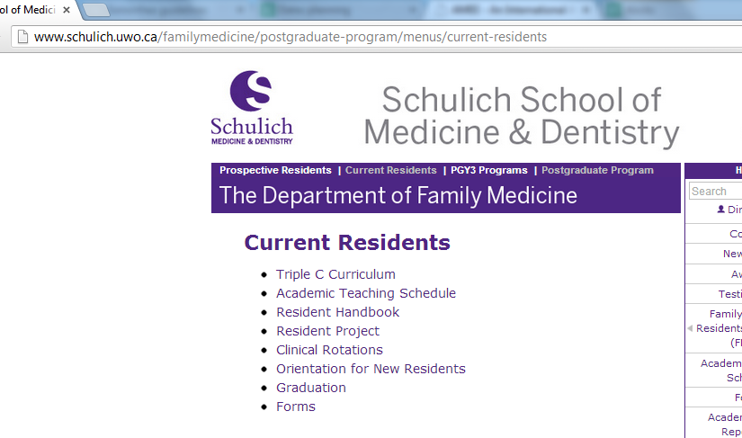
Resources

Slide 17

Program Overview

Slide 18
Minimum Requirements
Pass all rotations
Complete academic program
Complete residency project
Complete procedures policy requirements
Complete obstetric policy requirements
Complete faculty advisor meetings
Complete direct observations requirements
Residency & rotation objectives are here

Slide 19
Program Structure
Refer to specific program descriptions
Each rotation is 4 weeks long
There are 13 rotations per year; 26 rotations in your entire residency
Changeover = Tuesday

Slide 20
Program Structure
Enhanced Skills
Emergency Medicine
Academic family medicine
FM Anesthesia
Sport & exercise medicine
Care of Elderly
Child Health
Chronic disease management
Palliative care (mostly Windsor)
Women’s Health
Obstetrics
Hospitalist (Windsor)
Self-designed

Slide 21
Successful completion
Successful completion of all clinical rotations = NOT rated unsatisfactory/Does not meet expectations or Borderline (Multiple)
Categories of ratings:
Does not meet expectations/Unsatisfactory
Borderline
Meet expectations
Above average
Outstanding

Slide 22
Successful completion
Official failure = unsatisfactory/does not meet expectations
This requires formal remediation process
Can be appealed
Borderline ratings
An alert is sent to program and evaluation is reviewed
PG Exec Committee coordinates any action that needs to be taken

Slide 23
Successful completion
You MUST be your own advocate for your learning needs
Especially true in community-based rotations and off-service rotations
Tell EVERYONE, especially nurses, that you’re there and present!!!

Slide 24
Selectives vs. Electives
Selective = Limited to within Southwestern Ontario
Elective = Can be taken out of Southwestern Ontario, up to 3 maximum

Slide 25
Electives
Research Elective
4 weeks maximum
Must follow guidelines in resident handbook
Vacation Elective
1 rotation’s worth, 4 weeks
Still has 7 days of conference leave
Out-of province Elective
Can do 1 rotation
Mandatory pre-departure training (http://www.schulich.uwo.ca/GLOBALHEALTH)
You can spend a total of 3 rotations outside of Southwestern Ontario (LHINs 1 & 2)

Slide 26
Electives
Special Interest Elective:
Emergency Medicine
Focused on acute care skills; airway management and resuscitation with SimMan
Proposals accepted

Slide 27
Horizontal Electives in PGY2
To qualify:
Train in either London, London Regional or Windsor Program
Must be performing well in residency as judged by rotation evaluations
Preceptor must agree to choice of elective
Max. of 6 half-days during 4-month FM block @ 1 half-day per week

Slide 28
FM Rural
Mandated by CFPC
Occurs in PGY2 year
London Regional, Chatham-Kent, Stratford, Tavistock, Rural program – residents get 8 weeks of rural FM elective time
Eligible rotations (consult resident handbook):
In our catchment area with preceptor with appointment or via Northern Ontario Electives program, or Rural Ontario Medical Program
Not in city/town with academic centre/tertiary care hospital
Preceptor must work in >=2 settings in addition to office: inpatient, ER, delivery, housecalls, surgical assisting, GP-anesthesia, nursing home/chronic hospital care

Slide 29
Academic Program
Model: self-directed learning, like real-life CME for family practice
Monitoring:
Minimum of 150 hours / 150 credits of eligible educational activities in prescribed criteria per year (total 300 credits)
Must regularly log activities online
Must maintain proof of participation (e.g. certificates)

Slide 30
Academic Program
Cannot graduate unless complete all credits + evaluation of academic program
Teaching Schedule
Protected time every Wed 1-5 pm

Slide 31
Academic Program
Eligible activities:
Academic sessions
Protected time from ALL clinical rotations
Must fill-out on-line evaluation within 2 weeks of attendance to get credit
~1 mandatory session per month

Slide 32
Academic Program
Eligible activities:
Reading (journals, books, guidelines, McMaster modules, audio/video tapes, CFPC programs)
Educational sessions organized by residents & staff physicians (during FM block time)
Accredited conferences/courses/workshops: in person or on-line

Slide 33
Academic Program
Eligible activities:
Hospital rounds
Departmental Grand Rounds (1st Wed of each month 8:30-9:30 Shuttleworth)
Research/Publication (excludes residency project)
ACLS, ATLS, NRP, PALS, ALSO, ALARM, ACoRN, etc.
Practice audits/quality assurance (excludes department audits)

Slide 34
Academic Half-Days
1 Wed pm per month from 1 to 5 pm
2-3 topics per session
Credits automatically logged
Mandatory attendance:
Attendance will be taken for those attending in person and also collected for those that are attending by webconference (Blackboard) electronically
Within 40 km of London: attend in person
Greater than 40 km from London: webcast

Slide 35
Academic Program
Online logging system: http://ahd.uwofm.ca/
To get password:
Enter UWO email address
Click “Forgot your password” – an email with your password will be sent to your UWO email address
1-2 random audits per year to verify records
Update of credits provided by email Dec/June
Complete Credits 1 month before end date

Slide 36
Academic Program - Evals
Academic Half-Day Sessions:
Evaluations via One45 will be sent out to you the day of the session and be available for 14 days after

Slide 37
Academic Program
Ethics Curriculum:
Taught by Mr. Robert Sibbald, a clinical ethicist at LHSC
One 3 hour session per Family Medicine rotation
Attendance mandatory
Web-based modules to be developed
Schedule in One45 and will be emailed to you

Slide 38
Academic Program
Palliative Care Curriculum:
Mandatory in most programs
Two 3 hour seminars during Academic Half Day Schedule (Sept, Oct)
Attendance mandatory
Schedule in One45, and Windsor residents will be notified of their own schedule

Slide 39
Academic Program
Behavioural Medicine Curriculum:
Three 3 hour sessions per Family Medicine rotation – Attendance mandatory
Variety of topics – see schedule on-line
Mainly small group sessions
Focus on interviewing and communication skills through taped patient encounters and group discussion
Schedule in One45, Windsor residents will be notified of their own schedule

Slide 40
Academic Program
Continuous Quality Improvement:
6 online modules completed by 1st week September
Approximately 8 hours

Slide 41
Academic Program
Transition to Residency Series:
Mandatory educational sessions hosted by the Postgraduate Medical Education Office on the CanMEDS roles in July/Aug http://www.schulich.uwo.ca/medicine/postgraduate/academic-half-day-transition-to-residency/files/Linked/Transition%20to%20Residency%20Draft%20Poster%20update_1_3.pdf

Slide 42
Resident Project - CQI
Work in Groups at home Family Medicine site (groups up to 5 residents)
PGY1
Complete and submit Resident Project proposal to the Department ideally before the end of May, PGY1.
PGY2
Residents are required to present their progress to date at a Resident Project Progress Day in November/December
Residents are required to submit the final version of their Resident Project by end of March, PGY2 ( 6-8 double-spaced pages in total not including references
Residents are required to give a presentation (10 mins presentation with 5 mins for Q and A) of their project at Resident Project Day in June.

Slide 43
Procedures in Family Medicine
List in Handbook/Website
Core and Enhanced lists
http://ahd.uwofm.ca/login.asp?accessdenied=/procedures/Default.asp
Must have learned or performed each of the core procedures
Will have incomplete status in program until completed – will delay licensure

Slide 44
Procedures in Family Medicine
Curriculum:
1-2 small group based teaching sessions during FM block time
Use of DVD/online videos to aid instruction http://www.primarycareprocedures.com/
Each teaching unit does procedures

Slide 45
Obstetrics Policy
>=3 deliveries with family medicine preceptor
Experience during FM block time:
London: FMC preceptor, Women’s Health Clinic @ LHSC-VC
Mount Brydges/Strathroy: Strathroy OB clinic
Tavistock: None
Windsor: None
Ilderton: None
Petrolia, Hanover, Goderich, Chatham-Kent, Stratford: part of regular FM training
If incomplete will need to show that had adequate exposure to FM-OB role model and # of deliveries during OB rotation

Slide 46
Obstetrics Policy
Experience outside FM block time:
Use your FM selective or electives and choose FM preceptor who does OB
Evaluations/logbook: http://ahd.uwofm.ca/

Slide 47
Faculty Advisor Program
Why?
To provide longitudinal mentoring and support throughout residency
Who?
FM preceptor = default FA
Can speak with PG director, R/R coordinator, chief resident to switch
What?
3 meetings during PGY1
2 meetings during PGY2

Slide 48
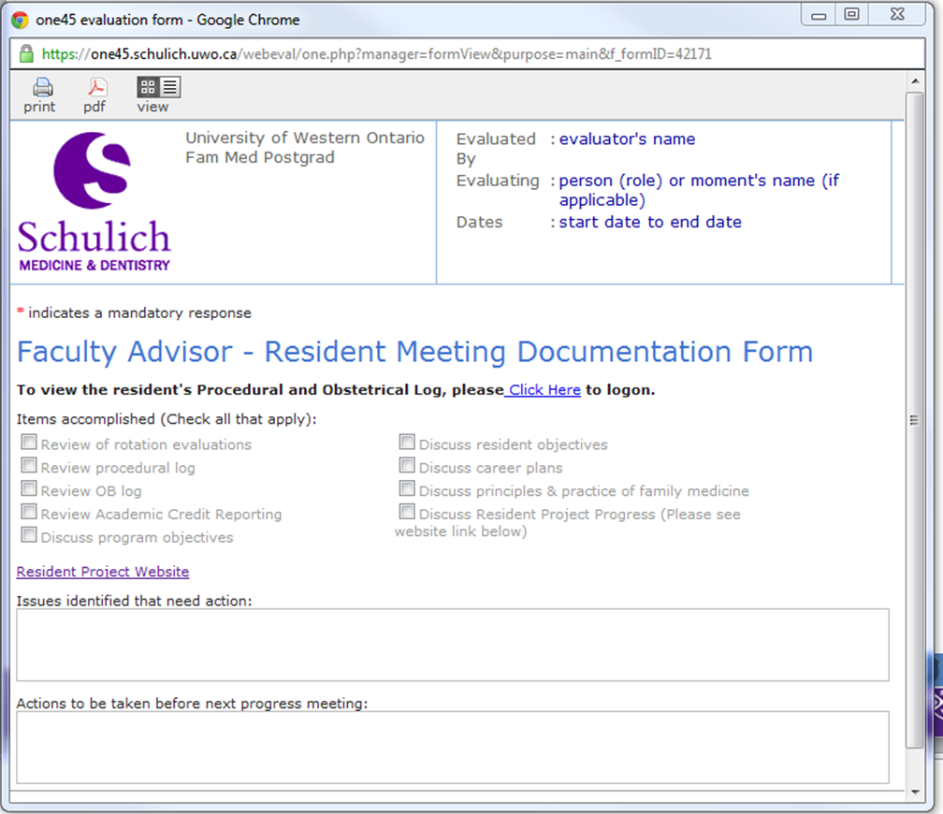
Faculty Advisor Program

Slide 49
Direct Observations
Each resident must have 32 documented direct observations by faculty over residency (4 per month of training)
2 of 32 have to be electronically recorded and documented
Documentation signed by resident and evaluator
Joint responsibility of resident & direct supervisor to ensure completion of observations
Some preceptors will be better than others in keeping track, so you can take things into your own hands and remind your preceptor if necessary, observation forms are here.
All signed forms must be submitted either to your preceptor or his/her secretary for safe-keeping

Slide 50
Other Policies
Not related to residency completion requirements

Slide 51
Other Policies
Accommodation/Travel Expense Policy
Professional Leave/Funding Policy
Vacation/Holiday Leave
Maternity/Parental/Health Leave Policy
Compassionate Leave Policy
Evaluation Policy
Rotation Change Requests Policy
Religious Holidays Policy
Code of Conduct
Appropriate Use of Internet, Electronic Networking and Other Media
Interaction with Industry
Resident Safety Policy
Resident Wellness
Miscellaneous Policies

Slide 52
Accommodation/Travel Expense Policy
Covers travel/accommodation necessary for core teaching-related activities and clinical rotations
Core teaching activities:
PGME Transition to Residency Series
Behavioural medicine curriculum (am)
Ethics curriculum (pm)
Mandatory Wed pm academic half-days
Courses: NRP (am)
For any teaching session in the am, accommodation can be provided for the night before at designated sites
Core clinical rotations: any non-elective rotations

Slide 53
Accommodation/Travel Expense Policy
If core clinical rotation occurs > 40 km from home-based teaching site:
1 round trip mileage
Accommodation provided or up to $600/month max
Submit receipts within 60 days of rotation completing
Computers are NOT always available at all accommodations although we strive to provide internet access at all sites
Good to have a laptop with wireless/wired access

Slide 54
Accommodation/Travel Expense Policy
Mileage reimbursement provided for core rotations ONLY @ established UWO rates
How to claim?
Mileage Logs Receipts must be submitted to Department of Family Medicine office to Ms. Pat Yong within 60 days of end of rotation
Travel Expense Forms/Policy

Slide 55
Professional Leave/Funding
Leave Policy:
Up to 7 working days per year (weekends do NOT count as working days for professional leave)
Eligible activities:
Any course or conference
Study days for examinations
Conditions of granting of leave:
Use request for leave form
Deemed not to have significant impact on the educational and clinical aspects of the rotation according to PAIRO guidelines (http://www.pairo.org/Content/Default.aspx?pg=1287)

Slide 56
Professional Leave/Funding
Funding Policy:
Eligible activities:
Any educational course (within or external to the residency program)
Any conference
Funding can be applied to ONLY registration fees
Available Funding:
$400/year
can be carried over
Conditions of reimbursement:
Original receipts submitted within 60 days of the incurrence of the expense

Slide 57
Vacation/Holiday Leave
Vacation:
4 wks per year (no carryover)
Request 4-6 weeks in advance using request for leave form and not later than March 1st
Can use vacation elective
Divide equitably
Follow instructions given to you by specific services: e.g. Medicine
You DO NOT have vacation until acknowledged by the service or us
Also notify services of time needed away from call (for Medicine)

Slide 58
Vacation/Holiday Leave
Vacation and Completion/Evaluation of Rotation:
If > 1 week of a 4 week rotation is missed due to any reason (including vacation leave), this may affect the evaluation of the rotation and remediation in the form of additional time in that particular rotation will be needed
If a significant portion of a 16-week family medicine core rotation is missed due to any reason (including vacation leave), this may affect the evaluation of the rotation and remediation in the form of additional time in family medicine will be needed

Slide 59
Vacation/Holiday Leave
Statutory Holidays
If residents work on a statutory holiday, they are entitled to a day off in lieu of that holiday. The "lieu day" is to be taken within 90 days.
All residents are entitled to 5 consecutive days off during the 12 day period encompassing Christmas Day and New Year’s Day. These 5 days account for Christmas Day, New Year’s Day, Boxing Day and two weekend days. Each resident will get either Christmas or New Year’s Day off.

Slide 60
Vacation/Holiday Leave
Reminders
You CANNOT take half a day of conference leave – but CAN take individual days
You CANNOT take vacation that is less than 1 week in duration
Academic half-day time is considered working hours – if you want to take off the Wednesday, you must use a conference leave day

Slide 61
Religious Holidays
Residents can take religious holidays as required
Must submit written request (can use request for leave form)
May not be granted due to popularity and patient care activities
Religious holidays taken = Conference Days

Slide 62
Maternity/Parental/Health Leave
Discuss with supervisor and respective program director ASAP
Inform Ms. Sharon Story
Written request & Doctor’s Note
Program requirements and schedule will be worked out with PG director
Maternity, paternity and health leave must be made up to complete a full 24 month program

Slide 63
Compassionate Leave
Special personal situation (e.g. death in family)
Discuss with PG director and rotation supervisor
Up to 7 paid working days
Additional time:
Vacation, professional leave
No pay leave

Slide 64
Evaluation Policy
Learning objectives for FM residents – website, Handbook
One-45 software – on line completion, resident evaluation and preceptor evaluation
Your responsibility to ask about your evaluation and try and see that it happens
Program incomplete if evaluations missing
Program will try to monitor this and give you feedback – email to you and preceptor
Borderline – possible remediation
Unsatisfactory/Does not meet expectations = failure; formal remediation process

Slide 65
Rotation Change Requests
Core rotations and core selectives:
Cannot be changed once scheduled
Due to off-service service scheduling and coverage issues
Electives
Cannot be changed within 4 weeks of the start date of rotation
Must fill out rotation change request form and get release from original service and acceptance from new service
Must advise Sharon Story of intention to change ASAP

Slide 66
Code of Conduct*
To guide proper behaviours in the teacher-learner context
Report to one of the following individuals
if you witness unacceptable behaviours:
Program Director
Associate Dean, Learner Equity and Wellness
Department Chair

Slide 67
Code of Conduct*
Unacceptable behaviours include:
Inappropriate comments related to sex, sexual orientation, race, religion, physical ability | Threat or contact when there is a perception of physical violence
Sexual harassment | Assigning tasks for punishment rather than for educational benefit
Denying educational opportunities as punishment | Public humiliation or intimidation
Grading used to punish rather than as objective performance evaluation | Preferential treatment
Intimate or sexual relationships between teachers and learners | Intimate or sexual relationships between clinical trainees and patients

Slide 68
Appropriate Use of Internet, Electronic Networking and Other Media*
To guide residents’ conduct around electronic media
Direct all questions or concerns to:
Immediate supervisor, OR
Program director

Slide 69
Appropriate Use of Internet, Electronic Networking and Other Media*
General principles:
Do NOT post any personal information about an individual patient or colleague without explicit consent
Communication with colleagues to remain professional
Do NOT misrepresent organizations that
you work in – e.g. hospital
Do NOT provide medical advice outside the educational environment
Always maintain academic honesty and integrity

Slide 70
Interactions with “Industry”*
Accredited events ONLY
No interaction with Pharma in absence of preceptor

Slide 71
Resident Safety
Provide principles around safety of residents when engaged in clinical/academic/research work as part of training
Main principle – A resident is excused from duties if in his/her opinion, his/her safety is at risk. A resident must notify his/her preceptor/program director immediately in this case

Slide 72
Resident Safety
Key points:
In all situations, safety risks should be discussed prior to start of clinical/academic/research activity between resident and preceptor
Weather conditions can make travel unsafe and prevent a resident from attending his/her duties
Residents generally should NOT work alone in the ambulatory setting during office hours
Residents may attend housecalls alone but safety must have been determined to be acceptable beforehand

Slide 73
Resident Wellness
You may be stressed….if you find yourself in difficulty:
Talk to your family/friends
Talk to your supervisor, faculty advisor or chief resident
Talk to your family physician
Talk to your program director
Talk to one of our confidential mentors

Slide 74
Resident Wellness
If you experience intimidation or harassment, report immediately to:
Your Program Director or Postgraduate Director
Wellness Office

Slide 75
Miscellaneous Policies
Consult resident handbook or Schulich Postgraduate Medical Education Office for further info on:
Issues related to Equity and Professionalism
Privacy and Security
Evaluation & Appeal Policy
Program transfer policy
Incomplete rotation guidelines

Slide 76
Reminders
Unique Pager:
Ensure that you discuss how your pager may or may not be used during each rotation.
Leadership Training Program
Personality Dimensions
Crucial Conversations
Crucial Confrontations
Influencer

Slide 77
Questions?

