Slide 2
Acuity STAR: Entering Competence by Design Activities Updated
Author: Derrick Gould
Last Update: September 2020
Target Audience: Faculty Members and Member Secretaries

Slide 3
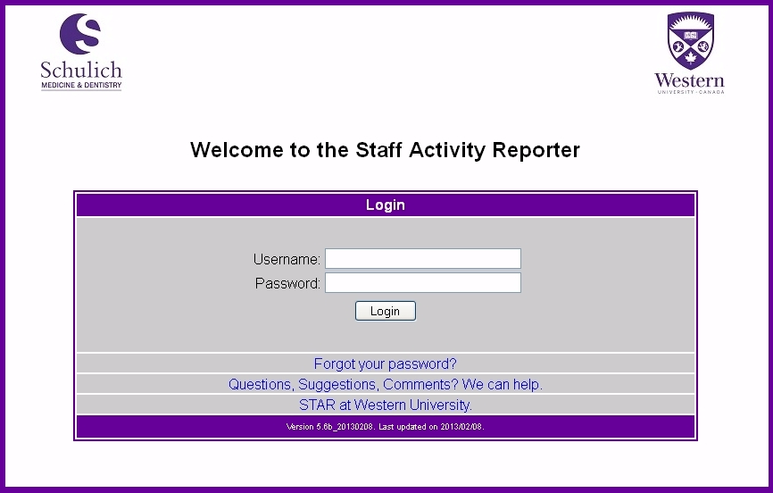
Login to STAR
https://star.schulich.uwo.ca

Slide 4
Administrative Committees

Slide 5
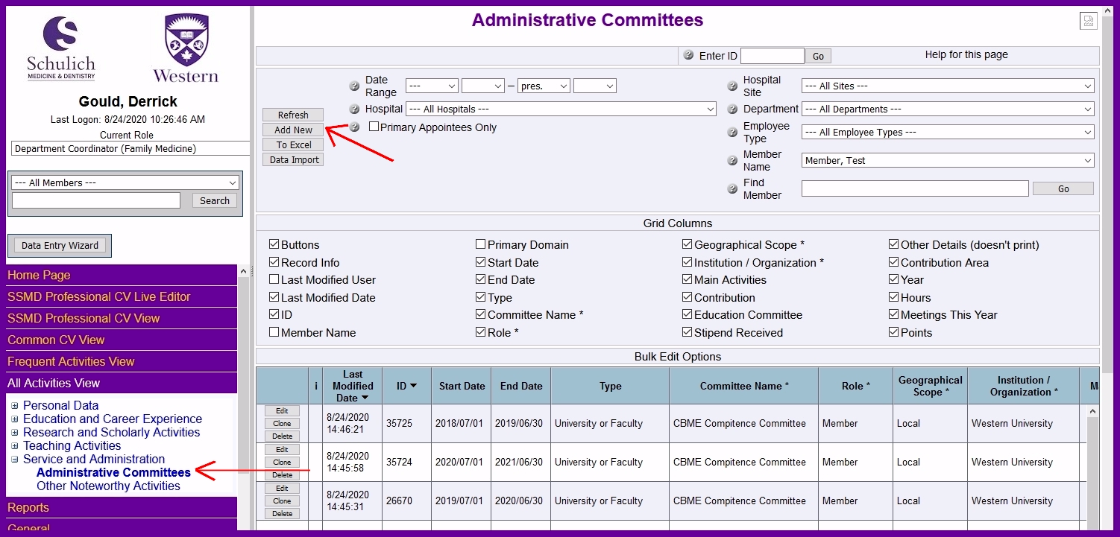
Administrative Committees
Open the All Activities View in the Left Menu
Open the Service & Administration Menu
Click on the Administrative Committees Page
Click on the ‘Add New’ button at the top of the content pane.

Slide 6
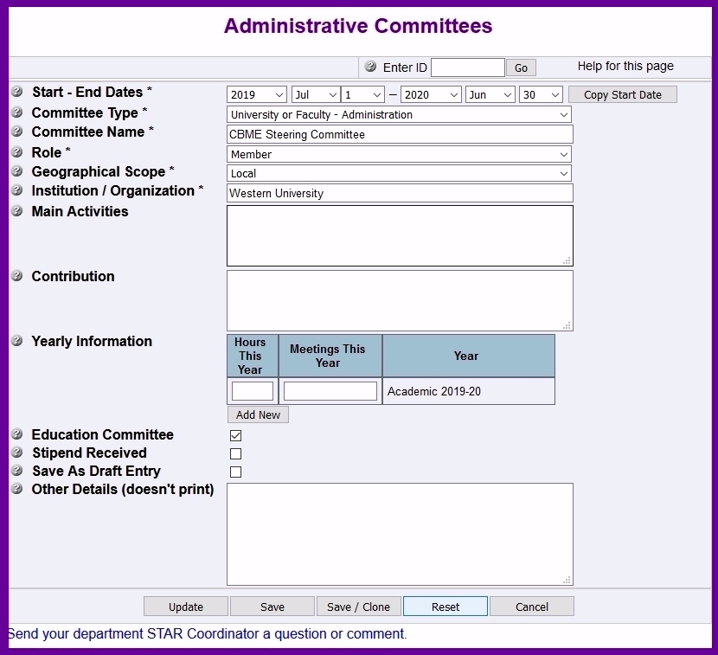
Open the Data Form
Enter the Academic Year Start & End Dates for your CBD Role
Select the Committee Type: ‘University or Faculty”
Enter the Committee Name (See List Below)
Select Your Role, Geographic Scope (Local) & Institution / Organization
Select the Education Committee Checkbox

Slide 7
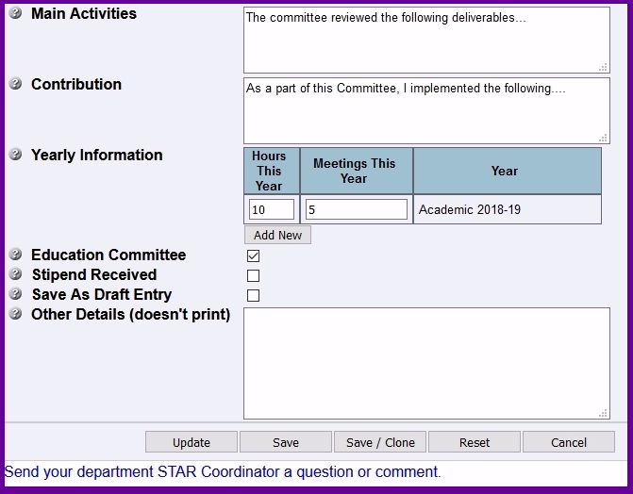
Add More Detail
Add the Main Activities of the Committee (Optional)
Add your specific contribution to the Committee (Optional)
Enter the number of Hours and meetings in the table by academic year (Optional)
Add in the number of residents for that Academic Year
Note:
The yearly information text box is only available once the record has been saved. It is not available when the record is new and unsaved.
…and then click the “Save” Button…

Slide 8
Program Teaching Administration

Slide 9
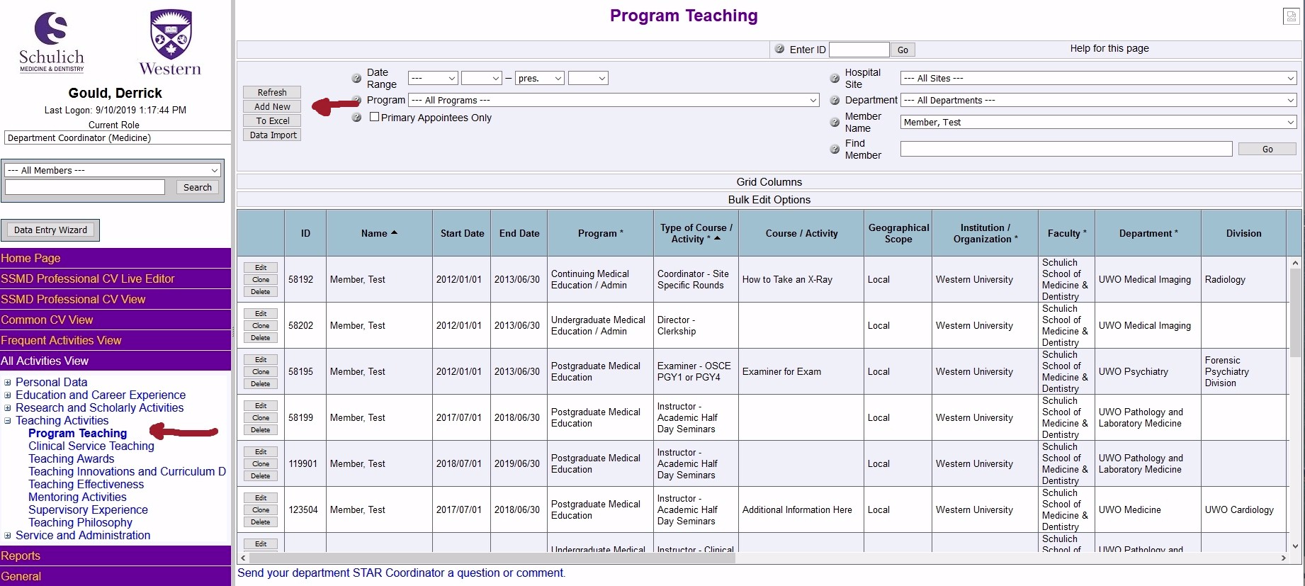
Program Teaching
Open the All Activities View in the Left Menu
Open the Teaching Activities Menu
Click on the Program Teaching Page
Click on the ‘Add New’ button at the top of the content pane.

Slide 10
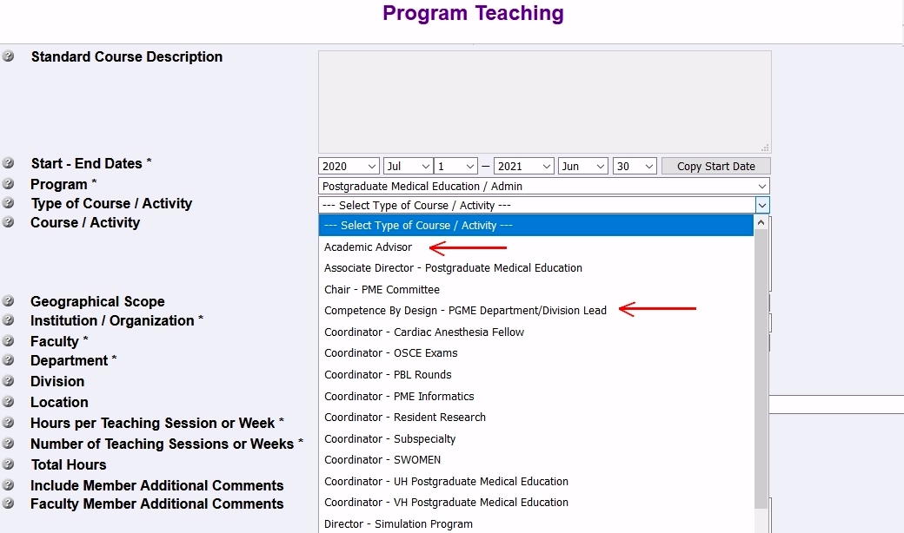
Open the Data Form
Enter the Academic Year Start & End Dates for your CBD Role
Select the program: ‘Postgraduate Medical Education / Admin”
Open the ‘Type of Course / Activity’ Picklist
Select one of the two CBD roles marked below.

Slide 11
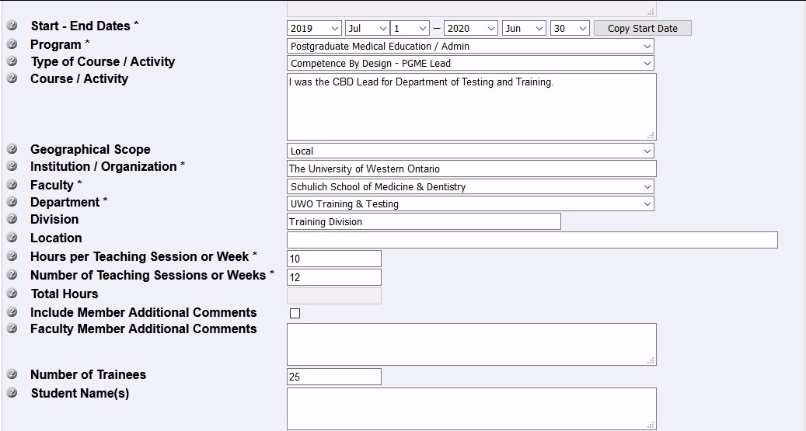
Add More Detail
Put comments about your role in the Course / Activity field
Add the Geographic Scope
Add the Institution/Organization, Faculty, Department & Division
Enter the number of Hours per Month & Number of Months
Add in the number of residents for that Academic Year
…and then click the “Save” Button…

Slide 12
Questions? Contact: Your STAR Coordinator or Derrick Gould

