Slide 1


Internal
Affairs:
Diseases of the GI Tract
PLAY
@Group 7

Slide 2
You are a Resident Doctor at a hospital. There are various patients seeking your help. Gather the information you need to diagnose and help them.
(To progress through the story, click the underlined text or click anywhere if there is no underline. Do NOT use your keyboard.)

Slide 3



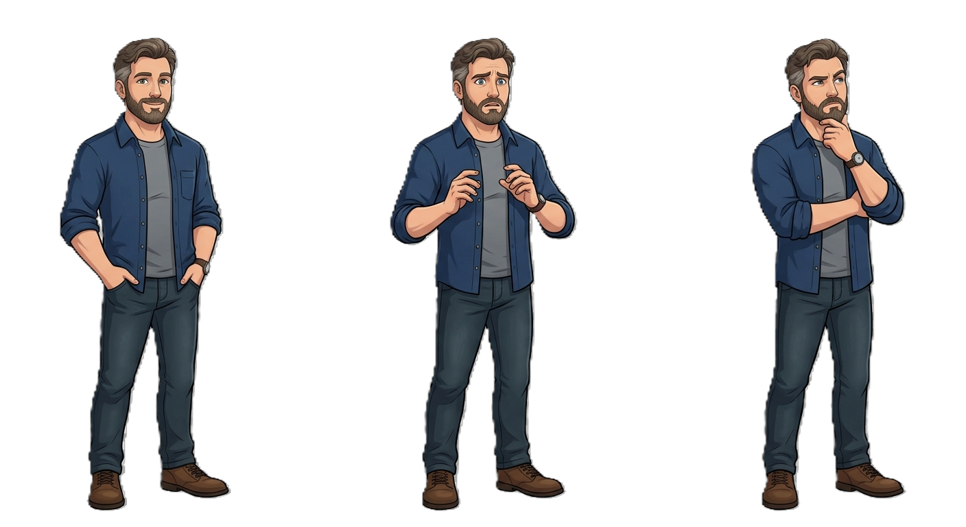

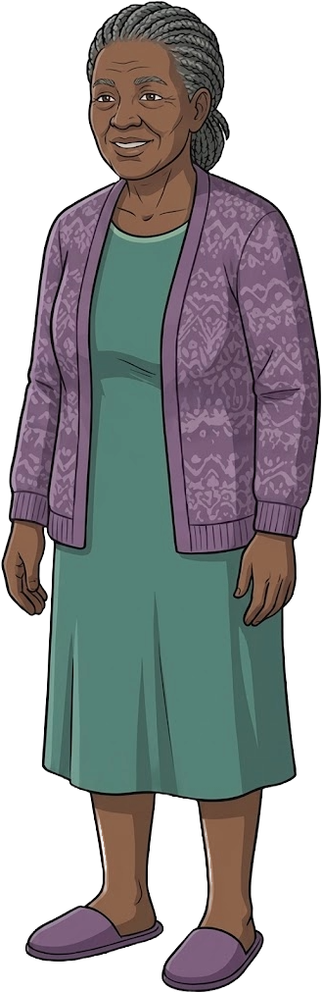

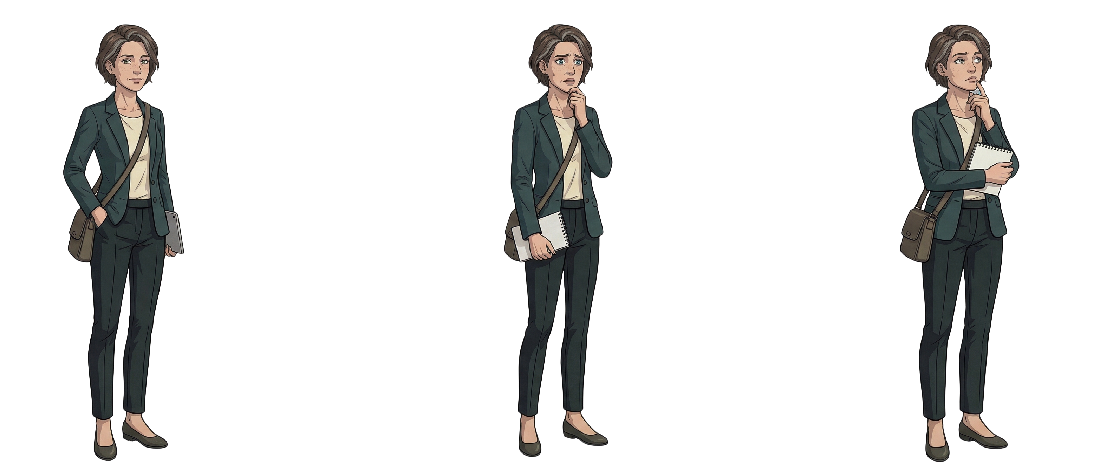
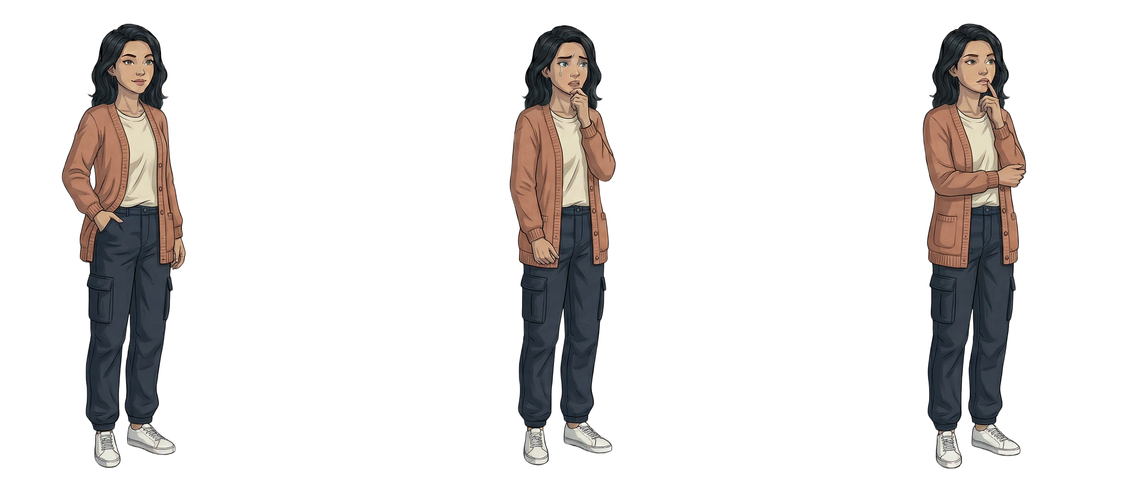
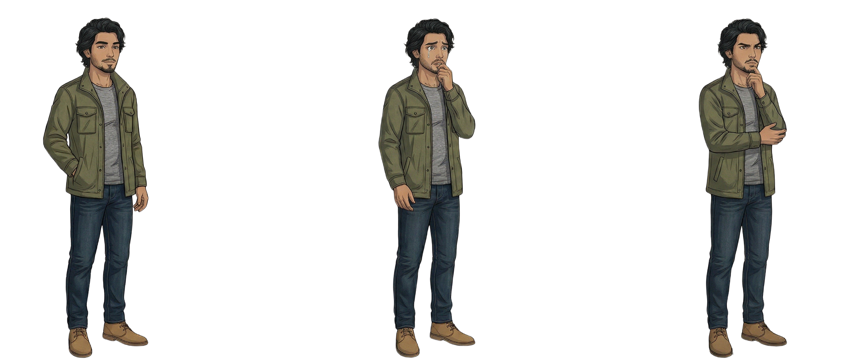
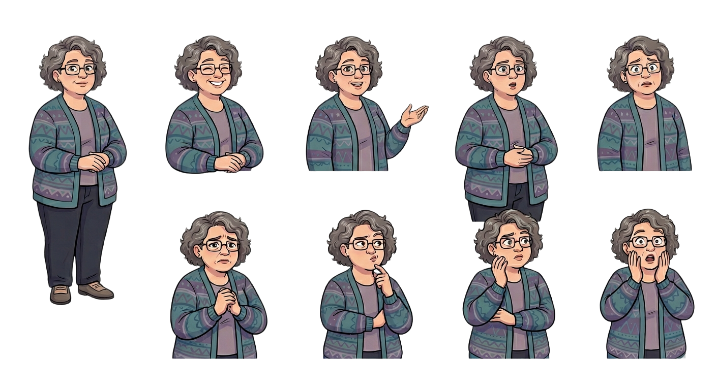

(Click on a patient to see them)
Nurse
  Good morning, Doctor! We have many patients in the waiting room today. Please pick who you want to see!

Slide 4
Patient 1: John Smith
53-year-old Male, Caucasian, 5 foot 7, 230 lbs

Slide 5
You
Let's get to know the patient first:
Ask about Symptoms
Ask about Lifestyle
Ask about Diet
Order Diagnostic Tests

Slide 6
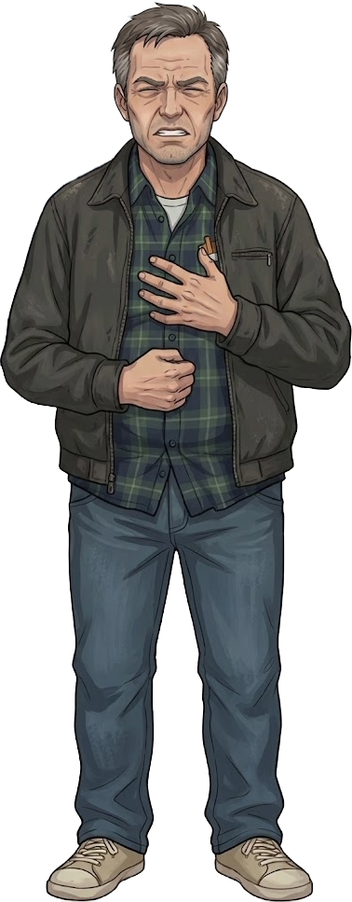
John Smith
For about 15 years now, I have had on and off cycles of a painful, burning sensation in my chest after eating a meal. Also, I get random bouts of difficulty swallowing food and have even had little bits of food or vomit come up my throat and burn the very deep back of my mouth before.

Slide 7
John Smith
I have been working at an office for 30 years. My job is so stressful, so I have been smoking around a pack a day during my breaks, for 25 years. I know it is not the healthiest, but sitting at my desk all day staring at a screen really stresses me out. I want to start doing exercise, but I get so tired from work.

Slide 8

John Smith
My diet is not the healthiest. When I get back from work, the only strength I can muster up to cook are some frozen meals or leftovers from work events. I honestly don't remember the last time I cooked a vegetable or ate anything "healthy".

Slide 9
You
What we have learned:
The burning chest pain sounds like heartburn, especially if it’s after a meal, the periodic swallowing trouble is dysphagia, and the stomach contents re-coming up the throat, is classic regurgitation.¹ Given these symptoms have been on and off for over a decade, I would say he has some chronic condition I can’t put a name to...
Notes:
https://pmc.ncbi.nlm.nih.gov/articles/PMC10245082/#S1 THIS IS [1]

Slide 10
You
After learning a bit about John, let's run some tests:
CT Scan of the Esophagus
Biopsy of the Esophagus
Endoscopy of the Esophagus
I am ready to Diagnosis

Slide 11

Radiologist
The CT scans of the esophagus were normal - some thickening of the esophageal walls, but nothing immediate to worry about.

Slide 12
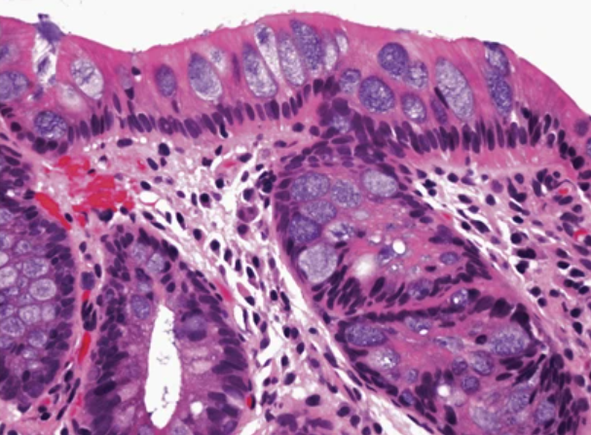
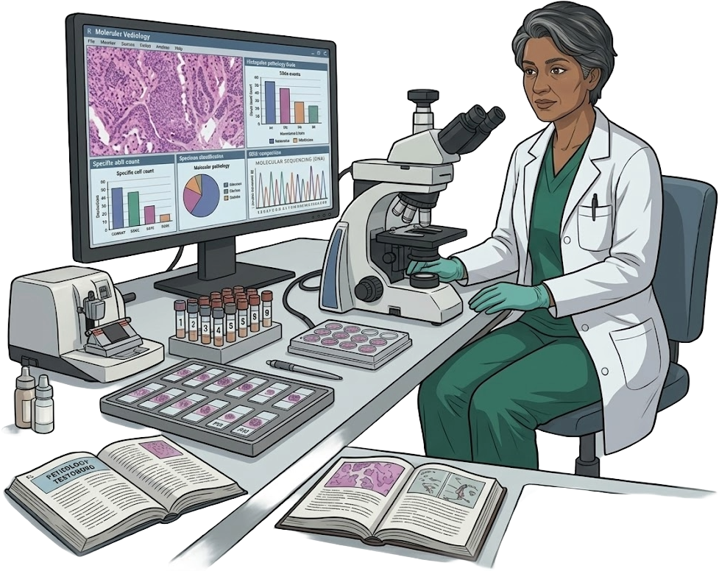
Pathologist
The biopsy was quite alarming; we found intestinal goblet cell metaplasia in the distal esophagus. In other words, the esophagus’ lining was damaged and then replaced by intestinal lining. This is probably due to damage in the lower esophagus caused by food coming back up from the stomach, in an attempt “protect” the esophagus skin. There was also some chronic and acute inflammatory cells in the area.²
For some good news, we found no dysplasia, or any abnormal, “pre-cancerous” growth.
Notes:
https://doi.org/10.1038/modpathol.2014.125 -> [2] text + Image

Slide 13

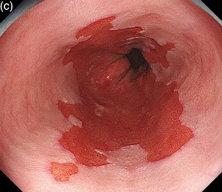
Attending Gastroenterologist
During the endoscopy, we saw that the lining of your lower esophagus has changed. Instead of the normal pale tissue throughout the entire esophagus lining, there is a section of salmon-colored tissue, about 1 cm or longer, stretching up from your stomach.³
We also did not find any dysplastic changes, no visible nodules or growths to suggest any pre-cancerous changes.
Notes:
https://pmc.ncbi.nlm.nih.gov/articles/PMC8828243/ -> Image + Text THIS IS [3]

Slide 14
You
With both patient info, symptoms, and tests, John has:
Esophageal Squamous Cell Carcinoma
Barrett's Esophagus
Esophageal Adenocarcinoma
Back to Diagnostic Tests

Slide 15
Attending Gastroenterologist
Esophageal Squamous Cell Carcinoma is INCORRECT
Although you are right, it is in the esophagus, there is a very tell-tale sign that our patient does not have esophageal cancer. The symptoms (specifically the chronic condition) and diagnostic tests are quite different in this case.
Hint: Re-look at the pathologist and biopsy report

Slide 16
Attending Gastroenterologist
Barrett’s Esophagus is CORRECT
Firstly, John fits with a lot of the risk factors for Barrett’s Esophagus (Caucasian, Male, over 50, smoker, obese, unhealthy diet). His symptoms follow chronic gastroesophageal reflux disease, a disease where stomach acids returns up the esophagus, which is common in Barrett’s Esophagus. Lastly, the biopsy and endoscopy solidify the diagnosis, intestinal goblet cell metaplasia, with no dysplasia, and salmon colored lining, shows no progression to esophageal adenocarcinoma.¹
Notes:
https://pmc.ncbi.nlm.nih.gov/articles/PMC10245082/#S1 THIS IS [1]

Slide 17
Attending Gastroenterologist
Esophageal Adenocarcinoma is INCORRECT
Although very similar in presentations at times, review the diagnostics tests and symptoms to see the specific differences between this patient’s case and Esophageal Adenocarcinoma.
Hint: look at the pathologist’s report.

Slide 18
Attending Gastroenterologist
Good job finding the correct diagnosis!
There are a few treatment or preventative options. First, lifestyle changes are needed, quit smoking, eat vegetables, do exercise. Secondly, we can give Proton Pump Inhibitors, which is medication to reduce that stomach acid, and heal the esophagus. Lastly, we need to set up multiple recurring visits to watch for any dysplasia, or any pre-cancerous cells that may show up, in case the Barrett’s Esophagus progresses to Esophageal Adenocarcinoma.¹
Notes:
https://pmc.ncbi.nlm.nih.gov/articles/PMC10245082/#S1\ THIS IS [1]

Slide 19

John Smith
Thanks Doc, after not going for check ups for over a decade, I’m glad I did. Who knew I could have almost gotten cancer. I will try to make lifestyle changes, protecting my esophagus, and coming to appointments to make sure I keep my disease at bay!

Slide 20
Patient 2: James Lee
68-year-old Male, Chinese, 5 foot 11, 158 lbs

Slide 21
You
Let's get to know the patient first:
Ask about Symptoms
Ask about Lifestyle
Ask about Diet
Order Diagnostic Tests

Slide 22

James Lee
My main issue is that I have a constant difficulty swallowing, and every time I eat, food gets stuck in my throat, and I get a sudden chest pain. Also, recently I started vomiting a lot. Also, I suddenly lost a bunch of weight recently, like around 40 pounds.

Slide 23
James Lee
I think I eat healthy. For breakfast, I have a couple of eggs and hashbrowns, lunch is some pre-made Hungry-Man boxes, and for dinner I always have some steak and potatoes. Not that I think about it, I don't think I have had a fruit or a vegetable in a while. Honestly, my appetite has been pretty low given how difficult it is to swallow.

Slide 24
James Lee
I am retired construction worker. I have been smoking 1 pack a day for about 40 years. I probably drink a couple of shots of whiskey a night, which helps get me through the evening.

Slide 25
You
What we have learned
Patient has constant long-standing dysphagia, or difficulty swallowing causing pain and the “stuck” feeling, vomiting, and chest pain when swallowing. They are 68-years-old and is at 40 pack-years (1 pack of cigarettes a day for 40 years), with multiple drinks of alcohol every night. They also don’t eat a lot of fiber (vegetables and fruits).

Slide 26
You
After learning a bit about James, let's run some tests:
X-Ray (Barium Swallow)
Biopsy of the Esophagus
Endoscopy of the Esophagus
I am ready to diagnose

Slide 27
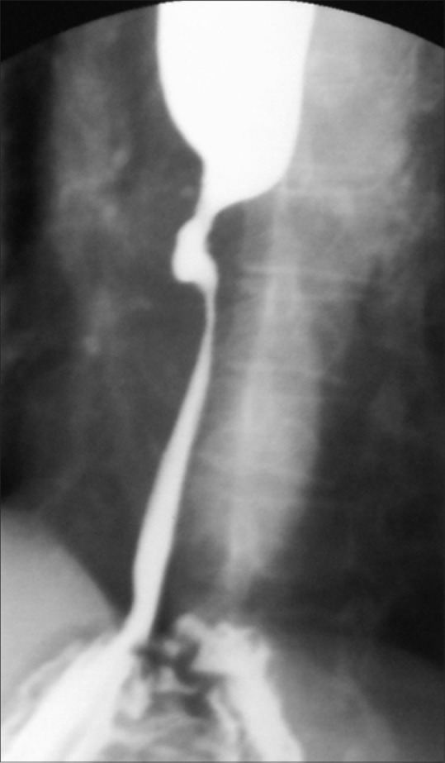
Radiologist
The Barium Swallow X-Ray revealed a narrowing and irregular lining contour of the middle third of the esophagus, suggestion there was an obstructive mass, in the middle of the esophagus.⁴
Notes:
https://pmc.ncbi.nlm.nih.gov/articles/PMC6639862/ THIS IS [4] -> Image citations

Slide 28
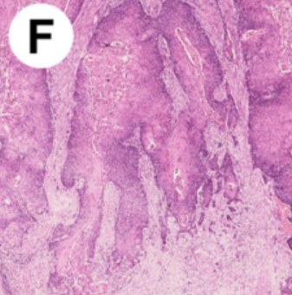
Pathologist
The biopsy has confirmed the presence of esophageal squamous lining dysplasia, or pre-cancerous, abnormal new cell growth, as well as hyper-keratinization, which is an abnormal thickening of the skin membrane in response to damage.⁵
Notes:
https://pmc.ncbi.nlm.nih.gov/articles/PMC7465394/#sec4-cancers-12-02160 THIS IS [5]

Slide 29
Attending Gastroenterologist
During the endoscopy, we saw a friable, fungating mass, which means it has broken from the esophagus’ lining and become an obstructive mass, approximately 28 cm from the incisors.

Slide 30
You
With both symptoms and tests, James has:
Barrett's Esophagus
Esophageal Squamous Cell Carcinoma
Peptic Ulcer Disease
Back to Diagnostic Tests

Slide 31
Attending Gastroenterologist
Barrett’s Esophagus is INCORRECT
Although James has a lot of the risk factors for Barrett’s Esophagus, the findings in his symptoms and diagnostic tests are very different. Also, he is missing the main symptom of chronic gastroesophageal reflux disease, a disease where stomach acids returns up the esophagus, which is indicative of Barrett’s Esophagus.¹
Hint: Examine all the diagnostic exams again.
Notes:
https://pmc.ncbi.nlm.nih.gov/articles/PMC10245082/#S1 THIS IS [1]

Slide 32
Attending Gastroenterologist
Esophageal Squamous Cell Carcinoma is CORRECT
Firstly, James meets all the risk factors (male, over 50-years-old, smokes, drinks alcohol), low-fiber intake). Secondly, his main symptom of dysphagia, weight loss, vomiting, and chest pain align with Esophageal cancer. The diagnostic tests which found a mass, and biopsy showing keratinization and dysplasia solidify the diagnosis as Esophageal Squamous Cell Carcinoma.^{5, 6}
Notes:
https://pmc.ncbi.nlm.nih.gov/articles/PMC7465394/#sec4-cancers-12-02160 THIS IS [5]
Lec slides citation for symptoms [6]

Slide 33
Attending Gastroenterologist
Peptic Ulcer Disease is INCORRECT
Although James has some overlap of risk factors for Peptic (smoking, alcohol, over 50-years-old), the main presentations are heavily different. Peptic ulcers, or open sores in the stomach or small intestine lining, are the most common presentation, and can sometimes present in the lower esophagus, but James did not have any stomach pain, or esophageal ulcers as seen in Peptic Ulcer Disease.⁷
Hint: Examine all the symptoms again.
Notes:
Lecture note citation: pre-fire (Andrews) [7]

Slide 34
Attending Gastroenterologist
Good job finding the correct diagnosis!
Unfortunately, it is cancer. There are a few treatment options, but the prognosis is not great as we diagnosed it at an advanced stage. For starters, you may need an esophagectomy, which is total removal of the esophagus. Alternatively, we can look at chemotherapy and radiation therapy options as well. If it is so far progressed, we may have to look towards palliative stenting, which is a metal cage place near the mass to return your esophageal function. You should firstly consult an oncologist.⁸
Notes:
Might have to explain the palliative stenting -> https://pmc.ncbi.nlm.nih.gov/articles/PMC9329770/ [8]

Slide 35
James Lee
Thanks Doc, I will book an appointment with the oncologist ASAP. I really wished I stopped smoking and drinking alcohol when I was younger. Who knew it would damage and eventually cause Esophagus Squamous Cell Carcinoma?

Slide 36
Patient 3: Ashley Sanchez
19-year-old Female, Puerto Rican, 5 foot 6, 120 lbs

Slide 37
You
Let's get to know the patient first:
Ask about Symptoms
Ask about Lifestyle
Ask about Diet
Order Diagnostic Tests

Slide 38
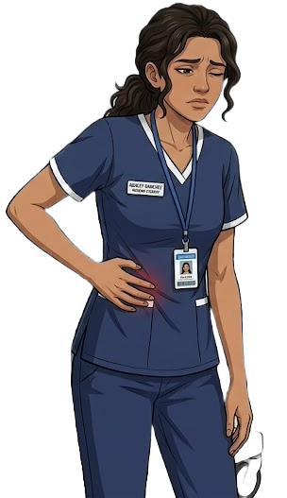
Ashley Sanchez
Hey Doctor, I was in clinical simulations when I got nauseous, started vomiting, and had fever-like symptoms. After dinner, I felt bloated and had an uncomfortable pain near my belly button but tried to sleep it off. But suddenly, there was a sharp, stabbing pain on my lower right stomach.

Slide 39
Ashley Sanchez
I am currently a Nursing student, normally I must spend 10 hours walking around at clinicals, but I suddenly felt so sick that my roommates drove me to the hospital. Also, since I have started my clinical simulations, it is really painful to poop.

Slide 40
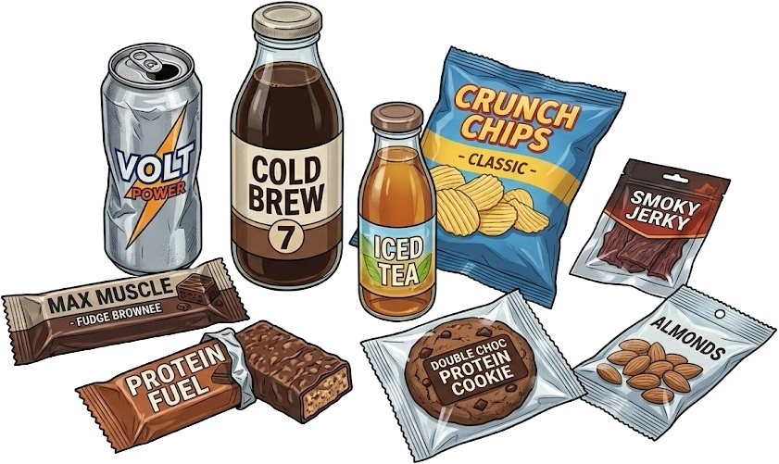
Ashley Sanchez
I normally eat really healthily, but because of clinical simulations I pretty much only eat granola and protein bars, as well as caffeinated drinks. I pretty much get home and sleep, because I have to wake up nice and early the next day.

Slide 41
You
What we have learned
Ashley initially had periumbilical pain, which is the area around the belly button, which progressed and localized the lower right area (quadrant) of the stomach area. She also had nausea, vomiting, and symptoms resembling a fever. She also has been under a lot of stress and been eating a lot of quick snacks and drinking caffeine.

Slide 42
You
After learning a bit about Ashley, let's run some tests:
Physical Exam
Blood Test
Ultrasound Test
I am ready to Diagnosis

Slide 43
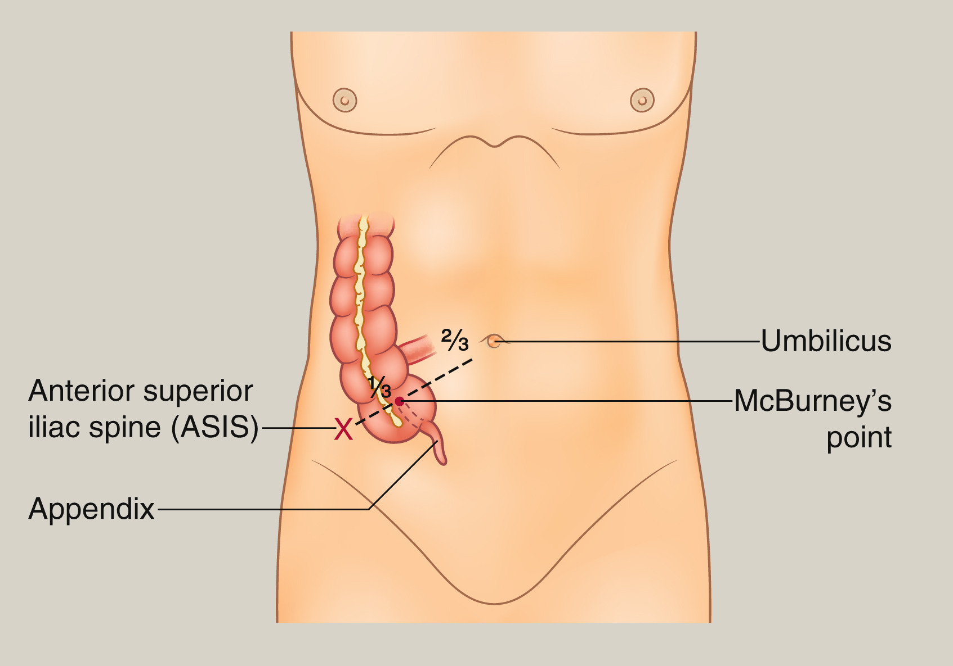
You
When pressing around the stomach, I found pressure and tenderness right at McBurney's point, right around the right lower quadrant.⁹
Notes:
https://www.sciencedirect.com/science/article/pii/S0263931917301345 -> McBurney’s Point image [9]

Slide 44
Nurse
Hey Doctor, the blood test appears normal except for ELEVATED White Blood Cells of 14,500/mm³! These are the cells apart of the body’s immune system and typically increase when fighting an attacker, which suggest she has a fever.⁶

Slide 45
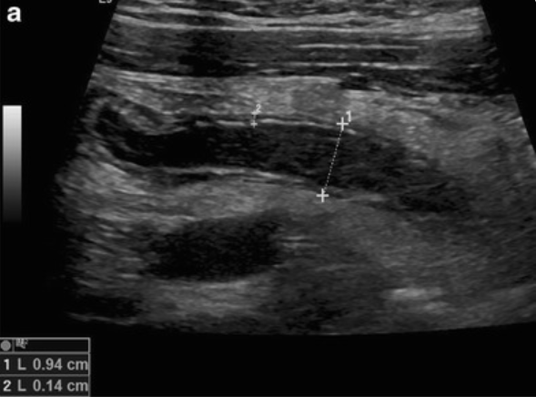
Radiologist
The ultrasound showed an inflamed appendix that is swollen to 9 mm and doesn't flatten when pressed.¹⁰
Notes:
[10] https://pmc.ncbi.nlm.nih.gov/articles/PMC4805616/ Ultrasound IMAGA -> Longitudinal (a) real-time US scan of acute appendicitis with thickening of the wall (crosses 2), target–sign, diameter > 6 mm (crosses 1) and free fluid surrounding the appendix (+)

Slide 46
You
With both symptoms and tests, Ashley has:
Diverticulitis
Crohn's Disease
Acute Appendicitis
Back to Diagnostic Tests

Slide 47
Attending Gastroenterologist
Diverticulitis is INCORRECT
Although Diverticulitis has some overlap with Ashley’s symptoms, there are some key clinical differences. Firstly, the pain is localized to the lower left quadrant of the stomach, instead of the right. Also, her appendix is affected, which differs from where diverticulitis occurs, which is the large intestine. Lastly, thought it can happen in most ages, diverticulitis typically occurs in older folk (over the age of 50-60).^{7, 11}
Notes:
https://jamanetwork.com/journals/jamasurgery/fullarticle/2817649 [11]
Might have to cite lec notes/slides [7]

Slide 48
Attending Gastroenterologist
Crohn’s Disease is INCORRECT
Crohn’s Differs from Ashley’s symptoms and Ultrasound results. Firstly, we would see persistent diarrhea (runny stools), compared to Ashley’s hardened stool. Secondly, the pain can be seen in the lower right quadrant, but is typically a cramping pain, rather than a stabbing pain. Lastly, the Ultrasound results show the appendix as the primary culprit.⁷
Notes:
Cite lecture notes for it -> Andrews stuff [7]

Slide 49
Attending Gastroenterologist
Acute Appendicitis is CORRECT
Ashley fits all the risk factors for Acute Appendicitis (10 to 25 years-old, hardened stool, low-fiber diet). Her symptoms also match, migrating and severe periumbilical pain to the right lower quadrant, nausea, fever, elevated White Blood Cell count, and pain/tenderness in McBurney’s point. The Ultrasound is double confirmation, as we see her appendix is inflamed and swollen.¹²
Notes:
https://my.clevelandclinic.org/health/diseases/8095-appendicitis [12]

Slide 50
Attending Gastroenterologist
Good job finding the correct diagnosis!
Because the appendix hasn’t ruptured, we need to get her to surgery immediately. First. Let's give her IV fluids and broad spectrum IV antibiotics, to kill any bacteria, while we prepare her for an appendectomy, or surgery to remove the appendix. This is a very common procedure, so hopefully she will be all healed up. If the appendix had perforated, there could have been a lot of complications like a peri-appendiceal abscess (localized infection causing pus collection) and generalized peritonitis (inflammation of the lining for all abdominal organs)!¹²
Notes:
https://my.clevelandclinic.org/health/diseases/8095-appendicitis [12]

Slide 51
Ashley Sanchez
Thanks, Doc, for figuring out my appendix was inflamed, and almost about to burst! I probably should not have only eaten protein and granola bars everyday, who would have thought it could rupture my appendix!

Slide 52
Patient 4: Evelyn Adebayo
68-year-old Female, Nigerian, 5 foot 4, 185 lbs

Slide 53
You
Let's get to know the patient first:
Ask about Symptoms
Ask about Lifestyle
Ask about Diet
Order Diagnostic Tests

Slide 54

Evelyn Adebayo
Hey Doctor, I recently had this constant, 'gnawing' pain in the lower left side of my belly, that has just progressively gotten worse. It feels crampy and tender and does not go away after using the bathroom. I recently also started having some constipation, and general malaise.

Slide 55
Evelyn Adebayo
I am a retired elementary school librarian. Now, I generally spend my days reading and knitting at home and rarely get out of bed.
Notes:
Lifestyle

Slide 56
Evelyn Adebayo
As I am getting older, I can't eat hard foods. So, I mostly eat soft foods, like white bread, pasta, canned soups, and very rarely do I eat raw fruits or vegetables, because they are too hard to chew!

Slide 57
You
What we have learned
Evelyn has a progressive onset of a crampy, constant pain in her lower left stomach, she also has recent constipation and fever-like symptoms as well. She has a very sedentary lifestyle, as she rarely gets out of bed. Lastly, she has a low-fiber diet and rarely eats any fruits and vegetables.

Slide 58
You
After learning a bit about Evelyn, let's run some tests:
Physical Exam + Vitals
Blood Test
CT Scan
I am ready to Diagnosis

Slide 59
You
When pressing around the stomach, there was significant tenderness and guarding in the lower left area, with no "rebound" tenderness. Temperature is at 38.6 °C and Blood Pressure is 135 over 85.

Slide 60
Nurse
Hey Doctor, the blood test appears normal except for ELEVATED White Blood Cells, 13,200/mm³! These are the cells apart of the body’s immune system and typically increase when fighting an attacker, which also suggest she has a fever.⁶
Notes:
Lec Slides [6]

Slide 61
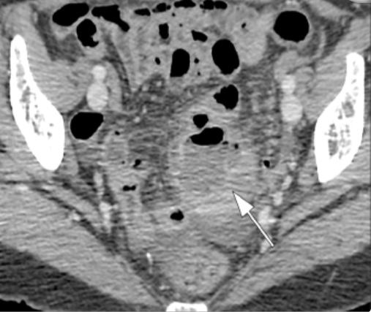
Radiologist
The CT scan shows multiple diverticula, or out-pocket pouches of the large intestine wall, in the sigmoid colon (last part of large intestine) and thickening of the intestine walls, some are surrounded by abscesses (pus collection from infection).¹³
Notes:
https://pmc.ncbi.nlm.nih.gov/articles/PMC7664754/#f9-dir-26-6-546 [13]

Slide 62
You
With both symptoms and tests, Evelyn has:
Diverticulitis
Crohn's Disease
Acute Appendicitis
Back to Diagnostic Tests

Slide 63
Attending Gastroenterologist
Diverticulitis is CORRECT
Firstly, Evelyn has a lot of risk factors for Diverticulitis (over 60-years-old, obesity, low-fiber diet, sedentary lifestyle). Secondly, she has the classic triad of symptoms, constant lower left stomach pain, fever, and elevated white blood cell count. The presence of diverticula with abscesses really confirmed the diagnosis for diverticulitis.¹¹
Notes:
https://jamanetwork.com/journals/jamasurgery/fullarticle/2817649 [11]

Slide 64
Attending Gastroenterologist
Crohn’s Disease is INCORRECT
Crohn’s Disease differs from Evelyn’s symptoms and onset. Firstly, we would see persistent diarrhea (runny stools), compared to Ashley’s current constipation. They are similar in elevated white blood count, and a constant cramping pain, and diverticula can be seen as well. However, Crohn’s Disease is a chronic inflammatory disease starting at a young age, and the symptoms and onset for Evelyn’s case are gradual and more acute.⁷
Notes:
Cite lecture notes for it -> Andrews stuff [7]

Slide 65
Attending Gastroenterologist
Acute Appendicitis is INCORRECT
Evelyn’s symptoms are different from one with acute appendicitis, her pain is more gradual and crampier, versus what is seen in acute appendicitis, which is a stab-like pain. Moreover, the area of pain is different, acute appendicitis is in the right lower stomach, versus Evelyn which has it in the lower left. The CT results showing diverticula also heavily suggest Evelyn does not have acute appendicitis.¹²
Notes:
https://my.clevelandclinic.org/health/diseases/8095-appendicitis [12]

Slide 66
Attending Gastroenterologist
Good job finding the correct diagnosis!
Because the diverticula don't appear to have any immediate complications, we are gonna put you on bowel rest, a liquid diet, and give you a course of broad-spectrum antibiotics, to prevent infection and inflammation spread. Eventually, you are going to have make some lifestyle changes, such as eating more fiber, physical activity, and drinking more water. Otherwise, your diverticulitis could worsen and cause complications like strictures (narrowing of the intestine), fistulas (abnormal passages between organs), ruptures of the diverticula which would require surgery.¹¹
Notes:
https://jamanetwork.com/journals/jamasurgery/fullarticle/2817649 + slides [11]

Slide 67
Evelyn Adebayo
Oh, thank you so much doctor! I will definitely make some changes, can't have old granny having surgery, when I have to knit my grandbabies some scarfs!

Slide 68
Patient 5: Leon Nowak
Patient file: 15-year-old, male, Polish, 5’8", 170lbs

Slide 69
You should ask some more questions:
Ask to elaborate on symptoms
Ask about diet
Ask about family history
Ask about present health issues
Order a diagnostic test

Slide 70

Leon
For the past few weeks, I’ve been having this unpleasant pain in my lower abdomen, along with diarrhea. Additionally, it constantly feels like I need to have a bowel movement, but often there’s nothing there. Finally, yesterday, when I went to the bathroom, it was bright red and bloody!^{7, 14}
Notes:
https://pmc.ncbi.nlm.nih.gov/articles/PMC10617668/

Slide 71
Leon
I just eat whatever my parents cook, which is pretty healthy. I don’t eat junk food that often, only the occasional soda or bag of chips. I’ve been trying to bulk up, though, so I’m eating a lot of protein recently.

Slide 72

Leon
My mom has some sort of bowel disease – I don’t remember what it was called. Do you think it could be something similar?⁷
Notes:
Lecture notes

Slide 73
Leon
Right now, none that I know of. But I do get colds often, and I also had a bad case of food poisoning a year ago – salmonella, I think it was.¹⁵
Notes:
https://pmc.ncbi.nlm.nih.gov/articles/PMC4745578/

Slide 74
You think you have enough information to begin some tests. What should you try?​
Colonoscopy
MRE scan
C.diff stool culture
Celiac panel
Make a diagnosis

Slide 75
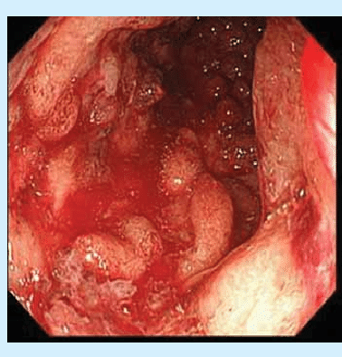
Colonoscopy
You perform the colonoscopy. In the patient’s rectum and distal colon, you find evidence of both acute and chronic inflammation, with mucosal lining that is red, swollen, and ulcerated. You notice that the entire region looks affected, without any healthy-looking areas.⁷
Notes:
https://www.researchgate.net/figure/Colonoscopy-photographs-showing-extensive-and-deep-ulcers-together-with-nearly-total-loss_fig2_265093225

Slide 76
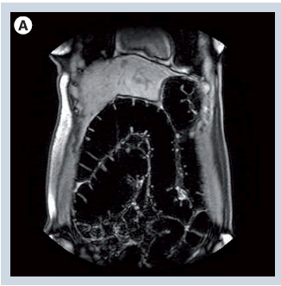
MRE
You perform the MRE. Everything appears normal, with the walls of the small and large bowel not showing any considerable signs of thickening or thinning. This likely means if there is inflammation present in the bowel, it is mucosal in nature, only affecting the lining.⁷
Notes:
https://www.openaccessjournals.com/articles/mri-of-the-colon-10985.html

Slide 77
C.diff stool culture
GDH antigen: Non-Reactive
Toxin A and B: Not Detected
NEGATIVE: No evidence of C.diff infection

Slide 78
Celiac panel
tTG-IgA levels: < 2.0 U/mL
NEGATIVE: No evidence of celiac disease

Slide 79
You think you have enough information to make a diagnosis. What does Leon have?​
Celiac disease
C.diff infection
Crohn’s disease
Ulcerative colitis

Slide 80
Celiac disease is incorrect.
The celiac panel returned negative, meaning celiac disease is likely absent. Additionally, the patient’s symptoms are not consistent with celiac disease.⁷

Slide 81
C.diff infection is incorrect.
The C.diff stool culture returned negative, meaning celiac disease is likely absent. Additionally, the patient’s symptoms are not consistent with C.diff infection.⁷

Slide 82
Crohn’s disease is incorrect.
Although the patient mentioned family history of IBD, the patient’s symptoms are inconsistent with Crohn’s disease – normal, not bloody diarrhea is commonly observed. Additionally, the MRE didn’t show signs of transmural inflammation, and the colonoscopy showed that skip sections were not present.⁷

Slide 83
Ulcerative colitis is correct!
The patient presented with bloody diarrhea (hematochezia), urge to defecate (tenesmus) and lower abdominal pain, all common signs of ulcerative colitis. The colonoscopy showed both chronic and acute inflammation of the rectum and distal colon, further confirming Crohn’s disease. Additionally, the MRE didn’t show any signs of transmural inflammation, setting it apart it from other IBDs such as Crohn’s disease. Finally, the patient mentioned their mother also suffered from an IBD, and concordance in first-degree relatives is high in ulcerative colitis patients.⁷

Slide 84
You
I’m sorry to tell you this; it looks like you have ulcerative colitis. This is a condition where your immune system responds in an unregulated, exaggerated manner to your gut microbes, causing inflammation in your GI tract. It doesn’t have a definitive cure, and you’ll likely have periods of flares and remission throughout your life.⁷
Notes:
https://www.ncbi.nlm.nih.gov/books/NBK551714/

Slide 85
You
Since you’re young and your condition isn’t too severe, we’ll start you on Mesalamine, an anti-inflammatory that helps reduce inflammation. We’ll also prescribe you Prednisolone, a corticosteroid, that should help during flares. If it gets worse, we also have the option of a proctocolectomy – the surgical removal of your large bowel. Ulcerative colitis increases your risk of large bowel cancer, so we’ll have you come in for periodic colonoscopies or biopsies, but as long as you do, you shouldn’t need to worry too much about it.^{7,18}
Notes:
https://www.ncbi.nlm.nih.gov/books/NBK551714/

Slide 86
Patient 6: Diane Hawthorne
Patient file: 43-year-old, female, Caucasian, 5'2", 150lbs

Slide 87
You should ask some more questions:
Ask to elaborate on symptoms
Ask about diet
Ask about lifestyle
Ask about family history
Ask about medication
Order a diagnostic test

Slide 88
Diane
I’ve been having pain in my upper abdomen for the past few weeks. I thought it was just because I’ve been stressed, but a few days ago I also had black stools that look kind of like tar, which really worried me. I’ve also been tired and dizzy recently.⁷

Slide 89
Diane
I would say my diet’s pretty good. I try to eat a balanced diet with lots of fibre, and we rarely have junk food. My kids sometimes don’t like the food that I make, though, so we get takeout every so often.

Slide 90
Diane
I think I have a healthy lifestyle. I get good sleep, and I go to the gym a few times every week. I also go on bike rides with my family every so often. I do smoke, but not often, and I’ve been trying to quit.

Slide 91
Diane
My dad’s side of the family has had a history of GI issues. My sister has celiac disease, and my grandfather is currently undergoing treatment for colorectal cancer. I think my dad had ulcers in the past, as well.⁷

Slide 92
Diane
I’m not on any medications.

Slide 93
You think you have enough information to begin some tests. What should I try?​
Urea breath test
Antibody test
Endoscopy
Make a diagnosis

Slide 94
Urea breath test
Delta Over Baseline (DOB): 4.1
POSITIVE: Evidence of active H. pylori infection

Slide 95
Antibody test
IgG antibodies: 1.3 U/mL
POSITIVE: Evidence of active H. pylori infection

Slide 96
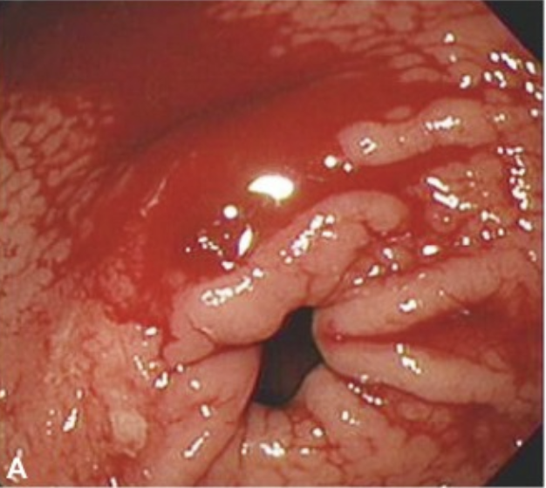
Endoscopy
You perform the endoscopy, lowering the camera in the patient's stomach. Next to the antrum, you find a well-circumscribed 1.8cm hole surrounded by blood. Upon further inspection, you see what appears to be a vessel at the base of the ulcer. Additionally, the walls of the stomach look red and bumpy, showing signs of inflammation.⁷
Notes:
https://www.e-ce.org/journal/view.php?number=6698

Slide 97
You think you have enough information to make a diagnosis. What does Diane have?​
NSAID-associated peptic ulcer
H.pylori-associated peptic ulcer
Diverticulitis
Large bowel adenocarcinoma

Slide 98
NSAID-associated peptic ulcer is incorrect.
Both the antibody test and the urea breath test returned positive, confirming H.pylori is present. Additionally, the endoscopy showed signs of inflammation, meaning infection is likely what caused the ulcer. Finally, the patient isn’t taking any NSAIDs.⁷

Slide 99
H.pylori-associated peptic ulcer is correct!
The endoscopy clearly showed a well-circumscribed 1.8cm hole in the wall of the stomach – a gastric ulcer – surrounded by blood. Additionally, the endoscopy showed signs of inflammation, meaning infection is likely what caused the ulcer. H.pylori is a strain of bacteria that is transmitted through bodily fluids, common in families (especially mother-child). Once inside the stomach, it adheres to the surface cells and releases toxins such as CagA and VacA, which attack the lining. It also causes inflammation, which can increase acid production and further damage the stomach. Additionally, it generates ammonia from urea to protect itself from the acidity of the stomach, which is what caused the urea breath test to return positive.⁷

Slide 100
Diverticulitis is incorrect.
The patient’s symptoms are inconsistent with diverticulitis – they complained of upper abdominal pain, melena and anemic symptoms, not lower left quadrant pain or fever.⁷

Slide 101
Large bowel adenocarcinoma is incorrect.
The patient’s symptoms are inconsistent with left-side large bowel adenocarcinoma – melena was observed, not hematochezia, meaning the bleeding is present in the upper GI tract, not the lower GI tract.⁷

Slide 102
You
It looks like you have a peptic ulcer in your stomach, caused by the bacteria H. pylori. We’re going to put you on pantoprazole, a protein-pump inhibitor to reduce the acid in your stomach, allowing it to heal. We’re also going to put you on clarithromycin and amoxicillin, two antibiotics that will work together to kill the bacteria. Additionally, the ulcer also caused bleeding, which is the reason for your black, tarry stools, fatigue, and dizziness. During the endoscopy, we treated it by injecting epinephrine to shrink the blood vessel and cauterized it to stop the bleeding.²⁰
Notes:
https://pmc.ncbi.nlm.nih.gov/articles/PMC10550623/#tbl1

Slide 103
Patient 7: Isolde Itou
Patient file: 26-year-old, female, Asian, 5’6", 170lbs

Slide 104
You should ask some more questions:
Ask to elaborate on symptoms
Ask about diet
Ask about family history
Ask about medication
Order a diagnostic test

Slide 105
Isolde
I’m having diarrhea all the time, and I have this cramping pain in my lower abdomen. I’ve also had a low-degree fever these past few weeks. I thought it was just the flu, but it hasn’t gone away.⁷

Slide 106
Isolde
I would like to think that my diet is fairly healthy. I have a lot of rice and vegetables, and I rarely eat red meat. I do have a sweet tooth, though – I have a sweet snacks often.

Slide 107
Isolde
My twin sister, Erika, has been having problems with her gut health as well. Her symptoms are similar to mine, except they aren’t as bad for her.⁷

Slide 108
Isolde
My mom told me to try taking probiotics, but other than that I don’t take anything else.

Slide 109
I think I have enough information to begin some tests. What should I try?​
Colonoscopy
MRE scan
C.diff stool culture
Celiac panel
Make a diagnosis

Slide 110
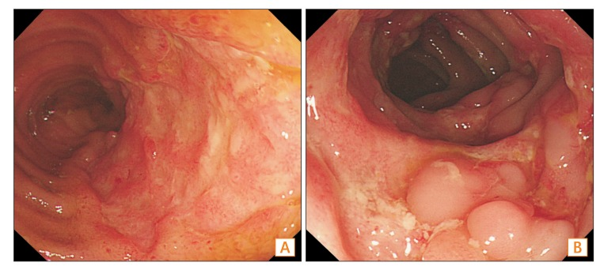
Colonoscopy
You perform the colonoscopy. In the patient’s terminal ileum, you find evidence of inflammation, with red, ulcerated tissue in a pattern that looks like a cobblestone road. Strangely, there seems to be some regions that are affected, and other regions that look completely healthy.⁷
Notes:
https://www.irjournal.org/journal/view.php?doi=10.5217/ir.2016.14.1.96

Slide 111
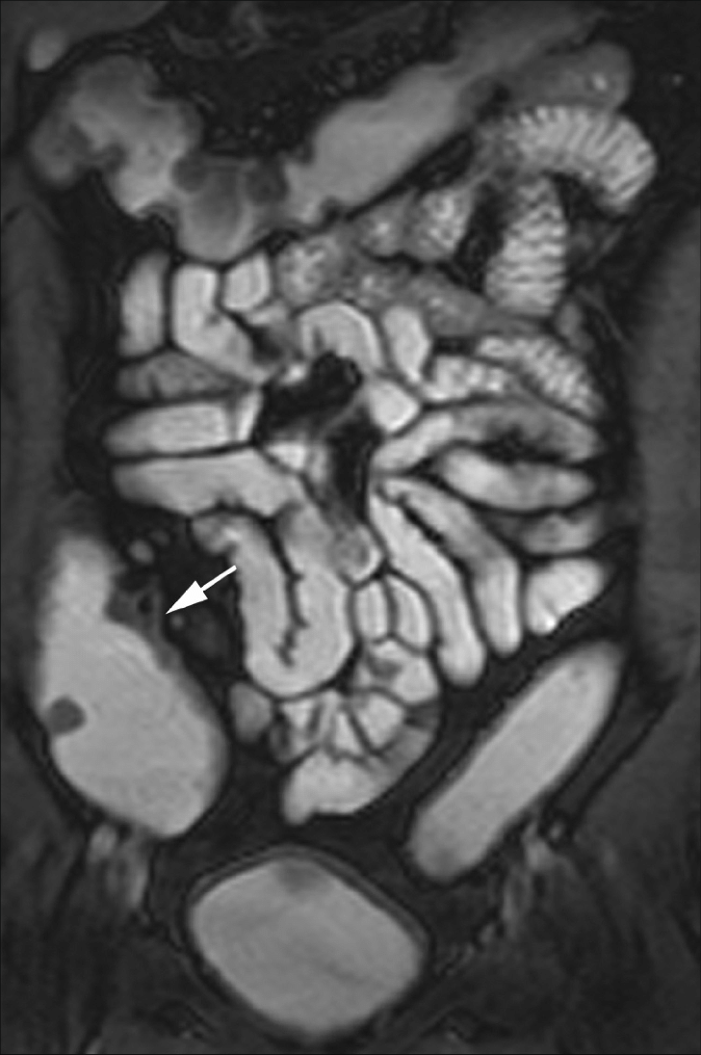
MRE
You perform the MRE. The walls of the small and large bowel are thickened considerably, around >3mm in thickness. This likely means that all layers of the bowel have been affected. ⁷
Notes:
https://www.researchgate.net/figure/A-patient-with-Crohn-disease-MRI-enterography-examination-shows-good-opacification-of_fig1_51731980

Slide 112
C.diff stool culture
GDH antigen: Non-Reactive
Toxin A and B: Not Detected
NEGATIVE: No evidence of C.diff infection

Slide 113
Celiac panel
tTG-IgA levels: < 2.0 U/mL
NEGATIVE: No evidence of celiac disease

Slide 114
You think you have enough information to make a diagnosis. What does Isolde have?​
Celiac disease
C.diff infection
Crohn’s disease
H.pylori-associated peptic ulcer

Slide 115
Celiac disease is incorrect.
The celiac panel returned negative, meaning celiac disease is likely absent. Additionally, the patient’s symptoms are not consistent with celiac disease.⁷

Slide 116
C.diff infection is incorrect.
The C.diff stool culture returned negative, meaning celiac disease is likely absent. Additionally, the patient’s symptoms are not consistent with C.diff infection.⁷

Slide 117
Crohn’s disease is correct!
The colonoscopy clearly showed bowel wall thickening of the small and large intestine. This is caused by transmural, chronic inflammation, characteristic of Crohn’s disease. Additionally, the inflammation showed a cobblestone-like appearance, occasionally separated by healthy regions. These are the “skip sections”, another key characteristic of Crohn’s disease, setting it apart from other IBDs such as ulcerative colitis. Finally, the patient mentioned their twin also suffered from Crohn’s disease, and concordance in monozygotic twins is very high in Crohn’s disease patients. ⁷

Slide 118
H.pylori-associated peptic ulcer is incorrect.
The patient’s symptoms are inconsistent with a H.pylori-associated peptic ulcer – bowel wall thickening and cobblestone-like ulceric inflammation of both the small and large bowel was observed, not a well-circumscribed perforation in the stomach/duodenum.⁷

Slide 119
You
Unfortunately, it looks like you have Crohn’s disease. This is a condition where your immune system responds in an unregulated, exaggerated manner to your gut microbes, causing inflammation in your GI tract. It doesn’t have a definitive cure, and you’ll likely have periods of flares and remission throughout your life. For now, we’ll start you on Infliximab, an anti-TNF monoclonal antibody that helps reduce inflammation. We’ll also prescribe you Budesonide, a corticosteroid, that should help during flares. ¹⁸

Slide 120
Patient 8: Jamie Martinez
Patient file: 20-year-old, male, Hispanic, 5'10", 190lbs

Slide 121
You should ask some more questions:
Ask to elaborate on symptoms
Ask about diet
Ask about lifestyle
Ask about present health issues
Ask about medication
Order a diagnostic test

Slide 122
Jamie
I've been having pain in my upper abdomen for the past few weeks. It's different than a stomachache – I don't have any nausea, it's more of like a burning, aching feeling that comes on and off, kind of like when I'm hungry. In fact, it gets worse when I'm hungry.⁷

Slide 123
Jamie
It's not great, I'll admit. Ramen, fried foods, pizza, burgers. Hey, cut me some slack – I'm a broke university student! I try to eat vegetables whenever I can, but they're too expensive. I also drink a lot of coffee and energy drinks to keep me awake. Do you think that's why I'm sick?

Slide 124
Jamie
I'm pretty active! I go to the gym a couple of times every week, and I'm part of the intermural basketball team. My sleep schedule isn't too good, though; I go to sleep late and wake up early.

Slide 125
Jamie
Apart from my stomach pain, I would say that I'm pretty healthy. I think my immune system's strong - I don't get sick often. I don’t have any other GI problems, either – no heartburn, and my bowel movements are normal. I do get headaches a lot, though; I think it's because I'm too stressed all the time.

Slide 126
Jamie
I don't take any prescription medicine. The only things I take are vitamin supplements, and aspirin for my headaches.

Slide 127
You think you have enough information to begin some tests. What should you try?​
Urea breath test
Antibody test
Endoscopy
Make a diagnosis

Slide 128
Urea breath test
Delta Over Baseline (DOB): 0.4
NEGATIVE: No evidence of active H. pylori infection

Slide 129
Antibody test
IgG antibodies: 0.8 U/mL
NEGATIVE: No evidence of active H. pylori infection

Slide 130
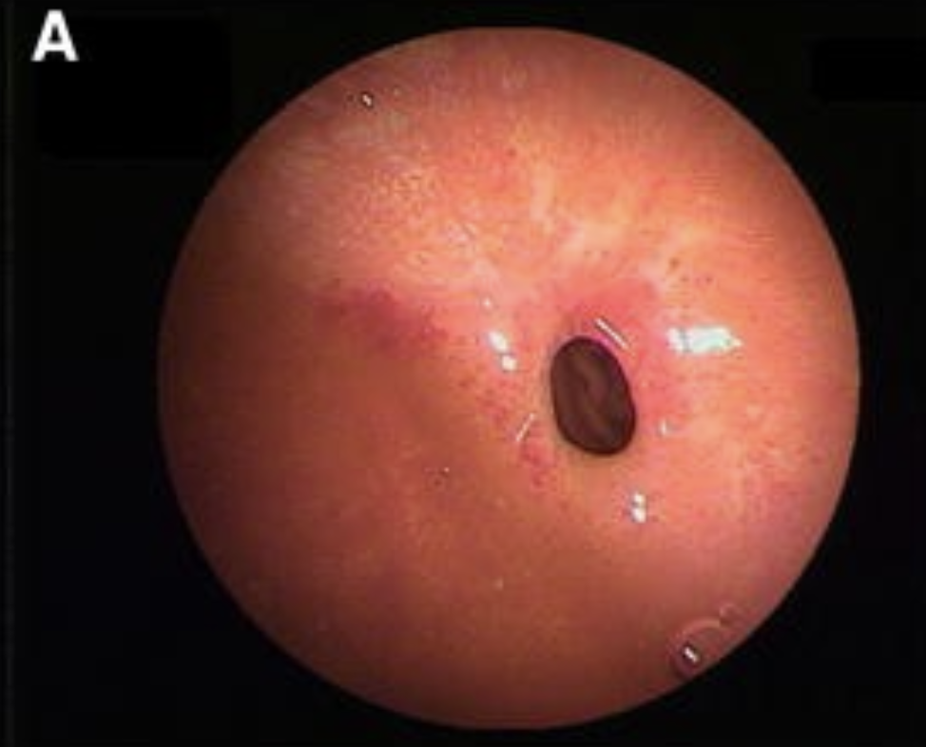
Endoscopy
You perform the endoscopy, first lowering the camera in the patient's stomach. The stomach looks healthy, without any signs of inflammation or damage. Next, you extend the camera into the patient's duodenum. In the anterior, you find a well-circumscribed 1.5cm hole that looks like the flesh has been punched out. Just like the stomach, the rest of the lumen looks healthy.⁷
Notes:
https://link.springer.com/article/10.1007/s00535-009-0102-2

Slide 131
You think you have enough information to make a diagnosis. What does Jamie have?​
NSAID-associated peptic ulcer
H.pylori-associated peptic ulcer
Diverticulitis
Large bowel adenocarcinoma

Slide 132
NSAID-associated peptic ulcer is correct!
The endoscopy clearly showed a well-circumscribed 1.5cm hole in the wall of the duodenum – a duodenal ulcer. Additionally, the patient mentioned they take aspirin, an NSAID, often for their headaches. One of the effects of NSAIDs are inhibition of prostaglandins, which are responsible for inflammation and pain. However, they also play a key role in maintaining the mucosal barrier of the GI tract. The more aspirin, the less prostaglandins, and the more exposed the mucosal barrier becomes, leading to the development of an ulcer.⁷

Slide 133
H.pylori-associated peptic ulcer is incorrect.
Both the antibody test and the urea breath test returned negative, confirming H.pylori is not present. Additionally, the endoscopy didn’t show any signs of inflammation/damage in the lumen wall apart from the ulcer itself, meaning infection isn’t what caused the ulcer.⁷

Slide 134
Diverticulitis is incorrect.
The patient’s symptoms are inconsistent with diverticulitis – they complained of upper abdominal pain, not lower left quadrant pain or fever.⁷

Slide 135
Large bowel adenocarcinoma is incorrect.
The patient’s symptoms are inconsistent with left-side large bowel adenocarcinoma – they complained of upper abdominal pain, not changes in bowel habits, hematochezia, or anemic symptoms.⁷

Slide 136
You
It looks like you have a peptic ulcer in your duodenum, likely due to your constant aspirin usage. We’re going to put you on omeprazole, a protein-pump inhibitor. This decreases the acidity in your duodenum, preventing further damage. Most importantly, stop taking aspirin immediately. This will give your duodenum the chance to rebuild its mucosal lining, allowing it to heal.²⁰

Slide 137
Patient 9: Fiona Marg
Patient File: Female, Slavic, 5 foot 3, 190 pounds, experiencing cramping pain and changes in bowel habits
Notes:
Patient 9 intro

Slide 138
Looking at her patient files, she has obesity. This is a non-modifiable risk factor.
Notes:
Patient 9 intro on file

Slide 139
I should ask some more questions:
Ask to elaborate on symptoms
Ask about diet
Ask about lifestyle
Ask about present health issues
Order a diagnostic test
Notes:
Patient 9 symptom questions

Slide 140
Ms. Marg
Well doctor, I often feel like something is being obstructed. I have a lot of constipation these days, and cramping pain. My stool is solid and looks pencil thin. I also see bright red blood too. My bowel habits have changed.
Notes:
Patient 9 patient symptoms response

Slide 141
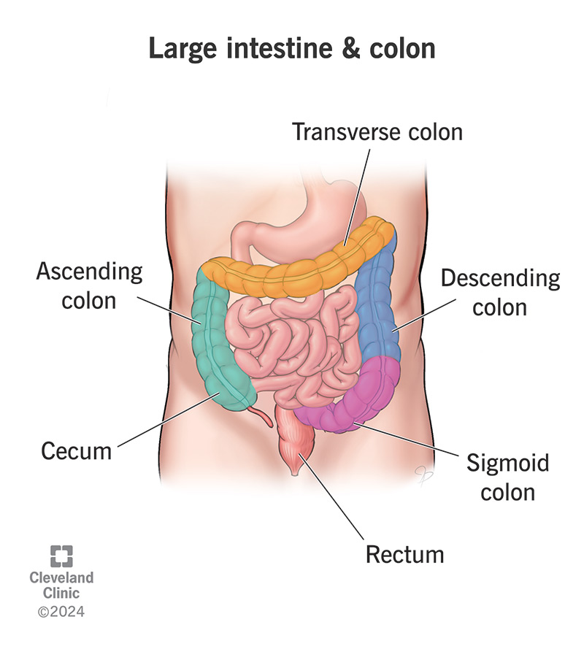
Hmm, pencil-thin stools? If it’s coming out thin, it sounds like something is blocking and narrowing the tube. If the stool is solid that means the stool went from liquid to solid in the …
Cecum and Ascending Colon
Sigmoid and Descending Colon
Notes:
Patient 9 doctor symptom choice A or B

Slide 142
I don’t think it’s here. The stool should still be liquid in the cecum and ascending colon.^{7,24}
Notes:
Lectures notes: https://westernu.brightspace.com/content/enforced/126670-UGRD_1259_3645/Lecture%20Notes/Lecture%20Notes%202024-2025/Parfitt-GI%20Tract.pdf

Slide 143
Yes, when the waste reaches the sigmoid and descending colon, the body has absorbed most of the water leaving it in a solid form.^{7,24}
Notes:
Lecture notes: https://westernu.brightspace.com/content/enforced/126670-UGRD_1259_3645/Lecture%20Notes/Lecture%20Notes%202024-2025/Parfitt-GI%20Tract.pdf

Slide 144
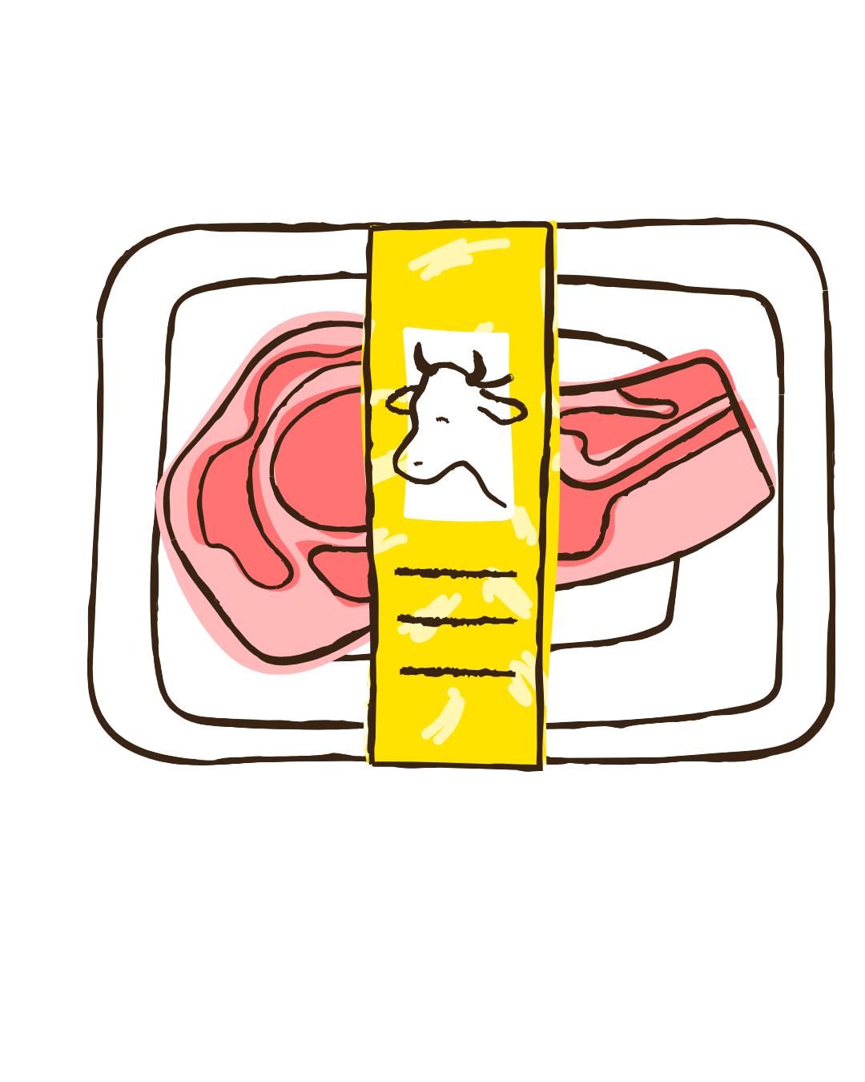

Ms. Marg
For dinner I often have a lot of carbs. I munch on a lot of chips and fries too. I’m a big meat-lover too, I love having BBQ.
Notes:
Patient 9 patient diet

Slide 145
You
Try to reduce your consumption of meat at high temperatures as it can have carcinogens. Including more fiber in your diet through eating vegetables can protect you. Increased carb, fat, and low fiber intake increases risk to gastrointestinal diseases.⁷
Notes:
Lecture notes: https://westernu.brightspace.com/content/enforced/126670-UGRD_1259_3645/Lecture%20Notes/Lecture%20Notes%202024-2025/Parfitt-GI%20Tract.pdf

Slide 146
Ms. Marg
I’m quite the couch potato, after I get home from work, I plop myself in front of the TV. It’s been a while since I’ve exercised.

Slide 147
You
Exercising everyday is important for bowel movement, you can try and go on walks in the future. A sedentary lifestyle can increase your risk.⁷
Notes:
Lecture notes:
https://westernu.brightspace.com/content/enforced/126670-UGRD_1259_3645/Lecture%20Notes/Lecture%20Notes%202024-2025/Parfitt-GI%20Tract.pdf

Slide 148
Ms. Marg
I have Type 2 diabetes.
Notes:
Patient 9 patient diabetes

Slide 149
Diabetes is another non-modifiable risk factor.
Notes:
Patient 9 doctor diabetes

Slide 150
I need to see what is wrong, what should I investigate?
Fecal Occult Blood Test (FOBT)
Barium Enema
Colonoscopy
Sigmoidoscopy
I am ready to make a diagnosis
Notes:
Patient 9 diagnostic testing

Slide 151
Clinical Pathology Report
Test
Result
Fecal Occult Blood Test
Positive
The test for her fecal matter came back positive. Occult means hidden so it is usually used to detect hidden bleeding. If I already knew she had visible blood in her stool, then there is no need to do this screening. FOBT is used to find the presence of blood in the stool.²⁶
Notes:
FOBT: https://www.ncbi.nlm.nih.gov/books/NBK537138/#:~:text=FOBT%20is%20employed%20to%20detect,Go%20to:

Slide 152
You
Your FOBT came back positive. This indicates that there is hidden bleeding. Other tests will need to be done because of this positive result such as barium enema, colonoscopy and sigmoidoscopy. An FOBT is recommend to be done every 2 years starting at the age of 50 for those without high risk factors such as IBD, hereditary syndromes like Lynch Syndrome and FAP, and family history.^{7,25}
Notes:
Lecture notes: https://westernu.brightspace.com/content/enforced/126670-UGRD_1259_3645/Lecture%20Notes/Lecture%20Notes%202024-2025/Parfitt-GI%20Tract.pdf
FOBT:
https://westernu.brightspace.com/content/enforced/126670-UGRD_1259_3645/Lecture%20Notes/Lecture%20Notes%202024-2025/Parfitt-GI%20Tract.pdf

Slide 153
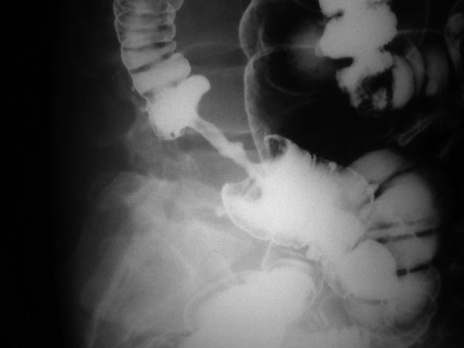
It shows an “Apple Core” lesion in the descending colon, it looks like a half-eaten apple core with a narrower area. The narrowed tube will cause mechanical obstruction when stool is passed. Patients will also experience constipation and abdominal pain. ^{7,26}
Notes:
RS and LS differences: https://pmc.ncbi.nlm.nih.gov/articles/PMC5206358/
https://radiopaedia.org/articles/apple-core-sign-colon-1
https://westernu.brightspace.com/content/enforced/126670-UGRD_1259_3645/Lecture%20Notes/Lecture%20Notes%202024-2025/Parfitt-GI%20Tract.pdf

Slide 154
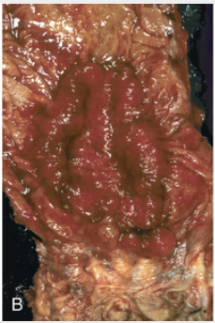
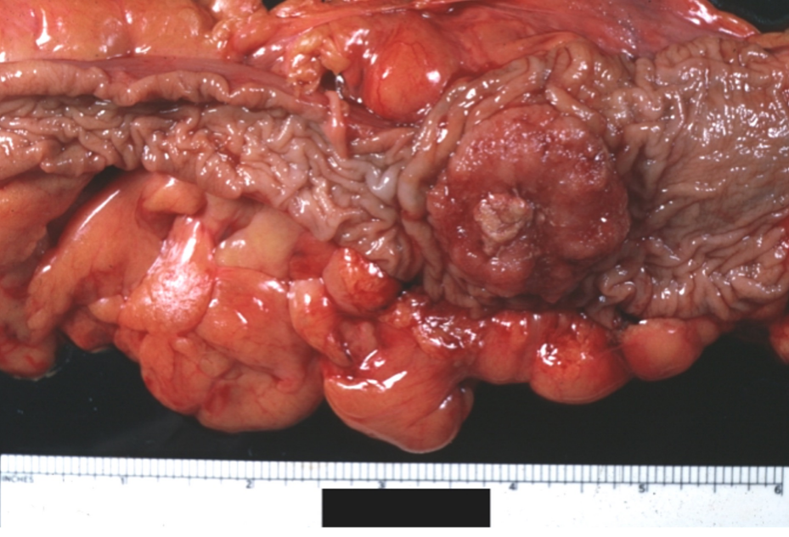
This is the most critical test for a definitive diagnosis. There is a circumferential stenosing lesion (“Apple Core” lesion) on the sigmoid colon.^{7,27} It circles the bowel wall like a ring, narrowing the opening. When water is absorbed in the sigmoid and descending colon, the stool becomes solid and when that is squished through the narrower tube, her stool will be pencil-thin. This also leads to mechanical obstruction, so she will experience constipation and cramping pain.^{7,26}
Notes:
RS and LS differences: https://pmc.ncbi.nlm.nih.gov/articles/PMC5206358/
https://radiopaedia.org/articles/apple-core-sign-colon-1
Endoscopic image courtesy of Dr. Ira Hanan, The Univeristy of Chicago, Chicago Illinois.
https://westernu.brightspace.com/content/enforced/126670-UGRD_1259_3645/Lecture%20Notes/Lecture%20Notes%202024-2025/Parfitt-GI%20Tract.pdf

Slide 155
The sigmoidoscopy is a more targeted test for the sigmoid colon and rectum. There appears to be an “Apple Core” lesion.^{7,27} The narrowed tube will cause mechanical obstruction when stool is passed. Patients will also experience constipation and abdominal pain in the left lower quadrant of the stomach.^{7,26}
Notes:
RS and LS differences: https://pmc.ncbi.nlm.nih.gov/articles/PMC5206358/
https://radiopaedia.org/articles/apple-core-sign-colon-1
Endoscopic image courtesy of Dr. Ira Hanan, The Univeristy of Chicago, Chicago Illinois.
https://westernu.brightspace.com/content/enforced/126670-UGRD_1259_3645/Lecture%20Notes/Lecture%20Notes%202024-2025/Parfitt-GI%20Tract.pdf
Endoscopic image courtesy of Dr. Ira Hanan, The Univeristy of Chicago, Chicago Illinois.

Slide 156
Given the symptoms, diagnosis test, I diagnosis it as…
Left-side adenocarcinoma
Right-side adenocarcinoma
Crohn’s Disease
Ulcerative Colitis
Small Intestine Diverticulosis
Notes:
Patient 9 diagnosis

Slide 157
Correct.
This is left-side adenocarcinoma where the rectum, descending colon, and sigmoid colon is. Left side adenocarcinoma is a type of large bowel cancer, 55% of large bowel cancers occur here. Symptoms include pain in the left lower quadrant of the abdomen, constipation, pencil-thin stool, feeling like there’s an obstruction. A colonoscopy test will show a circumferential stenosing lesion or “Apple Core” lesion.⁷
Notes:
Lecture notes:
https://westernu.brightspace.com/content/enforced/126670-UGRD_1259_3645/Lecture%20Notes/Lecture%20Notes%202024-2025/Parfitt-GI%20Tract.pdf
Pathology Textbook
Lecture notes: https://westernu.brightspace.com/content/enforced/126670-UGRD_1259_3645/Lecture%20Notes/Lecture%20Notes%202024-2025/Parfitt-GI%20Tract.pdf

Slide 158
Colorectal adenocarcinoma can develop from a mutation in the APC tumor suppressor gene.⁶ This affects the APC/β-catenin pathway, which is the classic adenoma-carcinoma development. This causes more cell division and sporadic growth into malignant polyps (pre-cancerous lesion).
Notes:
Lecture notes:
https://westernu.brightspace.com/content/enforced/126670-UGRD_1259_3645/Lecture%20Notes/Lecture%20Notes%202024-2025/Parfitt-GI%20Tract.pdf
Pathology Textbook
Lecture notes: https://westernu.brightspace.com/content/enforced/126670-UGRD_1259_3645/Lecture%20Notes/Lecture%20Notes%202024-2025/Parfitt-GI%20Tract.pdf

Slide 159
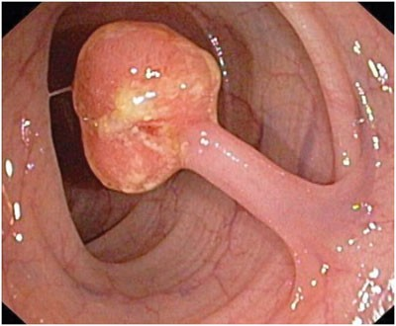
It started as a polyp which are small clumps of cells that form inside the colon. Polyps are not the issue, it’s when they go unnoticed for too long that the real danger begins.⁷ Benign polyps are known as adenomas. Only 1 in 100 adenomas will go on to develop into adenocarcinomas through the adenoma-carcinoma sequence.^{6,7} The risk will increase with the size of the adenoma. If polyps are removed early, cancer can be prevented before the malignancy develops.⁷
Notes:
Lecture notes:
https://westernu.brightspace.com/content/enforced/126670-UGRD_1259_3645/Lecture%20Notes/Lecture%20Notes%202024-2025/Parfitt-GI%20Tract.pdf
Pathology textbook:

Slide 160
Because it presents with adenocarcinoma, following the adenoma-carcinoma sequence, we need to act fast before it spreads. Colorectal cancer develops over a long time so the faster we find it the better the prognosis is.
Notes:
Lecture notes: https://westernu.brightspace.com/content/enforced/126670-UGRD_1259_3645/Lecture%20Notes/Lecture%20Notes%202024-2025/Parfitt-GI%20Tract.pdf

Slide 161
You
Ms. Marg, unfortunately you have left-side adenocarcinoma or colorectal cancer. Luckily because you came in as soon as your bowel habits changed, it is curable.
Notes:
Patient 9 diagnosis report

Slide 162
You
Colorectal adenocarcinoma is the most common cancer of the gastrointestinal tract. The incidence will increase with age and is the second most common cause of cancer death in Ontario.⁷
Notes:
Lecture notes: https://westernu.brightspace.com/content/enforced/126670-UGRD_1259_3645/Lecture%20Notes/Lecture%20Notes%202024-2025/Parfitt-GI%20Tract.pdf

Slide 163
You
We will perform surgical resection to remove the tumor. Since it hasn’t spread to the liver or other organs. The prognosis is good as it depends on the depth of invasion and presence or absence of metastasis.⁶
Notes:
Lecture slides 2: https://westernu.brightspace.com/content/enforced/126670-UGRD_1259_3645/Lecture%20Slides/Lecture%20Slides%202025-2026/Section%20C%20-%20W26/Path3500%20Diseases%20of%20the%20GI%20tract%20part%20II%202026%2001%2019.pdf

Slide 164
Ms. Marg
Since I have colorectal adenocarcinoma. Does that mean my family members are at risk of having it too?
Notes:
Patient 9 patient lifestyle

Slide 165
You
Yes, those with colorectal cancer should inform their immediate family members as family members are at higher risk of developing colorectal cancer.⁷ I would suggest earlier and more intense screening for those with family history, hereditary syndromes, and Inflammatory Bowel Disease.⁶ It would be best to be screened at least 5 to 10 years before the age of when the relative with colorectal cancer was diagnosed.⁶
Notes:
Lecture notes:
https://westernu.brightspace.com/content/enforced/126670-UGRD_1259_3645/Lecture%20Notes/Lecture%20Notes%202024-2025/Parfitt-GI%20Tract.pdf

Slide 166
Ms. Marg
Thank you for your help doctor. I will make sure to watch out for my diet and get more exercise in in the future. I’ll also tell my family to get their screening done too.
Notes:
Patient 9 patient lifestyle

Slide 167
Incorrect.
Right-side adenocarcinoma tends to present with polypoid fungating masses.⁷ The symptoms are usually hidden bleeding. Due to chronic blood loss, iron-deficiency anemia is a common symptom to watch out for. ⁷
Notes:
Lecture notes: https://westernu.brightspace.com/content/enforced/126670-UGRD_1259_3645/Lecture%20Notes/Lecture%20Notes%202024-2025/Parfitt-GI%20Tract.pdf

Slide 168
Ms. Marg came back 6 months later complaining of more pain in her abdomen area, constant constipation and pencil-thin stools with fresh red blood.
Notes:
Patient 9 RS

Slide 169
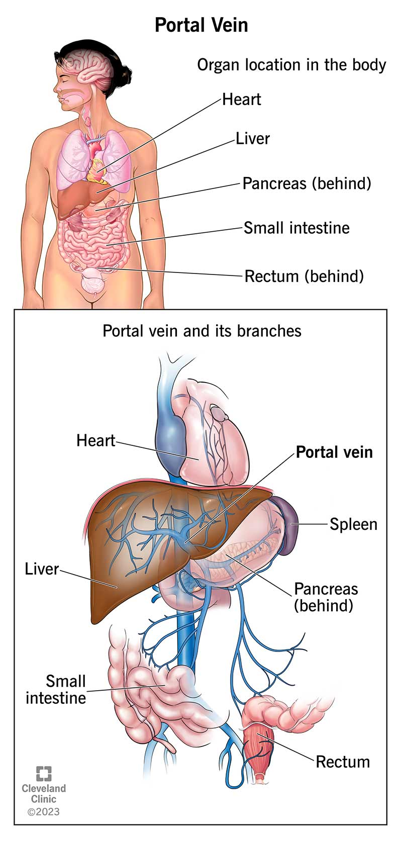
You found that the cancer has spread to her liver. It would have entered the Portal Venous System. Because blood from the colon drains into the portal vein, the first stop for the spreading cells is to the liver and is a common site for the cancer to spread to. This is called hematogenous spread.^{6,28}
Notes:
Lecture slides 2: https://westernu.brightspace.com/content/enforced/126670-UGRD_1259_3645/Lecture%20Slides/Lecture%20Slides%202025-2026/Section%20C%20-%20W26/Path3500%20Diseases%20of%20the%20GI%20tract%20part%20II%202026%2001%2019.pdf

Slide 170
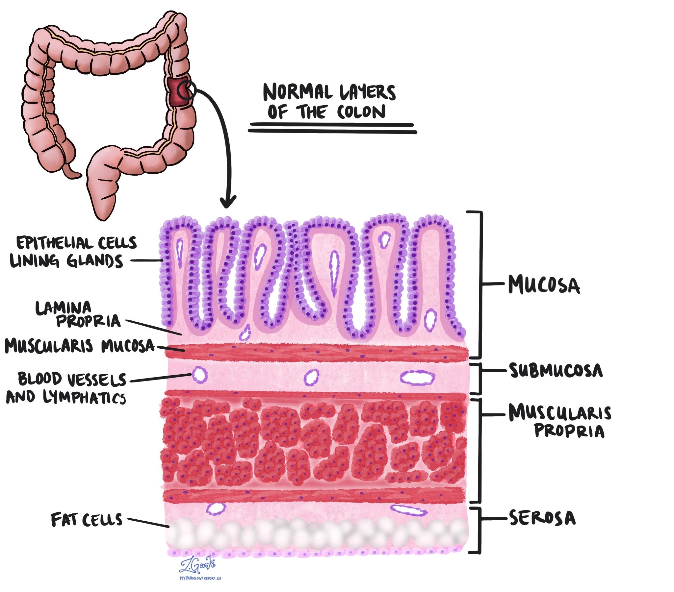
The common site for distant spread is to the liver, then lungs and bone. It can spread through direct invasion through the bowel wall, lymphatic invasion and spread to the liver.⁶ The tumour can spread to adjacent organs through direct invasion through the bowel wall when it goes past the submucosa layer.²⁹
Notes:
Lecture slides 2: https://westernu.brightspace.com/content/enforced/126670-UGRD_1259_3645/Lecture%20Slides/Lecture%20Slides%202025-2026/Section%20C%20-%20W26/Path3500%20Diseases%20of%20the%20GI%20tract%20part%20II%202026%2001%2019.pdf
Mucosa: https://www.mypathologyreport.ca/pathology-dictionary/colonic-mucosa/

Slide 171
At this point due to the depth of the invasion and the presence of metastases, surgery would not be enough. Chemotherapy will be needed as well, and the prognosis will be poorer.⁷
Diagnose again
Go to another patient
Notes:
Colon cancer: https://www.ncbi.nlm.nih.gov/books/NBK470380/#:~:text=Histologic%20grade:%20Adenocarcinomas%20are%20graded%20by%20the,cells%20of%20colonic%20origin%2C%20except%20medullary%2Dtype%20carcinomas
https://www.mypathologyreport.ca/pathology-dictionary/colonic-mucosa/

Slide 172
Incorrect.
Crohn’s disease can cause inflammation and narrowing of the colon.⁷ However, the patient doesn’t have the “skip sections” or cobble stoning typical of this disease.⁷
Notes:
Lecture notes: https://westernu.brightspace.com/content/enforced/126670-UGRD_1259_3645/Lecture%20Notes/Lecture%20Notes%202024-2025/Parfitt-GI%20Tract.pdf

Slide 173
Incorrect.
Ulcerative Colitis does affect the rectum and left colon. However, the inflammation is usually without a single, distinct mass.⁷
Notes:
Lecture notes: https://westernu.brightspace.com/content/enforced/126670-UGRD_1259_3645/Lecture%20Notes/Lecture%20Notes%202024-2025/Parfitt-GI%20Tract.pdf

Slide 174
Incorrect.
For Diverticulosis, while this can also cause abdominal pain, bleeding, and changes in bowel habits, this comes from small pouches in the small bowel.⁷
Notes:
Lecure notes: https://westernu.brightspace.com/content/enforced/126670-UGRD_1259_3645/Lecture%20Notes/Lecture%20Notes%202024-2025/Parfitt-GI%20Tract.pdf

Slide 175
Patient 10: Eshaan Singh
Patient File: Male, Indian, 35 years old, 5 foot 8, 140 pounds

Slide 176
I should ask some more questions:
Ask to elaborate on symptoms
Ask about diet
Ask about lifestyle
Ask about family history
Order a diagnostic test

Slide 177
Mr. Singh
Doctor I’ve been feeling very weak and fatigued lately. I’ve just been overall very tired all the time.

Slide 178
You run a bloodwork test and see that he has iron-deficiency anemia.

Slide 179
Mr. Singh
Sometimes my stool is black but I don’t feel any pain.

Slide 180

Mr. Singh
I have a pretty clean diet, I make sure to include lots of fiber. I do eat some meat too but I usually avoid eating BBQ or searing them at high temperatures because I know it can have carcinogens.⁷
Notes:
Lecture notes: https://westernu.brightspace.com/content/enforced/126670-UGRD_1259_3645/Lecture%20Notes/Lecture%20Notes%202024-2025/Parfitt-GI%20Tract.pdf

Slide 181
You
That’s good to hear! Low fiber, high meat, carb and fat intake can lead to an increased risk. While intake of fiber can play a protective role as it can potentially bind to carcinogens.⁷
Notes:
Lecture notes: https://westernu.brightspace.com/content/enforced/126670-UGRD_1259_3645/Lecture%20Notes/Lecture%20Notes%202024-2025/Parfitt-GI%20Tract.pdf

Slide 182

Mr. Singh
I do smoke maybe 2 times a week over 5 years and I consume alcohol.⁷

Slide 183
You
Smoking and alcohol consumption are modifiable risk factors. If you change these lifestyle habits, you will decrease your risk.⁷
Notes:
Lecture notes: https://westernu.brightspace.com/content/enforced/126670-UGRD_1259_3645/Lecture%20Notes/Lecture%20Notes%202024-2025/Parfitt-GI%20Tract.pdf

Slide 184
Mr. Singh
My father had Lynch Syndrome and passed away when he was only 44.

Slide 185
Hmm, Lynch Syndrome is a non-modifiable risk factor.
Notes:
Pathology textbook

Slide 186
I need to see what is wrong, what should I investigate?
Fecal Occult Blood Test (FOBT)
Colonoscopy
Sigmoidoscopy
I am ready to make a diagnosis
Notes:
Patient 9 diagnostic testing

Slide 187
Clinical Pathology Report
Test
Result
Fecal Occult Blood Test
Positive
The FOBT result is positive. There is an internal issue. Occult mean hidden so there is hidden bleeding happening.²⁵ This can mean the appearance of black stool which is mixed with the blood. Chronic blood loss will result in iron-deficiency anemia. If he is an older male or postmenopausal woman with unexplained iron-deficiency anemia, there should be warning signs blaring in my head.^{7,27}
Notes:
FOBT: https://www.ncbi.nlm.nih.gov/books/NBK537138/#:~:text=FOBT%20is%20employed%20to%20detect,Go%20to:
Pathology textbook

Slide 188
You
Your FOBT came back positive. This indicates that there is hidden bleeding. Other tests will need to be done because of this positive result such as barium enema, colonoscopy and sigmoidoscopy.^{6,7} If you have hereditary syndromes, family history or Inflammatory Bowel Disease, FOBT screening should be done earlier and more intensely.⁷
Notes:
Lecture notes: https://westernu.brightspace.com/content/enforced/126670-UGRD_1259_3645/Lecture%20Notes/Lecture%20Notes%202024-2025/Parfitt-GI%20Tract.pdf

Slide 189
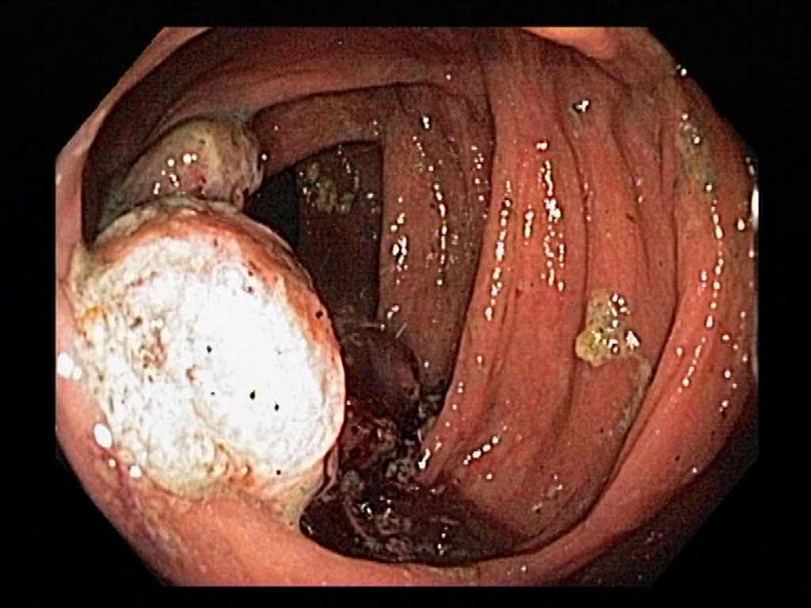
The colonoscopy shows a polypoid fungating mass. The appearance looks like a cauliflower.³² This is in the cecum and ascending colon. There was a polyp in this area, and because this area is wider than the descending colon, and the stool is still liquid, Mr. Singh won’t really feel anything when stool is passed.7,²⁶
Notes:
https://www.gastrolab.net/
Lecture slides 2: https://westernu.brightspace.com/content/enforced/126670-UGRD_1259_3645/Lecture%20Notes/Lecture%20Notes%202024-2025/Parfitt-GI%20Tract.pdf
LS vs RS: https://pmc.ncbi.nlm.nih.gov/articles/PMC5206358/

Slide 190
The sigmoidoscopy looks normal. The descending colon and rectum look healthy. The sigmoidoscopy will not reach the cecum and ascending colon.³²
Notes:
https://www.gastrolab.net/
Colon cancer screening: https://pmc.ncbi.nlm.nih.gov/articles/PMC4448630/

Slide 191
Given the symptoms, and diagnosis test, I diagnosis it as…
Left-side adenocarcinoma
Right-side adenocarcinoma
Crohn’s Disease
Ulcerative Colitis
Small Intestine Diverticulosis
Notes:
Patient 9 diagnosis

Slide 192
Incorrect.
Left side adenocarcinoma occurs in the rectum, descending and sigmoid colon. Symptoms are more obvious in left side adenocarcinoma and presents with obstruction which isn’t seen here.⁷ The sigmoidoscopy works for seeing the left colon, so if it was normal, it can’t detect the right colon issues.³²
Notes:
Colon cancer screening: https://pmc.ncbi.nlm.nih.gov/articles/PMC4448630/
LS vs. RS: https://pmc.ncbi.nlm.nih.gov/articles/PMC4448630/

Slide 193
Correct.
It is right side adenocarcinoma. It affects the right colon area which is the ascending colon and cecum. If an older male, or postmenopausal women presents with unexplained iron-deficiency anemia, we must assume it is right-sided colon cancer until proven otherwise.²⁸ It’s often found later compared to left-sided cases because of anemia symptoms.²⁶ Other symptoms include fatigue, weakness, and black stool. It is usually harder to treat compared to left-sided cases too.²⁶
Notes:
Pathology textbook

Slide 194
This can be caused from microsatellite instability, where DNA mismatches accumulate. Right-side adenocarcinoma are less likely to cause symptoms, so it is usually harder to detect and develops into tumours and have a worse prognosis.²⁷
Notes:
Pathology textbook

Slide 195
Polyp
It started as a polyp which are small clumps of cells that form inside the colon. Polyps are not the issue, it’s when they go unnoticed for too long that the real danger begins.⁷ Benign polyps are known as adenomas. Only 1 in 100 adenomas will go on to develop into adenocarcinomas through the adenoma-carcinoma sequence.^{6,7} The risk will increase with the size of the adenoma. If polyps are removed early, cancer can be prevented before the malignancy develops.⁷
Notes:
Lecture notes: https://westernu.brightspace.com/content/enforced/126670-UGRD_1259_3645/Lecture%20Notes/Lecture%20Notes%202024-2025/Parfitt-GI%20Tract.pdf

Slide 196
You
Unfortunately, you have right-side adenocarcinoma or colorectal cancer. It is hard to detect due to hidden bleeding, so a lot of patients with right-side large bowel cancer will not experience symptoms until it’s too late.²⁶ By the time you feel weakness or fatigue, there is already a lot of blood lost.
Notes:
Lecture notes: https://westernu.brightspace.com/content/enforced/126670-UGRD_1259_3645/Lecture%20Notes/Lecture%20Notes%202024-2025/Parfitt-GI%20Tract.pdf

Slide 197
Mr. Singh
Oh no, this explains why I felt so weak and have iron-deficiency anemia. What should I do doctor?

Slide 198
You
The depth of invasion and presence or absence of metastases is important for the prognosis.⁶ Since the depth of invasion is limited, it hasn’t spread to distant organs like the liver, only surgery is needed.⁶
Notes:
Lecture notes: https://westernu.brightspace.com/content/enforced/126670-UGRD_1259_3645/Lecture%20Notes/Lecture%20Notes%202024-2025/Parfitt-GI%20Tract.pdf
Colon cancer: https://www.ncbi.nlm.nih.gov/books/NBK470380/#:~:text=Histologic%20grade:%20Adenocarcinomas%20are%20graded%20by%20the,cells%20of%20colonic%20origin%2C%20except%20medullary%2Dtype%20carcinomas

Slide 199
Mr. Singh
I’m glad to hear that it hasn’t spread too far. Do you think I was at risk from hereditary factors?

Slide 200
You
Yes, if your family member had Lynch Syndrome this is a type of hereditary colon cancer. Colon cancer chance is increased if there are risk factors such as family history, hereditary syndromes like Lynch Syndrome and Familial Adenomatous Polyposis (FAP), or IBD.^{7,27}
Notes:
Lecture notes: https://westernu.brightspace.com/content/enforced/126670-UGRD_1259_3645/Lecture%20Notes/Lecture%20Notes%202024-2025/Parfitt-GI%20Tract.pdf

Slide 201
Mr. Singh
Thank you for letting me know doctor. I will make sure to attend the screenings and reduce the amount I smoke and drink.

Slide 202
Incorrect.
Crohn’s disease symptoms are usually diarrhea, and fever. It also has “skip sections” or cobble stoning typical of this disease which are not present in this patient.⁷
Notes:
Lecture notes: https://westernu.brightspace.com/content/enforced/126670-UGRD_1259_3645/Lecture%20Notes/Lecture%20Notes%202024-2025/Parfitt-GI%20Tract.pdf

Slide 203
Incorrect.
Ulcerative Colitis affects the rectum and left colon. The sigmoidoscopy would show inflammation but it doesn’t here.⁷
Notes:
Lecture notes: https://westernu.brightspace.com/content/enforced/126670-UGRD_1259_3645/Lecture%20Notes/Lecture%20Notes%202024-2025/Parfitt-GI%20Tract.pdf

Slide 204
Incorrect.
Diverticulosis is more common in the left colon in the sigmoid colon. They also have small pouches not present here.⁷
Notes:
Lecture notes: https://westernu.brightspace.com/content/enforced/126670-UGRD_1259_3645/Lecture%20Notes/Lecture%20Notes%202024-2025/Parfitt-GI%20Tract.pdf

Slide 205
He is back 5 years later with worse symptoms.

Slide 206
You found that the cancer has spread to her liver. It would have entered the Portal Venous System. Because blood from the colon drains into the portal vein, the first stop for the spreading cells is to the liver and is a common site the cancer spreads to. This is called hematogenous spread.^{6,28}
Notes:
Lecture slide 2: https://westernu.brightspace.com/content/enforced/126670-UGRD_1259_3645/Lecture%20Slides/Lecture%20Slides%202025-2026/Section%20C%20-%20W26/Path3500%20Diseases%20of%20the%20GI%20tract%20part%20II%202026%2001%2019.pdf

Slide 207
The common site for distant spread is to the liver, then lungs and bone. It can spread through direct invasion through the bowel wall, lymphatic invasion and hematogenous to the liver.⁶ The tumour can spread to adjacent organs through direct invasion through the bowel wall when it goes past the submucosa layer.²⁹ It can spread to the regional lymph nodes as well.
Notes:
Lecture 2 slides: https://westernu.brightspace.com/content/enforced/126670-UGRD_1259_3645/Lecture%20Slides/Lecture%20Slides%202025-2026/Section%20C%20-%20W26/Path3500%20Diseases%20of%20the%20GI%20tract%20part%20II%202026%2001%2019.pdf https://www.mypathologyreport.ca/pathology-dictionary/colonic-mucosa/

Slide 208
At this point due to the depth of the invasion and the presence of metastases, surgery would not be enough. Chemotherapy will be needed as well, and the prognosis will be poorer.⁶
Diagnose again
Go to another patient
Notes:
Colon cancer: https://www.ncbi.nlm.nih.gov/books/NBK470380/#:~:text=Histologic%20grade:%20Adenocarcinomas%20are%20graded%20by%20the,cells%20of%20colonic%20origin%2C%20except%20medullary%2Dtype%20carcinomas
https://www.mypathologyreport.ca/pathology-dictionary/colonic-mucosa/

Slide 209
Patient 11: Neil Simons
41-year-old Male, Italian, 5 foot 10, 232 lbs, BMI 33.3

Slide 210
You
Let's get to know the patient first:
Ask about Symptoms
Ask about Lifestyle and Work
Ask about Diet
Order Diagnostic Tests
Notes:
Symptoms -> 212
Diet -> 214
Lifestyle -> 213
Diagnostic Tests ->21

Slide 211
Niel Simons
I've been getting this pain around my groin area for a couple of years now. It started as a dull ache. Now there's also this burning pain. Additionally, I feel the pain is worse with my allergies and work.^{34,35}
Notes:
Symptoms
Hernia Information

Slide 212
Niel Simons
I have been a Furniture Mover and Assembler for around 11 years. It’s a tough job. The furniture is heavy, I often must move things myself, bend quite often, and I see multiple clients a day. Additionally, my environmental allergies make me feel strained, especially my coughing.^{34,35}
Notes:
Lifestyle and Job

Slide 213
Niel Simons
I’m not the best when it comes to healthy eating. Because of my job, I’m always on the move, so fast food is the most convenient for me. Honestly, I eat it every day.
Notes:
Diet

Slide 214
You
Patient has a BMI >30 and has had an unhealthy diet for several years. Recently, the aching pain and burning have gotten worse. Symptoms seem to amplify when lifting heavy objects or coughing. Neil's 11-year job and environmental allergies means that this happens often. Part of his abdominal wall could be weak, maybe testicular swelling or a mass of some sort…^{34,35}
What we have learned

Slide 215
You
After learning about Neil, let’s run some tests:
Physical Examination
Ultrasound (US)
I am ready to Diagnosis

Slide 216
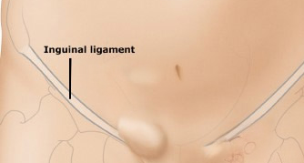
You
(Physical Exam)
When examining the groin area to the inguinal canal, I feel a notable protrusion on the pad of my finger from deep to superficial (from in the abdominal cavity outwards). Reduction is hard to tell. Coughing seems to agitate the protruded mass.^{34,37}
Notes:
Examination is performed with Neil standing. Asked to cough a few times during the exam to agitate the area.

Slide 217
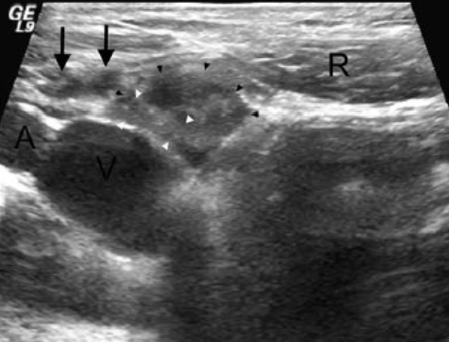
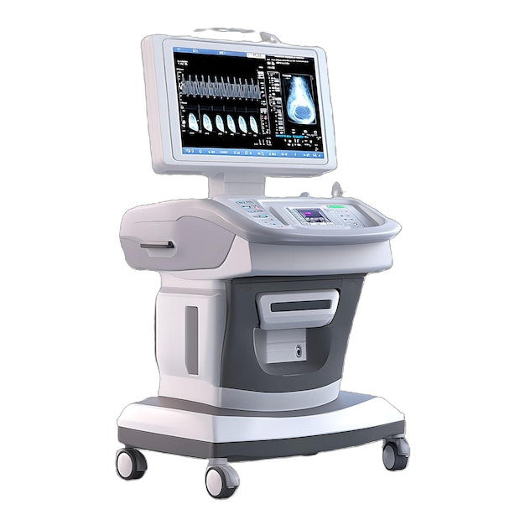
Sonographer
The ultrasound shows that there is a protrusion outwards from the inguinal area of the abdominal wall, rather than swelling in the groin or below the inguinal ligament. The shape and affected areas are consistent with a hernia, but it reduces less than it should with gentle pressure or positional changes.^{34,36,38}

Slide 218
Given the symptoms and tests, I believe the diagnosis to be…
Direct Inguinal Hernia
Femoral Hernia
Indirect Inguinal Hernia
Lymphoma
Back to diagnostic tests

Slide 219
You
Indirect Inguinal Hernia is Incorrect
While this is an Inguinal Hernia, the indication that the protrusion is from deep to superficial or from the ultrasound, outwards from the abdominal wall, tells us that this is a Direct Inguinal Hernia. If the hernia was indirect, it would likely present from the superolateral to inferomedial, which the ultrasound would confirm.³⁴

Slide 220
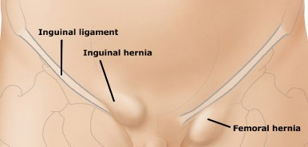
You
Femoral Hernia is Incorrect
A lot of the symptoms can overlap; however, a Femoral Hernia presents below the Inguinal ligament or near the top of the thigh. Femoral Hernia’s are rare, more common in women, and still more rare than Inguinal Hernias. Lastly, Femoral Hernias carry much higher risk of incarceration and strangulation as they intrude upon a more tightly packed space.^{34,35,47}

Slide 221
You
Lymphoma is Incorrect
Testicular Lymphoma is already much rarer; it would typically present as firm and not painful to the touch. Usually presenting from lower than the Inguinal ligament, more so from in the groin, or testis. Most notably is lack of reduction would be more distinct, as well as additional changes to surrounding tissues. In this case, the smaller-than-usual lack of reduction tells us the risk of the Direct Inguinal Hernia becoming incarcerated.^{33,34,35}

Slide 222
You
Direct Inguinal Hernia is CORRECT
Niel’s lifestyle, job and allergies were all risk factors for a Direct Inguinal Hernia (heavy lifting, coughing, overweight) which led to continuous strain on his abdominal wall. The symptoms and confirm the location along the inguinal ligament showing us it presents from deep to superficial. The prominent symptoms and lack of reduction indicates high risk of future obstruction, incarceration and/or strangulation. It’s fortunate that we can treat it now. Operative surgery is the only option for treatment. A Lichtenstein surgery involves anesthesia, the patient, pushing the hernia back in, and securing the abdominal wall with a mesh as a preventative before closing. It will take a few months for your abdominal wall to heal and absorb the mesh.^{34,35}

Slide 223
Neil Simons
Thanks for letting me know, doctor. After I recover from the surgery, I’ll reduce the amount of strain I put on my body. I’ll lose some weight by making my own lunches, get proper help lifting furniture and take less clients in each day.^{34,35}

