Slide 2
PGME Committee Meeting
Wednesday, March 20, 2024

Slide 3
Internal Review: Surveyor Perspective
Dr. D. Fortin and Dr. H. Iyer

Slide 4
Hari Iyer
Director – Curriculum and Assessment, PGME
March 20, 2024

Slide 18
Decision Making Principles
CanERA places increased emphasis on CQI
Entrusting institutions to drive their own CQI
Consideration given to:
Persistence of areas for improvement (AFIs)
Impact of AFIs on learning environment
Impact of AFIs on the integrity of the institution
Strength and robustness of the institution’s IR process

Slide 19
Call Out To Program Directors
Please sign-up as faculty reps for the IR process!
Great learning experience
Helps improve your own program
Share best practices & innovations (e.g. hidden curriculum, trainee selection, CQI, etc.)
Learn how to generate a report (as Chair)

Slide 20
Internal Review: Surveyor Perspective
Overview of accreditation process
CanAMS documentation / review
What surveyors like / don’t like
Deciding if an indicator has been met
Value of participating in accreditation process

Slide 21
Overview of Accreditation Process
Accreditation is a review process to determine if educational programs meet defined standard of quality
CQI process
CanERA (since July 2019), CanRAC, CanAMS (Dr. Iyer)
Two levels:
Institution (PGME) accreditation standards
Residency Program (or AFC) accreditation
General standards – modified as of July 2024?
Specialty specific standards

Slide 22
Who is Involved (Regular Review)
Royal College Survey Team
University (Institution) review team
Vote on outcome/status
RR
APOR
External review
Notice (External review)
Residency Programs review team
2+/-1 Surveyors
Specialty Committee
Input
Your Program
Documents
Onsite
Survey Report & Recommendation
RC Res-AC committee ( 20+ PGME )
Feb-May-Oct
Program Response (errors of fact)
Institution Report & Internal Review Process
Specialty Committee
Input
Final
Recommendation
2 Res-AC members' independent review

Slide 23
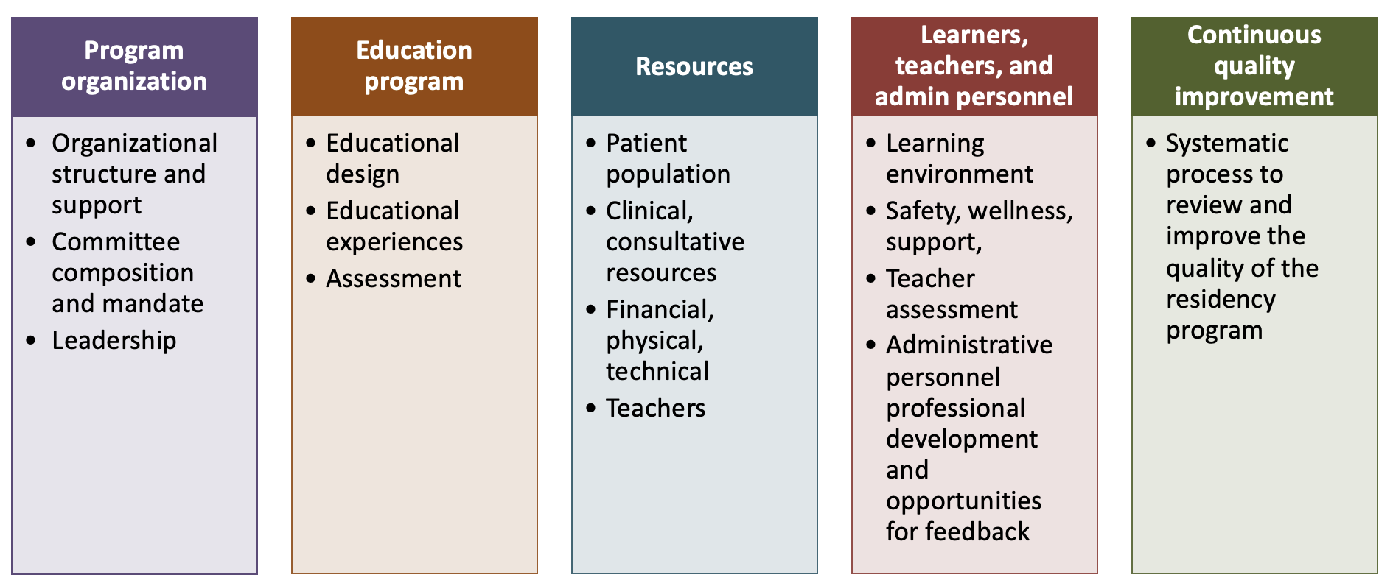
Role of Specialty Committee
Specialty Committee
Input

Slide 24
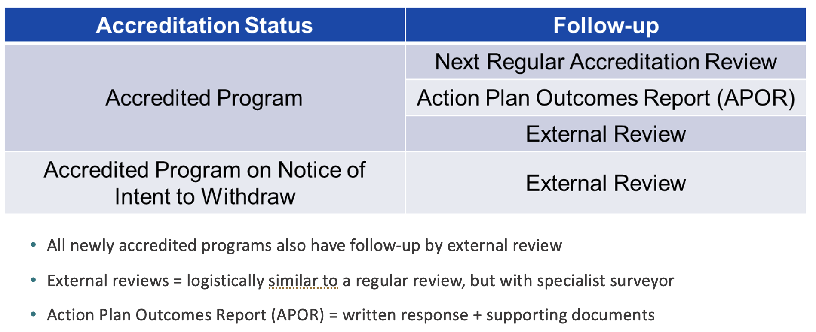
Possible Outcomes

Slide 25
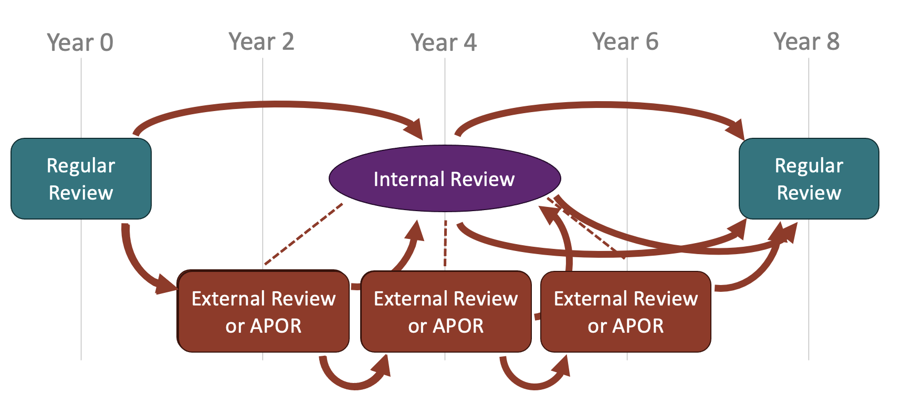
Sequence

Slide 26
CanAMS Documentation and Review
Appearance does matter!
3 portions:
Filling the instrument profile
Response to previous AFIs
Presenting your program
Attaching relevant documents
Preparing files for on-site review (minutes of RPC/CC, residents files)

Slide 27
Filling the Instrument & Attaching Documents
Present your program: entry route, year CBD, # residents, usual rotation sequence (a nice table is useful), organigram (with names ideal), define the roles (advisor?), etc.
Surveyors will look for documents that support what you say
Make the surveyors’ life easy
Assessment tools - combine them in ONE document with a table of content linking to each
Meeting agenda - add a presenting page

Slide 28
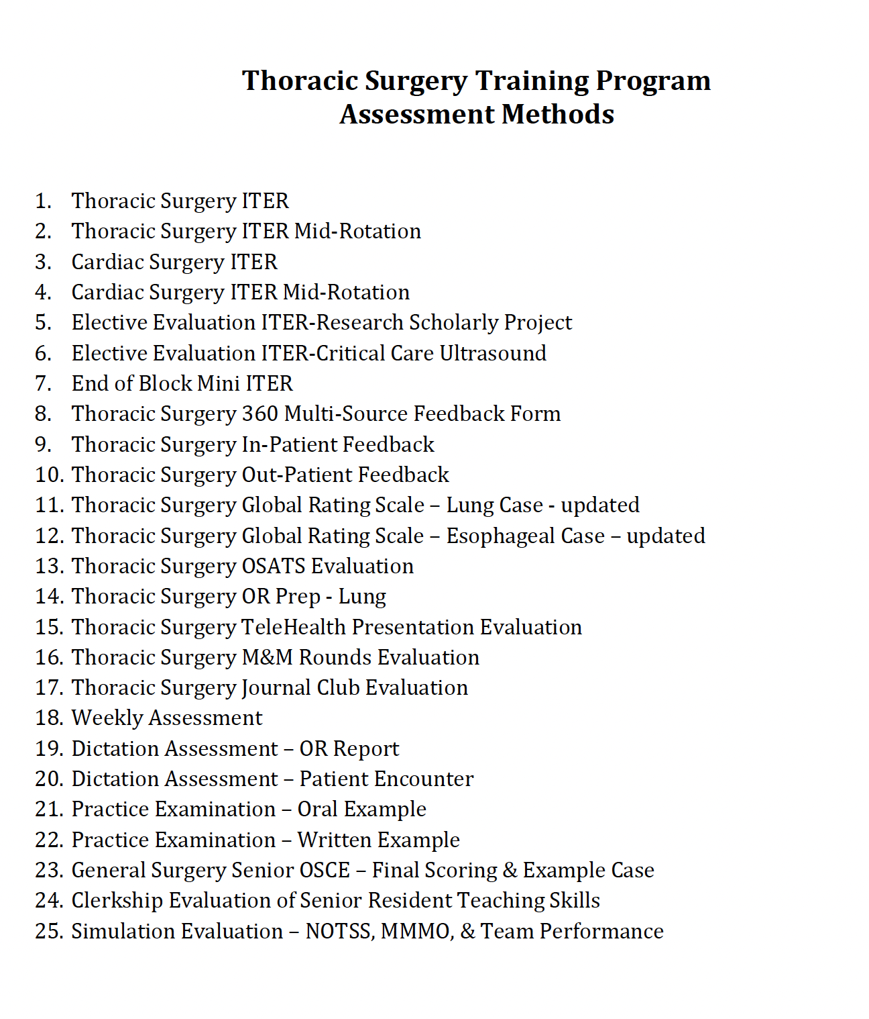
Filling the Instrument & Attaching Documents

Slide 29
Filling the Instrument & Attaching Documents
Make the surveyors’ life easy
Choose a background and a font – keep it throughout!
PDF your documents
TOR, policies, assessment tools, and else:
Dates, dates, dates!
One page document that summarize when last reviewed (CQI)
Policies: Make them your own ! Or at least approve them
Use the PGME templates and tools

Slide 30
Filling the Instrument & Attaching Documents
Make the surveyors’ life easy
Present data (CQI): timelines of EPAs/ITER filling, faculty vs senior filled, resident questionnaire, etc.
Make sure your faculty at large (not just the RPC) & your residents know
What are the program’s documents
Where to find them

Slide 31
Preparing Files for On-Site Review
Make it ALL available
Minutes of meeting: Presentation page / FUP on action items (CQI)
Residents' files
Various level / some “not progressing as expected”
Signed agreement to share
“put it all together” (portfolio) & get it organized
Documentation of meeting with PD **
Assessment of all kind
CC letters or other communication

Slide 32
Do’s and Don’ts
Do go through each standard: Are they met? How can you prove it?
Do share your challenges and what you are doing about it
Don’t put in the instrument (attached documents in CanAMS) things that are NOT being used
Example of assessment tools, but nowhere to be found in resident portfolio
Your PA is key –
Get involved in reviews –
Give ideas on better ways to do
Give insight into your own program

Slide 33
Internal Review: Frequent Feedback
Dr. L. Champion

Slide 34
Frequent Feedback from Internal Reviews
The top 7 AFI comments from recent reports are:
Lack of documentation: processes not documented
Missing site representation on RPC membership
Not clear when (and how) policies and TORs are reviewed: no revision dates, not documented in minutes
Lack of action items in minutes
Lack of a formal CQI process (Standard 9)
Unclear assessment and promotion processes (CC processes)
Lack of protected time for residents to attend AHDs

