Slide 1
Opioid use Disorder and Suboxone Use for FP
Dr. Sharon Koivu
Physician Consultant-
Palliative Care, Supportive Team Addiction Recovery;
London Health Sciences Centre,
Associate Professor,
Department of Family Medicine,
Western University

Slide 2
Declaration
No Conflict of Interest

Slide 3
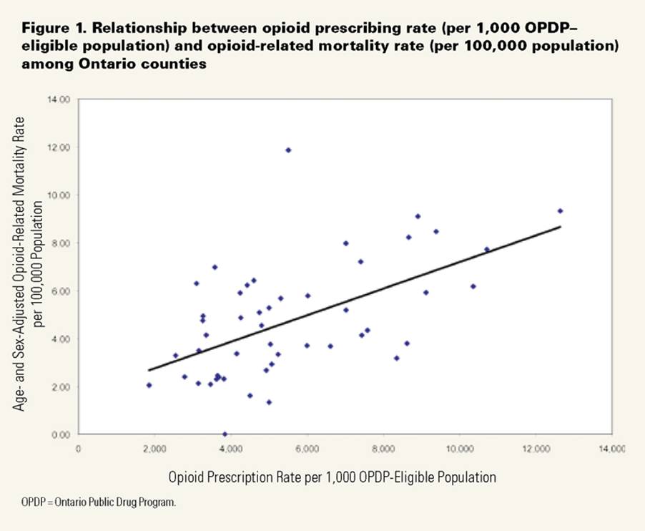

Slide 4
Deaths due to Prescription Opioids
1/8 young adult (age 25-34) deaths in Canada is from prescription opioid use
Approximately 1 of every 170 deaths in Ontario is now related to opioid use.
Opioid-related deaths result in ~ 22,000 years of potential life lost annually,
Death by drug overdose is 3xs higher than deaths due to motor vehicle crashes as a cause of unintentional deaths, (2012,London,ON:MLHU)
Most deaths occur in people who were prescribed opioids

Slide 5
Opioid Related Mortality
Most deaths occur in people who were prescribed opioids
•56% dispensed an opioid in the 4 weeks prior to death
•82% dispensed an opioid in the year prior to death
Median number of opioid prescriptions in year prior to death
10 prescriptions

Slide 6
Opioid Use Disorder (Addiction)
A predictable complication of prescribing opioids
Occurs in 2-14% of all patients treated with opioids for chronic non-cancer pain
Highest in patients on doses greater than 90 MME per day
Comparable to nausea in frequency of side effects
Being in pain does not prevent opioid use disorder

Slide 7
Opioid Use Disorder: DSM-5
Opioid Abuse, Opioid Dependence
Replaced by Opioid Use Disorder

Slide 8
Monitoring Long-term Opioid Therapy-2010
If adverse effects or ineffective by 200mg/day morphine equivalent consider rotating or stopping opioid NOT escalating.

Slide 9
CDC Guidelines-2016 The 2017 Canadian Guideline
Clinicians should use caution when prescribing opioids at any dosage,
should carefully reassess evidence of individual benefits and risks when increasing dosage to ≥50 morphine milligram equivalents (MME)/day,

Slide 10
CDC Guidelines-2016 The 2017 Canadian Guideline
avoid increasing dosage to ≥90 MME/day or carefully justify a decision to titrate dosage to ≥90 MME/day.

Slide 11
Diversion
The vast majority of opioids on the street started as legal prescriptions which have been diverted.

Slide 12
Diversion
In 2011,
London Police estimate as much as 50% of prescribed OxyContin was diverted.
In 2016
50% of prescribed HydromorphContin may be diverted

Slide 13
Diversion
14 % of adolescents say they have used prescription opioids recreationally
75% got them from the medicine cupboard in their own home
(OSDUHS 2011)

Slide 14
Avoiding Diversion
What is the most common age demographic for prescription opioids to be diverted?
under 20
20-30
30 -40
40-50
50-60
60-75
Over 75

Slide 15
Avoiding Diversion
60-75
Are you profiling appropriately?

Slide 16
Case 1
MR is a 39 year old female
Diagnosed with fibromyalgia
History of PTSD
Meds:
HydroMorph Contin 30 mg q8h
Hydomorphone 8 mg q6h prn
Gabapentin 300 mg q 8 h
Lorazepam 1qhs and q6h prn

Slide 17
Case 1
Admitted to LHSC on 3 occasions with Tricuspid valve endocarditis

Slide 18
Case 2
JC is a 61 year old man
Chronic low back pain
Lost job as drywaller
Recent dose escalation
Meds:
OxyNeo 80 mg tid
Percocet 1-2 po q4 h prn

Slide 19
Case 3
ML 58 year old woman
Diagnosed with beast cancer 8 years ago
Live on Grey Street
Meds:
HydroMorph Contin 18 mg tid
Tamoxifen
Always polite thankful and never misses an appointment

Slide 20
Case 3
A Family Medicine Resident does an elective with you and does a urine Toxicology screen
She test negative for opiates

Slide 21
Case 4
SC 42 yo male
Diagnosed with osteoarthritis of knee from skiing injury
Meds:
HydroMorph Contin 30 mg tid x years
Suffers from apathy, decreased libido

Slide 22
Case 5
MW is an 39 year old man
Long history of OUD, injection drug use
DOC has been HydromMorph Contin
Meds: Suboxone 8-2mg daily
Successfully in recovery x 18 months
Requires elective surgery

Slide 23
Community-Based OUD Treatment: Options
Opioid Maintenance Programs with opioid agonist
Structured Opioid Treatment(in controlled setting)
Abstinence (after taper)
Canadian Guidelines for Safe and Effective use of Opioids for Chronic Non-Cancer pain (2010)
CDC Guideline for Prescribing Opioids for Chronic Pain — United States, 2016 Recommendations and Reports / March 18, 2016 / 65(1);1–49

Slide 24
Opioid Agonist Therapy
Known injection drug use
Patient has a complication associated with injection drug use- eg. Tricuspid valve endocarditis
Diversion while also using opioids
Unable to follow structured opioid

Slide 25
Opioid Maintenance Programs with opioid agonist
1. Buprenorphine/Naloxone
Better safety profile
Less abuse potential
Less diversion potential
All physicians can prescribe
Methadone
Recovery vs harm reduction

Slide 26
Patients on Suboxone
Surgical Considerations

Slide 27
Avoid stopping Suboxone
Minor surgery
Patient has a history of injection drug addiction

Slide 28
Consider stopping Suboxone pre-op
Using for reasons other than addiction-chronic pain, cancer
Expecting severe post-operative pain
History of difficult to control post-operative pain while on Suboxone

Slide 29
If decide to continue on Suboxone
Do not miss doses, even on day of surgery
May need additional doses of Suboxone above baseline immediately post-op
May need higher doses of full opioid agonist analgesic than usually expected
May need close monitoring for respiratory depression if full opioid agonist added

Slide 30
If decide to discontinue Suboxone pre-op
Bridge with full opioid agonist analgesic
Avoid previous drug of choice and oxycodone if patient has opioid uses disorder
If high risk consider hospitalization to bridge pre-op.
Must be off Suboxone at least 5 days
May still require higher doses than average of full opioid agonist
Consider adjuvants

Slide 31
Structured Opioids
Concerns regarding possible misuse, running out early
Dispense Frequent Small amounts
1 day-14 days
Frequent urine tox screens
Monitor closely for negative effects of opioids

Slide 32
When to Taper
Patient requests opioid taper.
Patient is maintained on opioids for at least 3 months, and there is no sustained clinically meaningful improvement in function
Patient’s risk from continued treatment outweighs the benefit(e.g. decreased function and increased risk for opioid-related toxicity from concurrent drug therapy or comorbid medical conditions)

Slide 33
When to Taper
Patient has experienced a severe adverse outcome or overdose event
Patient has a complication associated with opioids:
Depression,
fatigue,
sleep apnea,
sexual dysfunction,
falls

Slide 34
When to Taper
Patient has a substance use disorder
Use of opioids is not in compliance with current guidelines
If patient already on opioids without a proper trial revisit appropriateness
Patient exhibits aberrant behaviors
Suspected diversion

Slide 35
How to Taper
Explain that tapering improves pain, mood and function
Establish goal of taper
Endpoint not necessarily abstinence
Use scheduled doses
Frequent dispensing

Slide 36
How to Taper
May taper quickly if medically indicated such as overdose or for diversion (over 2-3 weeks)
Generally negotiate with patient re rate of taper

Slide 37
How to Taper
Tapering too quickly may lead to:
Uncontrollable pain
Withdrawal
Craving
Loss of buy-in to process
Street drug use
Injection drug use

Slide 38
How to Taper
Slow taper for patients with no acute safety concerns.
Start with a taper of ≤10% of the original dose per week and assess the patient’s functional and pain status at each visit.

Slide 39
How to Taper
Adjust the rate, intensity, and duration of the taper according to the patient’s response (e.g. emergence of opioid withdrawal symptoms

Slide 40
How to Taper
Taper by 10% every 6-8 weeks may be required
Reassess patient before a reduction
The rate may be slowed or paused while monitoring for and managing withdrawal symptoms
Do not reverse the taper; it must be unidirectional
Reflective on the positive
Avoid focusing on pain
Assess function
Assess quality of life

Slide 41
How to Taper
It may take months to years to prevent reactivating cravings/ drug seeking
Slow and steady wins the race

Slide 42
How to Taper
Advise re overdose if return to previous dose

Slide 43
Observe
Watch for signs of unmasked mental health disorders (e.g. depression, PTSD, panic disorder) during taper, especially in patients on prolonged or high dose opioids.

Slide 44
Case 1
MR is a 39 year old female
Diagnosed with fibromyalgia
History of PTSD
Meds:
HydroMorph Contin 30 mg q8h
Hydomorphone 8 mg q6h prn
Gabapentin 300 mg q 8 h
Lorazepam 1qhs and q6h prn

Slide 45
Case 1
Admitted to LHSC on 3 occasions with Tricuspid valve endocarditis
Recommend:
OAT

Slide 46
Case 2
JC 61 year old man
Chronic low back pain
Lost job as drywaller
Recent dose escalation
Meds:
OxyNeo 80 mg tid
Percocet 1-2 po q4 h prn

Slide 47
Case 2
Consider Use + diversion
Recommend:
Taper with Structured opioids
OAT

Slide 48
Case 3
ML 58 year old woman
Diagnosed with beast cancer 8 years ago
Live on Grey Street
Meds:
HydroMorph Contin 18 mg tid
Tamoxifen
Always polite thankful and never misses an appointment

Slide 49
Case 3
A Family Medicine Resident does an elective with you and does a urine Toxicology screen
She test negative for opiates
Remember:
Patients with bad diagnoses can have socio-economic influences
Recommend:
This is purely diversion: Discontinue

Slide 50
Case 4
SC 42 yo male
Diagnosed with osteoarthritis of knee from skiing injury
Meds:
HydroMorph Contin 30 mg tid x years
Suffers from apathy, decreased libido

Slide 51
Case 4
Recommend:
Taper

Slide 52
Case 5
MW is an 39 year old man
Long history of OUD, injection drug use
DOC has been hydromMorph Contin
Meds: Suboxone 8-2mg daily
Successfully in recovery x 18 months
Requires elective surgery

Slide 53
Case 5
Recommend:
Continuing Suboxone

Slide 54
References
Canadian Guideline for Safe and Effective Use of Opioids for Chronic Non-Cancer Pain (2010)
2017 Canadian Guideline for Opioids for Chronic Pain
National Advisory Committee on Prescription Drug Misuse. (2013). First do no harm: Responding to Canada’s prescription drug crisis. Ottawa: Canadian Centre on Substance Abuse.

Slide 55
References
Interagency Guideline on Prescribing Opioids for Pain
Developed by the Washington State Agency Medical Directors’ Group (AMDG) in collaboration with an Expert Advisory Panel, Actively Practicing Providers, Public Stakeholders, and Senior State Officials. Written for Clinicians who Care for People with Pain 3rd Edition, June 2015
www.agencymeddirectors.wa.gov

Slide 56
References
CDC Guideline for Prescribing Opioids for Chronic Pain — United States, 2016 Recommendations and Reports / March 18, 2016 / 65(1);1–49
Darchuk, K, et al, Longitudinal Treatment Outcomes for Geriatric Patients with Chronic Non-Cancer Pain at an Interdisciplinary Pain RehabilitationProgram. Pain Medicine 2010; 11: 1352-1364
Dhalla I MD MSc, Mamdani M, Sivilotti M, Kopp A, Qureshi O, Juurlink D Prescribing of opioid analgesics and related mortality before and after the introduction of long-acting oxycodone. CMAJ December 8, 2009 vol. 181 no. 12 891-896
Gomes T, Mamdani M, Dhalla I, Cornish S, Paterson M, Juurlink D. The burden of premature opioid-related mortality. Addiction. Volume 109, issue 9 1482-1488 2014 Sep

Slide 57
References
Use of opioid analgesics for the treatment of
chronic noncancer pain–A consensus statement and guidelines from the Canadian Pain Society (1998)
Chair: Dr. Roman Jovey
included 2 London Physicians
Presentation of these guidelines supported by an educational grant from Purdue

Slide 58
Thank You

