Slide 1
“Screen Time” and Kids What can families do?
George Kim, MD, MClSc(FM), CCFP, FCFP
Assistant Professor, Family Medicine
Schulich School of Medicine and Dentistry
Western University

Slide 2
Faculty Disclosure
Faculty: George Kim
Relationships with commercial interests:
No relationships with commercial interests

Slide 3
Disclosure of Commercial Support
This program has received no financial or in-kind support.

Slide 4
Mitigating Potential Bias
There is no bias.

Slide 5
Objectives
Review the literature around impact of screen time on child development
Identify strategies for healthy screen time/social media use and review the need for monitoring for problems with an online presence
(Identify the myriad of social media options available to youth today)

Slide 6
Disclosure 2.0
As up to date as I have tried to make this presentation, there is a good chance it is already “dated”.
There is very little scientific literature on this topic, lots of ‘expert opinion’-AAP, CPS
After today’s talk you will hopefully see that the solutions are simple, though implementation can be a challenge ☺ (i.e. answers are obvious, but the message is still hard to hear)

Slide 7
Disclosure 3.0
“Yondr” and “Phubbing” are not swear words
I can not come to your house and take away your child’s smartphone…
or your partner’s…
or yours

Slide 8
Acknowledgements
BBC Discovery Series
CBC Nature of Things
PEW Institute
Kaiser Family Institute
MediaSmarts
CommonSense Media
Dr. Michelle Ponti
Dr. Frances Jensen
National Center for Health Research
Canadian Paediatric Society
American Academy of Pediatrics
Urban Child Institute
Dr. Sarah Jane Blakemore

Slide 9
Lynn
Lynn is a 41 year old who is in today for a renewal of her thyroid medication. You take the opportunity to review her CPP and ask about the family.
She chuckles that all is going well.
As you stand up to leave, she comments that she wishes Janet would stop using her phone so much when they spend time together…

Slide 11
Guidelines
American Academy of Pediatrics-2016
0-18 yrs
1999, 2011
Canadian Paediatric Society-2017
0-4 yrs

Slide 13
2016 CPS Survey of Members
How much is too much?
How to set limits?
The effect on health and wellbeing.
Optimal Content.

Slide 14
Consider this…
2.5 hours/day for 0-2 year old-BABYTV
Rates of mobile media use among 2-4 y.o. increased from 39% to 80% between 2011-2013
51% of UK infants touch a screen daily
In the US between 8mos and 8 years, children are exposed to 4 hours of background television a day
Teenagers spend 6.5 hrs/day on a screen

Slide 15
More considerations….
90% parents report that their kids under the age of 2 have to watch television
In 2014 Active Health Kids Canada reported that children 3 to 5 spend about 2hrs a day on screens
By the age of 3, 1/3 have a TV in their room
Canadian Society for Exercise Physiology had guidelines from the early 2000’s that resulted in the 2017 Canadian 24 hour movement guidelines

Slide 18
But wait…is all bad???

Slide 21
Radesky et al. Keeping Children’s Attention: The Problem with Bells and Whistles. JAMA Pediatrics. December 2015, DOI: 10.1001/jamapediatrics.2015.3877

Slide 22
Is it a problem?
American Academy of Pediatrics-2013
No screens less than 2 years of age
Limited screens for those above 2 years of age
Limiting it to 1 hour, cited evidence that greater than 5 hours/day was harmful
Effects on sleep
Updated guideline 2015
Is it any worse than riding on a train watching the sights zoom by? (1850’s)
2016-maybe <2 y.o. only Skype

Slide 23
What kind of screens are in your home (e.g., TV, tablet, computer, smartphone)? Which does your child use?
Is watching TV or programs/movies on other devices a shared family activity and a common way to relax? How often is a screen on in the background although no one is really watching?
Does anyone in the family use screens during mealtimes?
What do you watch with your child? What does your child watch alone?
Do you encourage or discourage conversation with your child while you are using screens?

Slide 24
Do you ever watch adult/commercial programming with your child?
Does your child use screens while you do chores around the home? Often? Sometimes?
Are there any screen-based activities in your child’s day care program? Do you know how much these are used?
Does your child use any kind of screen before bedtime? How long before bedtime? Is there a TV or computer in your child’s bedroom? Does your child take mobile devices into the bedroom?
Does your family have rules or guidelines for screen use that everyone understands and shares?

Slide 25
Facts…
Children are not inherently malicious
Children are inherently curious
Reward centre and judgement/insight centres of the brain are not connected until late adolescence/early adulthood
Neurodevelopment in children does not “grind” to a halt at the age of 6 or at puberty

Slide 27
Teens crave support and community
Friends are more valued than family
But they need guardians
“Virtual” friends are the same
Teens need to develop social cognition
“digital citizenship”
Poor multi-taskers
Early childhood development requires “depth” to their experiences
Devices and the classroom ☹
Notes:
High School Students who went to camp vs usual routine-emotion recognition
2013 Norweigian Study-Professor Mangen, discovered students performed better with material read from a paper than from a device
2016 British Study – 91 schools, over 130 000 students, devices removed standardized test scores improved 10%
2017 California Project – Yondr and behaviours

Slide 28
Screens…good?
Interactive media
Adults can help put context to the snapshots on the screen (Levine and Guernsey-Tap, Click, Read)
Demonstrate healthy online presence for preteens
How to be discerning consumer

Slide 29
What’s the Solution?

Slide 32
1 in 4 kids spends > 3 hours on a device

Slide 33
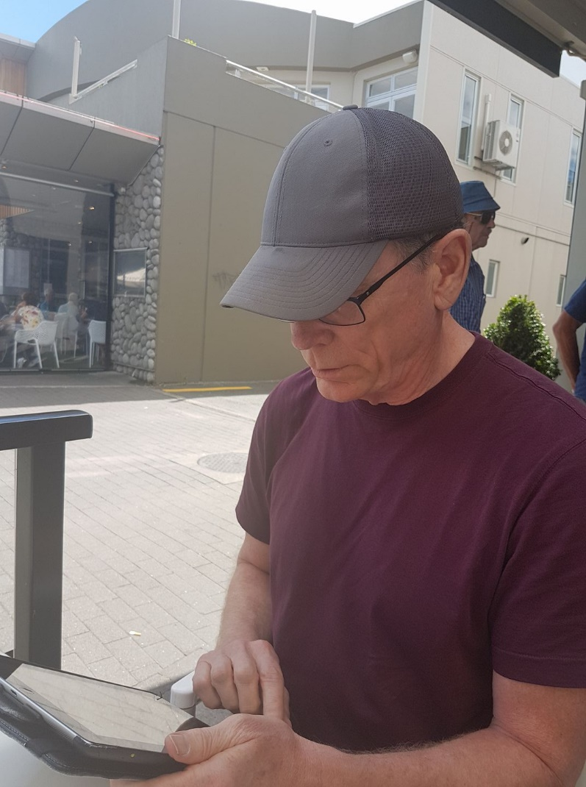
1 in 4 boomers spends >9 hours on a device

Slide 34
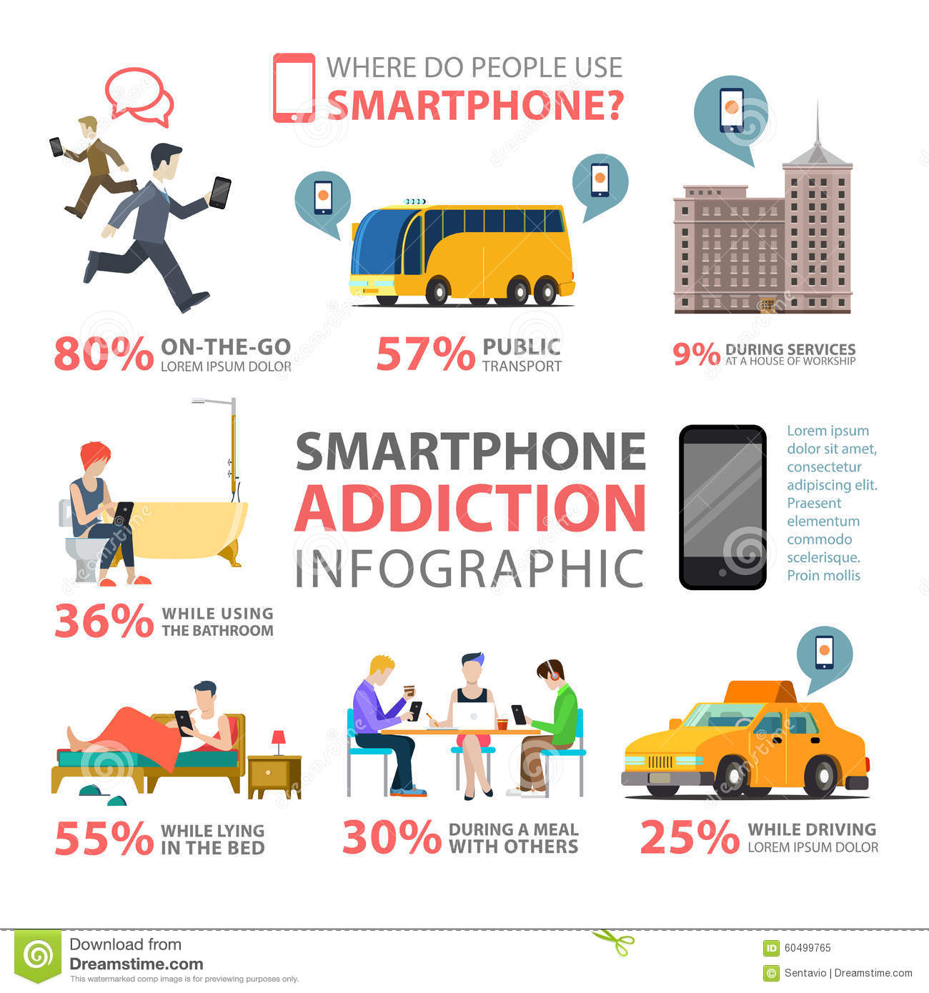
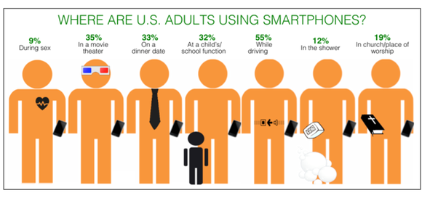
Practice What You Preach or Change your Speech

Slide 36
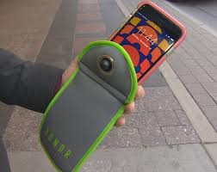
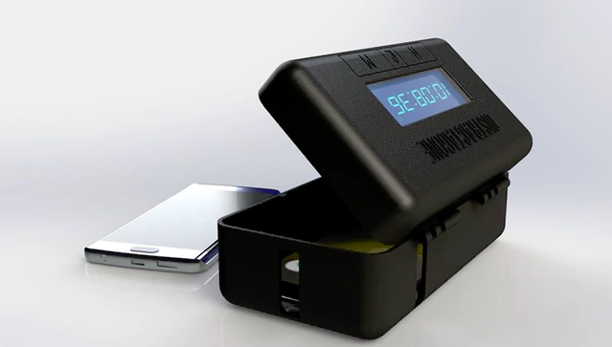

Slide 38
Ok, ok, ok…what now?

Slide 39
Rules?
Morally reprehensible
Physically Harmful
Illegal
Barbara Coloroso

Slide 41
Family Meal Time
Place of Worship
Board Games
U.S. Department of Health and Human Services
Building Community, Building Hope, 2016

Slide 42
Steve Jobs, his family and the iPad (2010)
When asked whether his children liked the new device, Steve Jobs famously responded…”They haven’t used it. We limit how much technology our kids use at home.”

Slide 43
Suggestions
Media is just another environment
Parenting has not changed
Role model
Learn from each other
Content matters
Playtime is important-social skills
Set limits
It’s ok for the teens to be online…honest!
Create a tech free zone
Kids will be kids…

Slide 44
CPS-2017
Minimize
Mitigate
Mindfulness
Model
Notes:
Minimize, no screens 1 hr before bed nothing for under 2, about 1 hour for 2-5 year olds
Mitigate be present, be aware, self-regulate
Mindful

Slide 45
For parents/guardians…

Slide 46
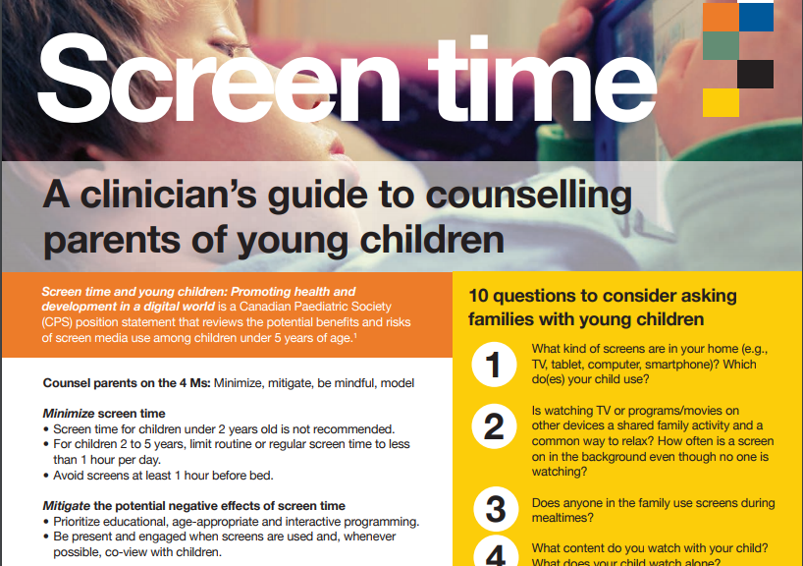

Slide 48
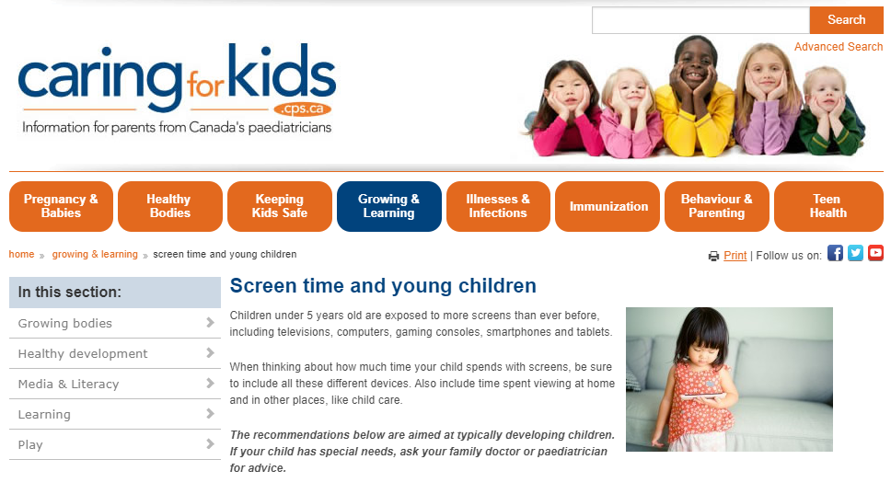

Slide 49
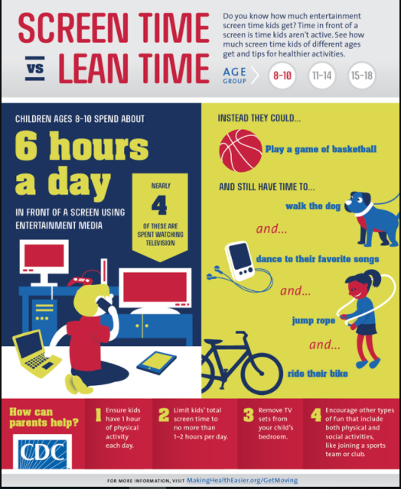

Slide 50
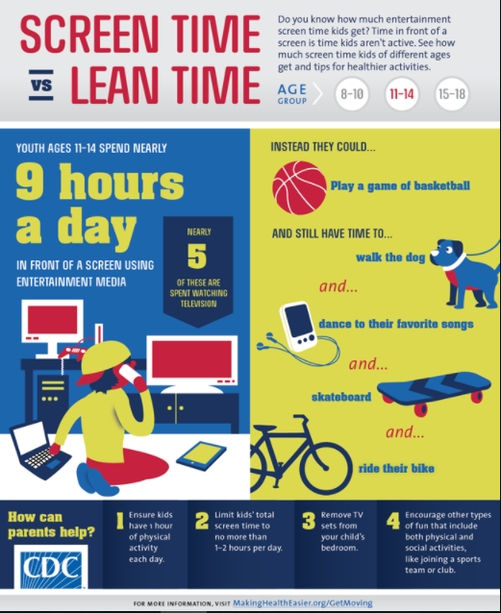

Slide 51
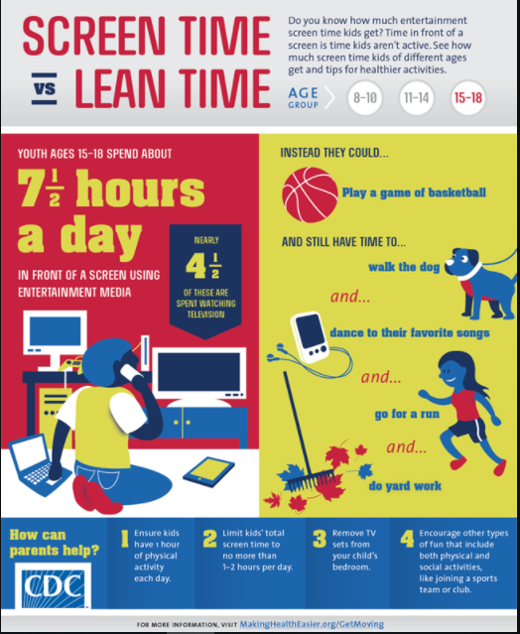

Slide 52
Script for Literacy

Slide 53
Case Revisited
Lynn is a 41 year old who is in today for a renewal of her thyroid medication. You take the opportunity to review her CPP and ask about the family.
She chuckles that all is going well.
As you stand up to leave, she comments that she wishes Janet would stop using her phone so much when they spend time together…

Slide 54
Case Revisited
You sit down to chat with Lynn about what is bothering her, when you remember that Lynn only has sons, and you ask, “Who’s Janet?”
She replies, “…my mother-in-law…”

Slide 55
Questions?
Thank you
George.Kim@Schulich.uwo.ca
@GeorgeKimMD

Slide 56
https://vimeo.com/215750447

Slide 57
References
Jensen, Frances E (2015). The Teenage Brain: A Neuroscientist’s Survival Guide to Raising Adolescents and Young Adults. Toronto, ON: Harper Collins.
Suzuki, David. The Nature of Things with David Suzuki: Surviving ☺ The Teenage Brain. February 7, 2015, CBC-TV. http://www.cbc.ca/natureofthings/episodes/surviving-the-teenage-brain
National Institute of Mental Health, National Institute of Health. The Teen Brain: Still Under Construction. 2011. https://www.nimh.nih.gov/health/publications/the-teen-brain-still-under-construction/teen-brain_141903.pdf

Slide 58
References
Casey et al. The Adolescent Brain. Annals of New York Academy of Sciences. 2008 Mar: 1124: 111-126.
Ravichandran et al. Young children and screen time (television, DVD, computer). National Center for Health Research. 2016. http://center4research.org/child-teen-health/early-childhood-development/
http://www.pewinternet.org/2015/04/09/teens-social-media-technology-2015/

Slide 59
References
The Henry J. Kaiser Family Foundation. Generation M2: Media in the lives of 8-18 year olds. http://kff.org/other/report/generation-m2-media-in-the-lives-of-8-to-18-year-olds/
Coloroso, Barbara (2010). Kids Are Worth It: Raising Resilient, Responsible, Compassionate Kids. Toronto, ON: Penguin Canada.
Blakemore, S. J. (April 13, 2015). The Teenage Brain: Sarah-Jayne Blakemore. BBC World Service Discovery. http://www.bbc.co.uk/programmes/p02nk8c0/broadcasts

Slide 60
Tremblay et al. Canadian 24-hour Movement Guidelines for the early years (0-4 years): An integration of physical activity, sedentary behaviour and sleep. BMC Public Health 2017 17(suppl 5): 874

Slide 61
References
Falbe et al. Sleep duration, restfulness, screens in sleep environments. Pediatrics. 2015. 135:2, 1-10. SSBN 1098-4275
Brown et al. Beyond turn it off. Pediatrics. 2015.
Ponti et al. Screen Time and Young Children: Promoting Health and Development in a Digital World. CPS. June 1, 2017. http://www.cps.ca/en/documents/position/screen-time-and-young-children
Levine, M.H. and Guernsey, L. (2015). Tap Click Read: Growing Readers in a World of Screens. Wiley, San Franscisco.

