Slide 2
Orientation to CBME:
Program Name
INSERT PRESENTER NAME

Slide 3
Topics
What is CBME?
Why are we implementing it?
What does the curriculum look like?
How will I be assessed?
How will I progress?
How can I succeed?

Slide 4
What is CBME?
Competency-based Medical Education
Focus on achievement of competencies
Focus on formative feedback
CBME vs CBD
Notes:
CBME is an educational framework (used around the world) that focuses on trainees achieving specific competencies. Instead of assuming that a trainee is competent to practice independently, CBME reconstructs traditional assessment to include more frequent and systematic assessment – while providing greater formative feedback - so you can target your individual education needs based on your ongoing performance.
You’ll hear both acronyms: CBME and CBD. What’s the difference? CBME or competency-based medical education refers to the educational approach in general – focusing on gaining competency – whereas CBD or Competence by Design is the Royal College’s own brand of CBME. At Western we like to use CBME as it is more inclusive of all residency training programs including those not associated with the Royal College.

Slide 5
Why CBME?
Past 100 years
# years X # cases = assume competence
CBME
Socially accountable education = prove competence
1. focus education on patient outcomes
2. emphasize learner abilities
3. de-emphasize time-based learning
4. increase individualized training
Notes:
Historically, residency education has been centred around a time based learning model, where participating in a particular number of cases, surgeries or years of training will allow one to reach an appropriate level of competence to practice alone. CBME is socially accountable education wherein competence must be proven. The construct for CBME relies on four foundations; focusing education on patient outcomes, emphasizing learner abilities, de-emphasizing time based learning and increasing individualized trainee plans for the learner [4].
https://canadiem.org/competency-based-medical-education/

Slide 6
Why CBME?
Increased supervision, formative assessment, and mentorship from faculty supervisors
Increased flexibility to pursue enrichment opportunities
Increased focus on coaching and feedback
Increased observations in real life situations, directly or indirectly

Slide 7
What does the curriculum look like?
National specialty committee
EPAs and Milestones
Four stages of training
Notes:
Representatives of a specialty from each medical school meet in Ottawa to collectively create Entrustable Professional Activities (EPAs). Approved by the Specialty Review Committee. Each specialty’s CBME curriculum is composed of a series of EPAs. Each one has a variety of Milestones, the stepping stones, attached to it. Training is divided into four stages of training.

Slide 8
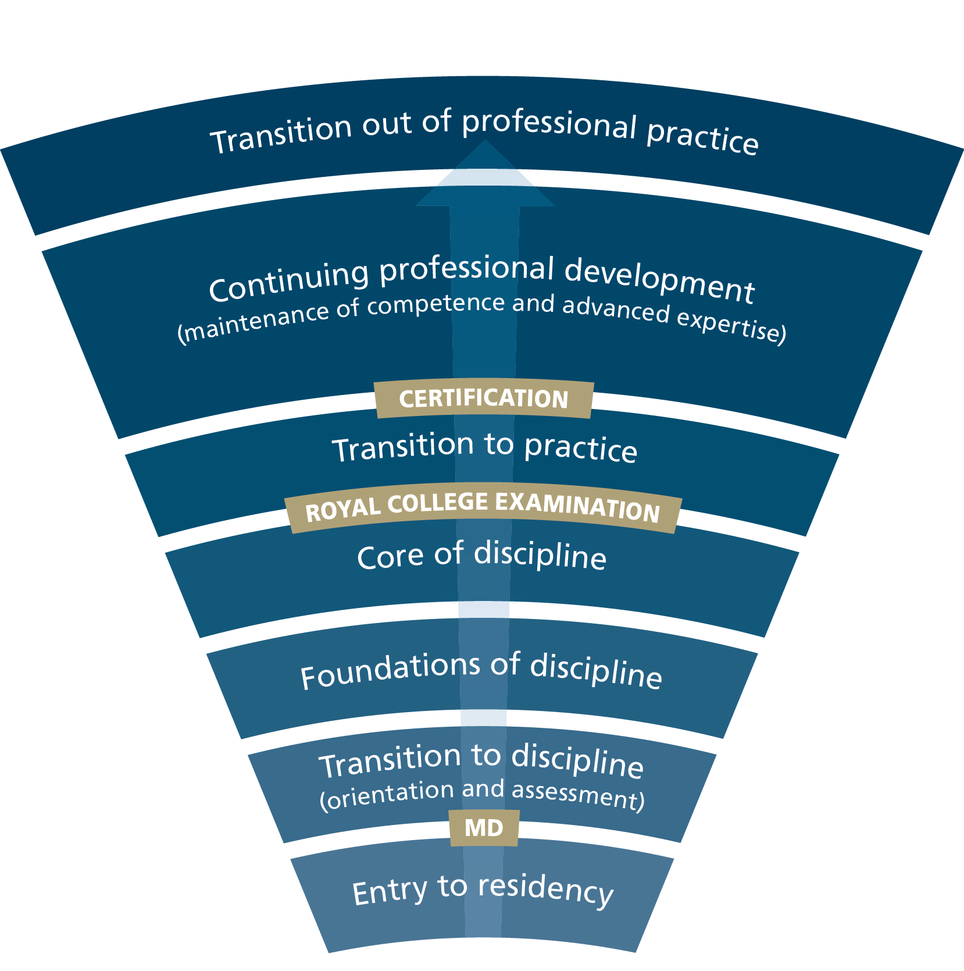
Notes:
The last stage of training is Transition to Practice. This is a stage that allows you to develop the skills to manage your practice independently.

Slide 9
Notes:
Your curriculum in each stage of training is composed of EPAs and their associated Milestones. EPAs are …… and Milestones are….

Slide 10
T2D EPA #1: Performing initial assessments for uncomplicated obstetric patients
SAMPLE
Notes:
Here’s an example EPA from Transition to Discipline. It lists the key features at the top but you’ll also want to pay close attention to the assessment plan which lists the required criteria. Note that while it says, “Collect 3 observations of achievement” what it really means is “Collect AT LEAST 3 observations of achievement.”

Slide 11
Milestones
SAMPLE
Notes:
Example of what Milestones look like. These are the stepping stones toward achieving the Transition to Discipline EPA #1 that we just looked at. Each is preceded by reference to the CanMEDS competency to which it aligns.

Slide 12
ObsGyn EPAs
Foundations of Discipline: 10 EPAs + 1 SA
SAMPLE
FND EPA #1
Performing routine prenatal care to a low-risk, healthy population
FND SA #1
Performing critical appraisal of health literature and initiating scholarly projects
Notes:
Examples from the second stage of training: Foundations of Discipline
SA: Special Assessment

Slide 13
ObsGyn EPAs
Core of Discipline: 19 EPAs
SAMPLE
CORE EPA #1
Providing preconception and antenatal care to women with high risk pregnancies
Notes:
Example from the third stage of training: Core of Discipline. EPAs become increasingly more challenging as you progress through your training.

Slide 14
ObsGyn EPAs
Transition to Practice: 2 EPAs + 2 SAs
SAMPLE
T2P EPA #1
Managing complex patients, including those requiring longitudinal care
T2P SA #1
Conducting scholarly work
Notes:
Examples from the final stage of training: Transition to Practice.
Total 33 EPAs + 3 SAs
T2P SA #1 = scholarly work; T2P SA #2 = teaching/managing learners

Slide 15
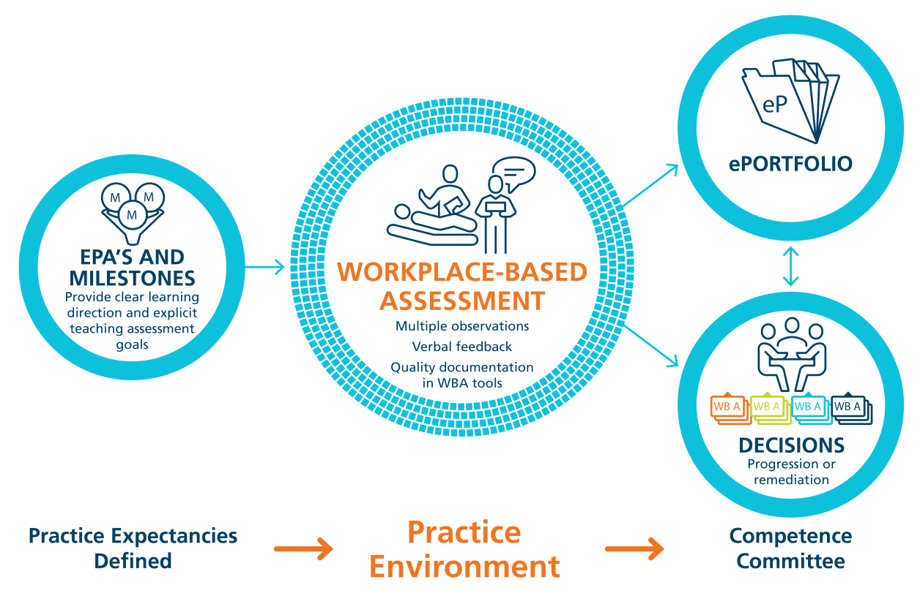
How will I be assessed?
Notes:
How will trainees be assessed? There is increased focus on formative (helping to learn) as opposed to summative (testing what’s been learned) assessment. EPAs are a form of workplace-based assessment that require multiple observations, in multiple settings, by multiple assessors in order to provide enough data for progress decisions to be made. (All the little squares in the circle around Workplace-based Assessment are meant to reflect these many low stakes, quick EPA assessments.) Because of this, EPAs are not pass/fail. We specifically avoid using that terminology. To have an EPA observation that is not and 4 or 5 is not a fail – it is simply a demonstration of learning.

Slide 16
But EPAs aren’t everything!
Non-EPA Assessments
Include list of other forms of assessment that will continue to be used by your program.
+ EXAMS
Notes:
EPAs are not the only form of assessment in (name of program). In addition to EPAs, residents will continue to be assessed through the use of X, Y, Z assessments. (We will no longer be using x, y, z assessments.)

Slide 17
Obstetrics & Gynecology: Transition to Discipline EPA #1
Performing initial assessments for uncomplicated obstetric patients
Key Features:
This EPA includes assessment, documentation, and case presentation, including a basic differential diagnosis and initial investigation of uncomplicated obstetric patients
This EPA must be observed in a clinical setting
Assessment Plan:
Collect 3 observations of achievement
At least 1 antepartum patient
At least 1 intrapartum patient
At least 2 observations by faculty
At least 3 different observers
SAMPLE: replace
Notes:
The next few slides illustrate what the assessment form actually looks like. Much like the EPA document itself, the form begins with the EPA, Key Features, and the Assessment Plan.

Slide 18
SAMPLE: replace
Notes:
There is a section for select the contextual variables. In this case, the drop down under Clinical Setting provides two setting choices, inpatient vs outpatient, from which you would select. The drop down for Patient Demographics provides antepartum and intrapartum choices. These contextual variables help situate the case for the assessor.

Slide 19
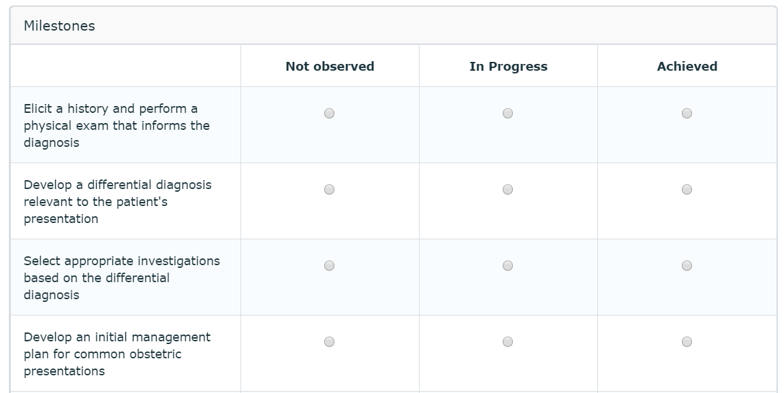
SAMPLE: replace
Notes:
Milestones are listed and are assessed as being either “not observed,” “in progress,” or “achieved.”

Slide 20
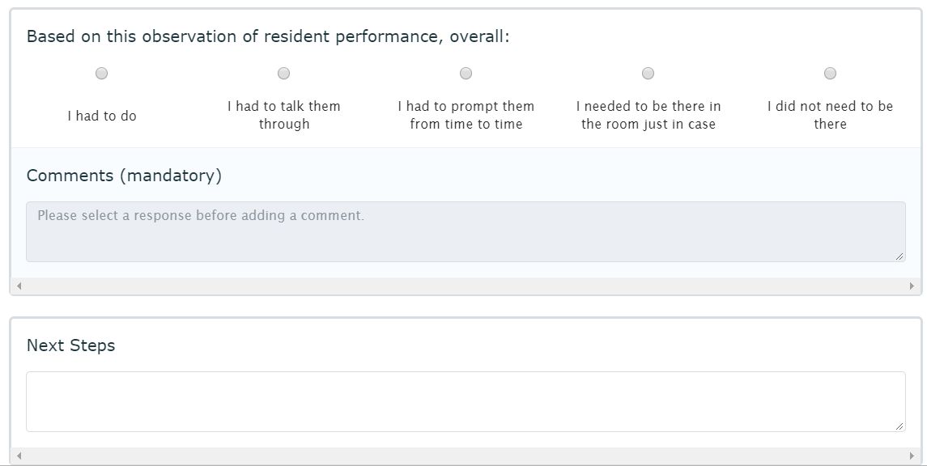
The Entrustment Scale
1 | 2 | 3 | 4 | 5
I had to do | I had to talk them through | I had to prompt them from time to time | I needed to be there in the room just in case | I did not need to be there
Notes:
The next section presents the overall score achieved on that EPA at that time using an entrustment scale. Scores of 1, 2, and 3 are expected on early attempts of an EPA, while aiming for higher scores of 4 and 5 on later attempts. Each EPA assessment is reflective of a moment in time. It is just one snapshot of performance on that task, at that time. EPA achievement is predicated on continuous development rather than pass/fail. And a resident does not need to receive 5 on each and every EPA assessment in order to progress to the next stage of training.
A score of 5 indicates that the assessor feels the resident is entrusted to perform that task independently without supervision.
A score of 4 indicates that there is still room for improvement. Faculty should provide concrete feedback indicating what you (the resident) could do in order to achieve a 5. Similarly, a score of 4 or below should prompt you to solicit feedback in order to learn what you need to work on.

Slide 21
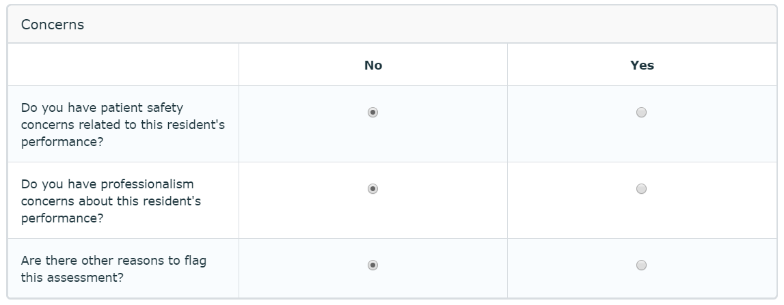
Notes:
The bottom of the form provides the opportunity for assessors to indicate if there are particular concerns about the resident‘s performance related to safety or professionalism.

Slide 22
Notes:
Finally, if you have any comments on the structure of the form, please feel free to submit it here.

Slide 23
How will I progress?
Competence Committee
Holistic progression decisions based on all available assessment evidence
Collective judgement used to decide if enough evidence exists to promote the trainee
EPA assessments and other assessments
Focus on progression and growth rather than specific scores
Notes:
Impt: EPAs are not the only form of assessment.
Competence Committee will assess how well you are progressing and when you are ready to move on to the next stage of training. You’ll have a group of faculty focused on helping you develop efficiently and effectively.
Competence Committee will also identify residents who have not achieved the required EPAs and arrange support to help them progress. The ultimate goal of a CC is to identify strengths and areas of improvement for every resident.

Slide 24
Tips for CBME success!
Be proactive
Become familiar with your EPAs
Anticipate opportunities
Ask for assessment before the encounter
Notes:
EPAs may not present themselves in sequential order. Review upcoming schedules to anticipate opportunities for EPA assessment. Seek out your Academic Advisor or Program Directors if you have any concerns about your progress.

Slide 25
Tips for CBME success!
Be organized
Record previous and pending EPAs
Send professional reminders for pending assessments

Slide 26
Tips for CBME success!
Be collegial
CBME is continually developing – everybody is in this together!
Notes:
Importance of working together.

Slide 27
Tips for CBME success!
Be responsive
Respond in a timely manner to your Academic Advisor or Program Director if approached to discuss ongoing progress

Slide 28
Tips for CBME success!
Be open to feedback
Learn to separate constructive criticism from your sense of self
Don’t be surprised or disappointed to be told you need to work on certain things
Ask for feedback – make it a regular part of interactions with faculty. Feedback helps you improve!
Take time to reflect on the feedback you receive
Notes:
This approach will allow you to actively request feedback in order to improve more efficiently.

Slide 29
Notes:
Being open to feedback is part of having a growth mindset. As opposed to a fixed mindset, which believes you have what you have no matter what you do, a growth mindset believes that skills and intelligence can be grown and developed through perseverance and effort. Feedback is valued because mistakes are learning opportunities that help us grow.

